Slide 1




INTRODUCTION
TO GROOMING AND EXPLOITATION
Recommended for:
Key stage 3, 4 and above

Slide 2

Learning
Outcomes
What grooming is and tactics used.
How child sexual exploitation works.
How child criminal exploitation works.
How to reduce risk and get help.

Slide 3

Trigger warning!
Content on online grooming, sexual assault and violence.
If any content causes
distress, a safe place to
go is…
Session Expectations
No personal questions or comments.
Listen to each other.
Treat each other with respect, even if you disagree.
Engage with and try to enjoy the learning.

Slide 4

What we’re going to do in this session
Click for video
“What is grooming?”
Introduction on grooming.
  Short film then quiz.
Interactive film: “Chloe’s Story.”
  You choose what happens next!
Quiz.
Discussion.
Drama film “Exploited.”
Discussion.
Recap on learning.
If you're having trouble accessing the video, here's a direct link:
What is grooming?

Slide 5
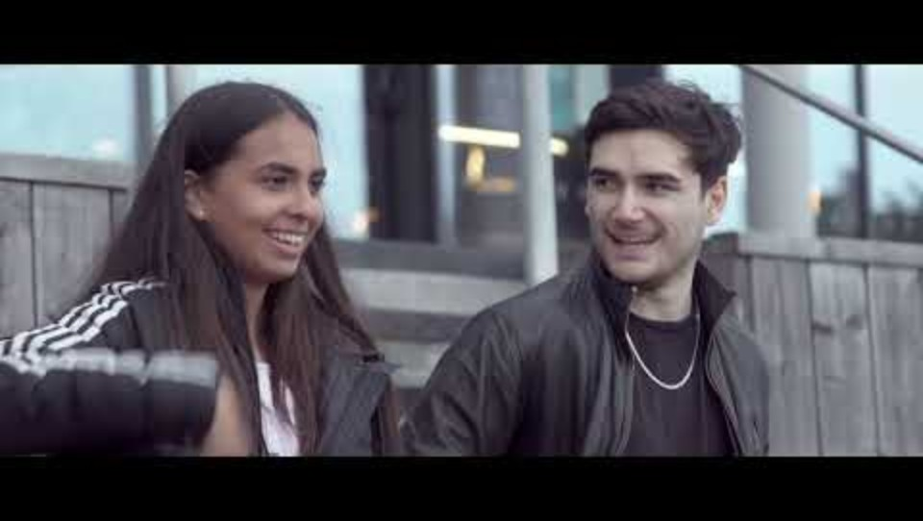

Slide 6


ABOUT GROOMING
How would you describe grooming to someone who hasn’t heard of it?
Grooming is when someone builds trust and a connection with a young person so they can manipulate, exploit and abuse them.
How long does grooming take?
Grooming can happen over a short or long period of time, from weeks to years!
Click for hints
6

Slide 7

Please maximise the screen & be ready to click on choices.
Click here to open

Slide 8
ABOUT GROOMING
Who was groomed in the film?
How were they manipulated and controlled?
MADE TO FEEL SPECIAL
FELT THEY WERE IN A RELATIONSHIP
MADE TO FEEL THEY OWED SOMETHING TO THEIR ABUSER
SEX AND SEXUALISATION HAD BEEN NORMALISED
MAYBE THEY HAD FEELINGS SUCH AS LOVE?
Click for hints

Slide 9
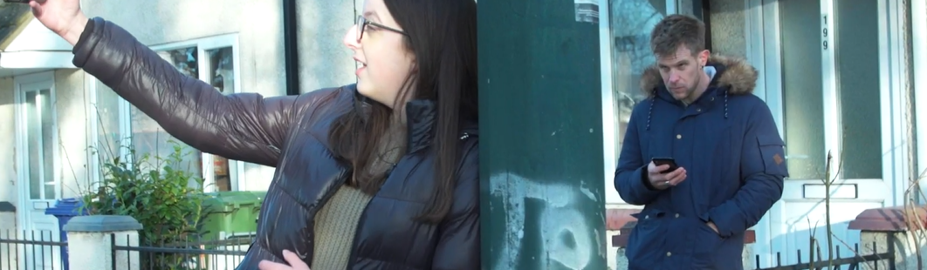

Click for hints
Where does grooming take place?
As we saw in Chloe’s story, grooming can happen online, however…
Grooming doesn’t necessarily always take place in private; groomers might build relationships with a young person’s friends or family to make them seem more trustworthy and authoritative.
Who are groomers?
Anybody can be a groomer, no matter their age, gender or race.

Slide 10
ABOUT GROOMING
Do you think grooming and child sexual exploitation like this happens around here?
Yes, as it can happen anywhere.
However, just because it can happen, does not mean it will.
Try to be aware and ask yourself questions but try not to be scared of everyone you meet.
Lessons like this help you protect yourselves and friends.
Click for hints

Slide 11

Quiz Time
True or false?
“You cannot be groomed by someone you are in a romantic relationship with.”
FALSE
One tactic that abusers use is to make you think that they are your boyfriend or girlfriend or that they care about you.

Slide 12
Quiz Time
True or false?
“Child sexual exploitation only happens to girls. If a boy is involved it’s called child criminal exploitation.”
FALSE
Boys can be sexually exploited, and girls can be criminally exploited, too.

Slide 13
Quiz Time
True or false?
Click for video
“More than half of children and young people living around here have been groomed and sexually exploited.”
“What is Child
Sexual Exploitation?”
FALSE
Be careful, but don’t live in fear!
If you're having trouble accessing the video, here's a direct link:
What is child sexual exploitation
13

Slide 14
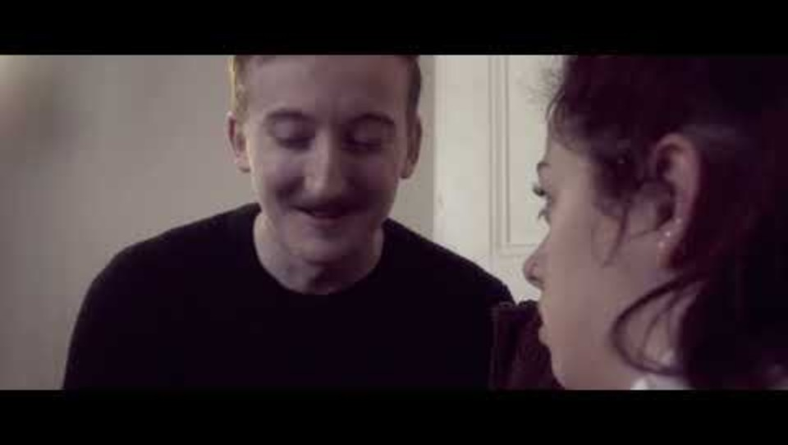

Slide 15

could be a sign of child sexual exploitation.
Regularly getting…
Complete the sentence:
Regularly getting…
Sexually transmitted
infections (STI’s)…
TikTok likes…
Homework…
15

Slide 16
could be a sign of child sexual exploitation.
Signs of unexplained…
Complete the sentence:
Regularly getting…
High attendance
Physical Harm
Increased interest
in Sport
16

Slide 17
could be a sign of child sexual exploitation.
Going missing for periods of time or regularly returning home…
Complete the sentence:
Regularly getting…
late…
with unexplained gifts…
drunk or high…
all of the above…
17

Slide 18
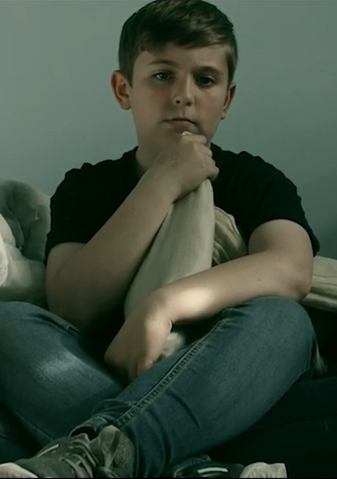
We’ll discuss what you should do if you spot the signs of child exploitation soon… but first we are going to look more closely at CCE.
Can you remember
what CCE stands for?

Slide 19
Child Criminal
Exploitation
Click for video
“What is Child Criminal Exploitation?”
CCE is a growing issue, and it is a problem in the Humber area.
Children are targeted by gangs to carry drugs, weapons, steal, and do other things that may help the gang.
If you're having trouble accessing the video, here's a direct link:
What is child criminal exploitation

Slide 20
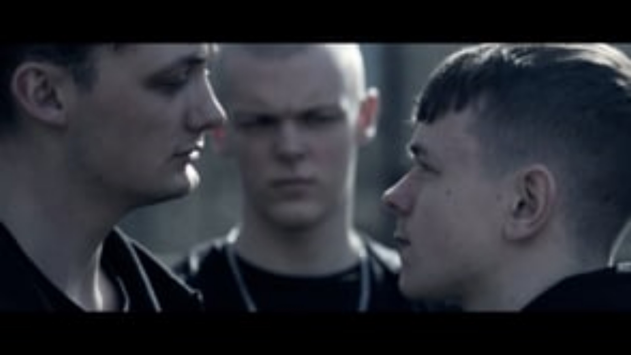

Slide 21



Exploited
We are now going to watch a short
film from the Circle North series.
The film features actors but is based on a true story.
Keep an eye out for signs of
grooming and exploitation.
If you're having trouble accessing the video, here's a direct link:
Exploited
Trigger warning!
This film features scenes of violence.

Slide 22
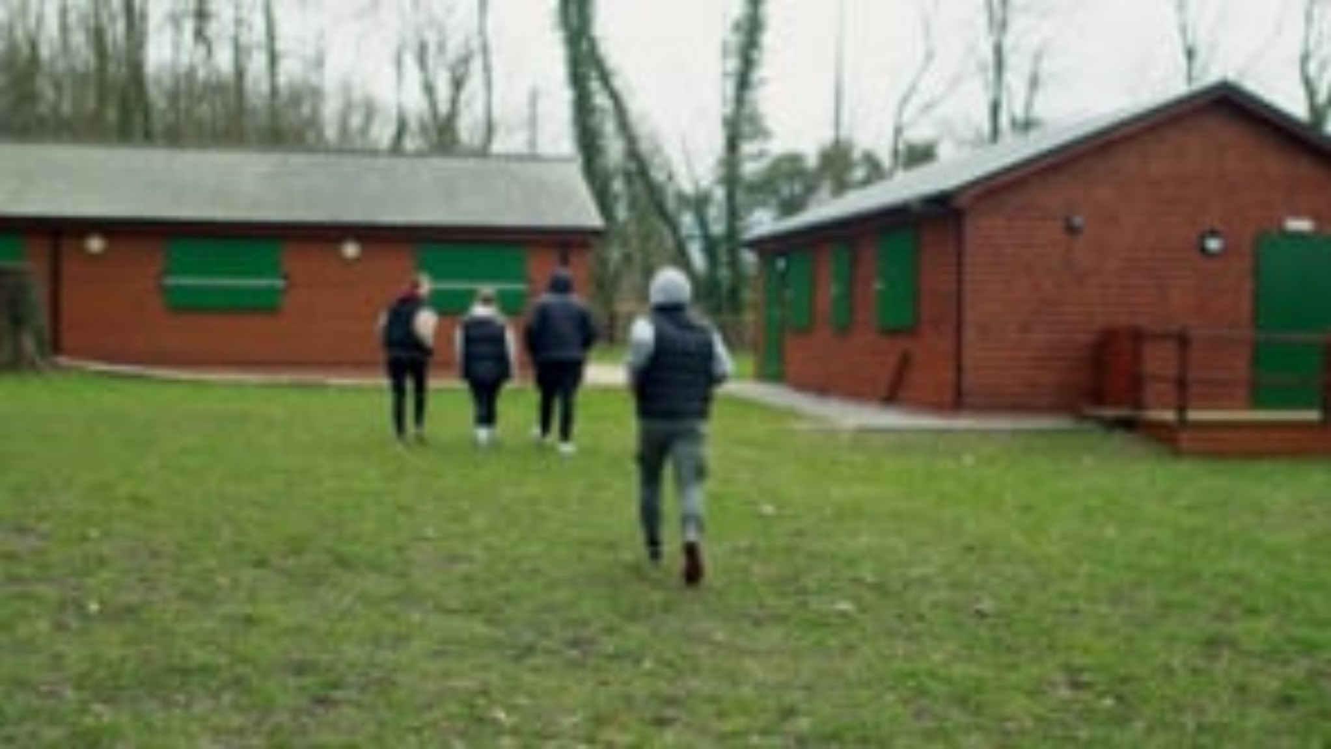

Slide 23
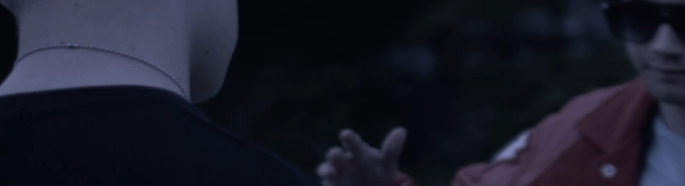
1. Is what happened to Ethan his fault? Did he have other choices?
2. How was Ethan controlled by the group?
3. Why was Ethan vulnerable and at risk of being groomed?
In pairs / small groups / call it out
Hints on
the next slides

Slide 24
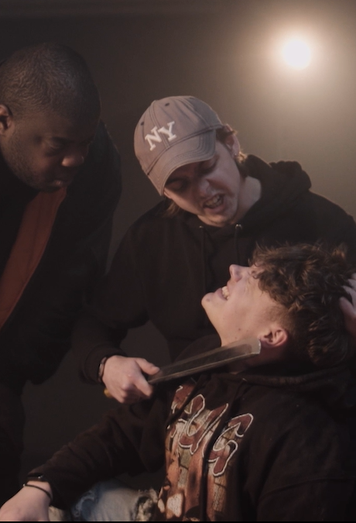
Did Ethan have choices?
Once a child or young person is groomed for child criminal exploitation, their choices are taken away.
Groomers can be clever, and it is not always easy, though you must try to avoid getting involved in the first place.
Losing control
Victims can be controlled by a sense that they are not being exploited, fear, debt, or threats to people and pets they care about.

Slide 25
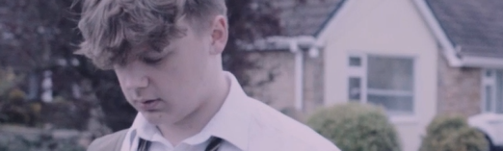
Ethan’s vulnerabilities included:
Anyone can be groomed, though other vulnerabilities include:
SPENDING A LOT OF TIME ALONE OR NOT SUPERVISED.
LOW CONFIDENCE AND SELF-ESTEEM.
NEURODIVERSITY.
PHYSICAL OR LEARNING DISABILITY.
HAVE BEEN A VICTIM OF ABUSE BEFORE.
DON’T HAVE MUCH MONEY OR STATUS.
That he was young :
> most CCE victims are aged between 12 and 17.
That he had fallen out with his friends.
That he might have been missing his dad.

Slide 26
ABOUT GROOMING
Do you think that grooming and child criminal exploitation like this happens around here?
Yes, as with child sexual exploitation it can happen anywhere.
However, just because it can happen, does not mean it will.
Try to be aware and ask yourself questions, but try not to be scared of everyone you meet.
Lessons like this help you to protect yourselves and your friends.
Click for thoughts

Slide 27
Quiz Time
True or false?
“CCE is when someone manipulates a child into committing crimes for someone else's benefit.”
TRUE

Slide 28
Quiz Time
True or false?
“A child in the eyes of the law is someone under the age of 16.”
FALSE
A child is someone under the age of 18.

Slide 29
Quiz Time
True or false?
“CCE only happens to young people living in areas that are less wealthy.”
FALSE
Children from a diverse range of backgrounds are targeted.

Slide 30
Quiz Time
True or false?
“If a child commits a crime because they have been exploited, they are still criminals.”
Click for video
“Signs of
Child Exploitation?”
IT DEPENDS!
Each case is dealt with individually; however, children who have been groomed are themselves victims of a crime.
If you're having trouble accessing the video, here's a direct link:
Signs of exploitation

Slide 31


Slide 32
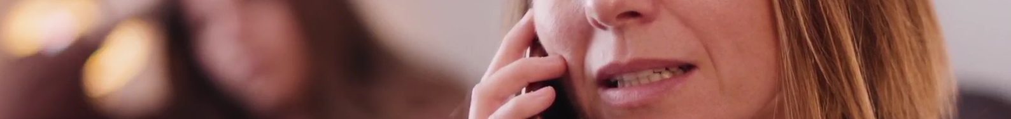

So, what can you do if someone is at risk of grooming or child exploitation?
When someone has been groomed and exploited it can be hard to understand what is going on.
Often victims do not see themselves as being exploited and might be defensive.

Slide 33
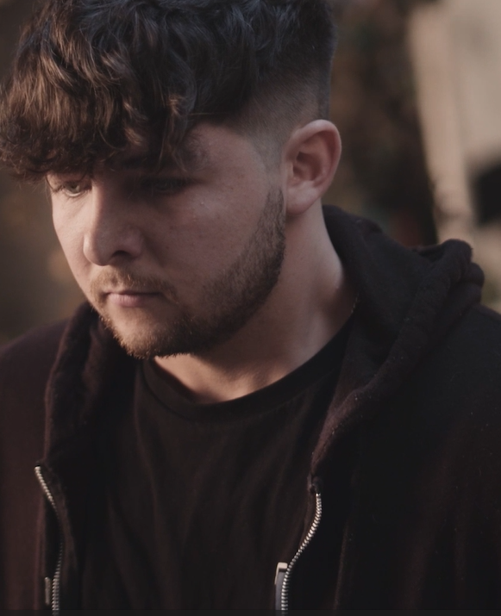
Persuasion activity
Split into pairs or small groups.
In your groups, decide which one of you is playing the part of someone who is being groomed.
The challenge for the others is to try to convince them not to trust the groomer and stay safe.
Consider what points you will make to help them understand, without making them feel like they’ve made mistakes, or that the situation is their fault.
Good luck!

Slide 34
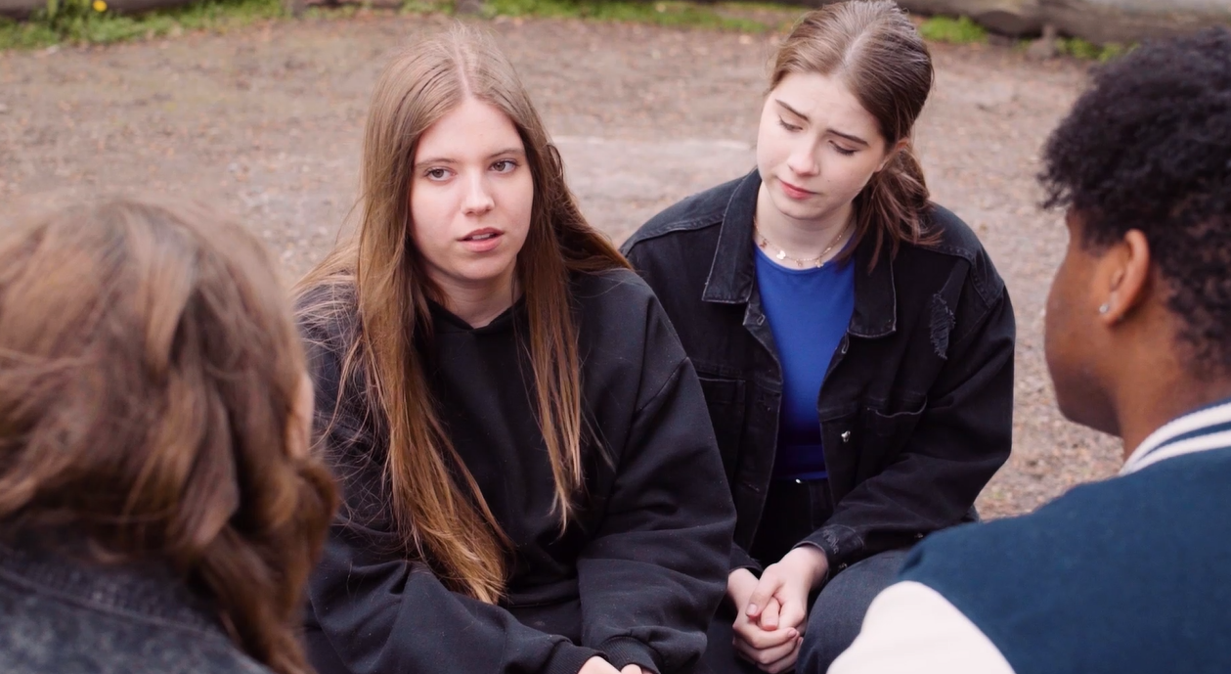

Because groomers and abusers know what they are doing, it can be hard for victims to see past the lies and manipulation.
So, what can you do?
Taking matters into your own hands can be risky and could create more danger.
Speaking with a trusted adult to share what you know and to raise your concerns would be a good idea so that they can help decide how to get help.

Slide 35
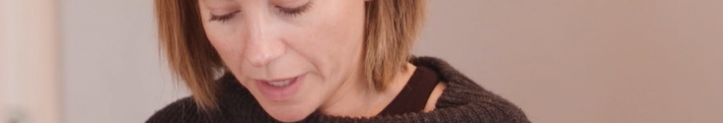
Can you suggest any types of trusted adult?
A Teacher
Member of staff at school
Family
Parents
Grandparents
Older brother, sister or cousin
Nurse or Doctor
Youth Worker
Social Worker
Police officer
Click for suggestions

Slide 36

Other ways of getting help
Every school has a Designated Safeguarding Lead, but you can talk to any adult working at your school.
Alternatively, you could speak anonymously to Fearless or Crimestoppers on 0800 555 111 or call Childline on 0800 111.
If you have concerns about child exploitation, you can call the local police on 101.
If someone is in immediate danger call 999.

Slide 37
This short film has some tips on how to help yourself and others in a risky situation.
What do you think led Kai to follow Mikey and get involved in the situat
The criminal environment around substances often includes violent behaviour, either as part of gang conflicts or because of drug deals g wrong.
What do you think made him act violent?
Gro
Click for video
If you're having trouble accessing the video, here's a direct link:
Staying Safe General Advice Animation

Slide 38


Slide 39
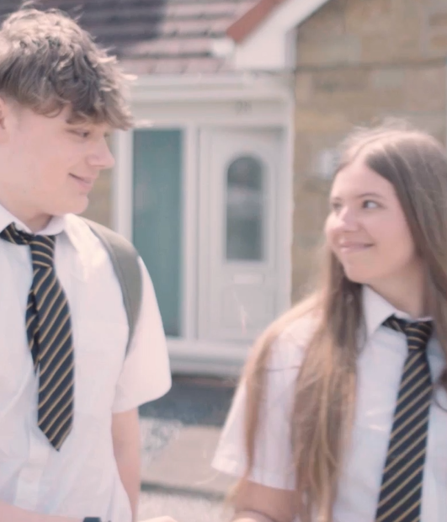
The best way to stop exploitation is to not let the grooming process start.
Be wary of new friends both online and in person.
  Remember: Abusers can be male or female, they can be the same age or older, and they can be from any background.
Don’t stop talking to friends and family. Isolating a potential victim is key to a groomer’s success.
Make sure that no matter what, your friends know you are there for them.
This might not always be possible, but here are some tips to stay safe:

Slide 40
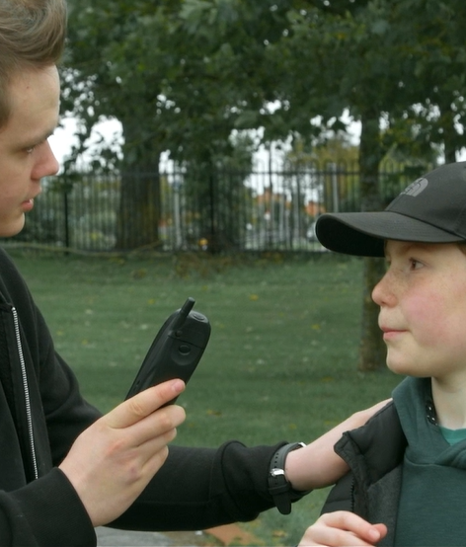
If someone asks you to look after something, deliver a package or sell something, be suspicious. Once you’ve done it that first time, they will have something on you.
If something seems too good to be true, it probably is – think twice.
Find positive activities to be involved in, with people you can trust.

Slide 41
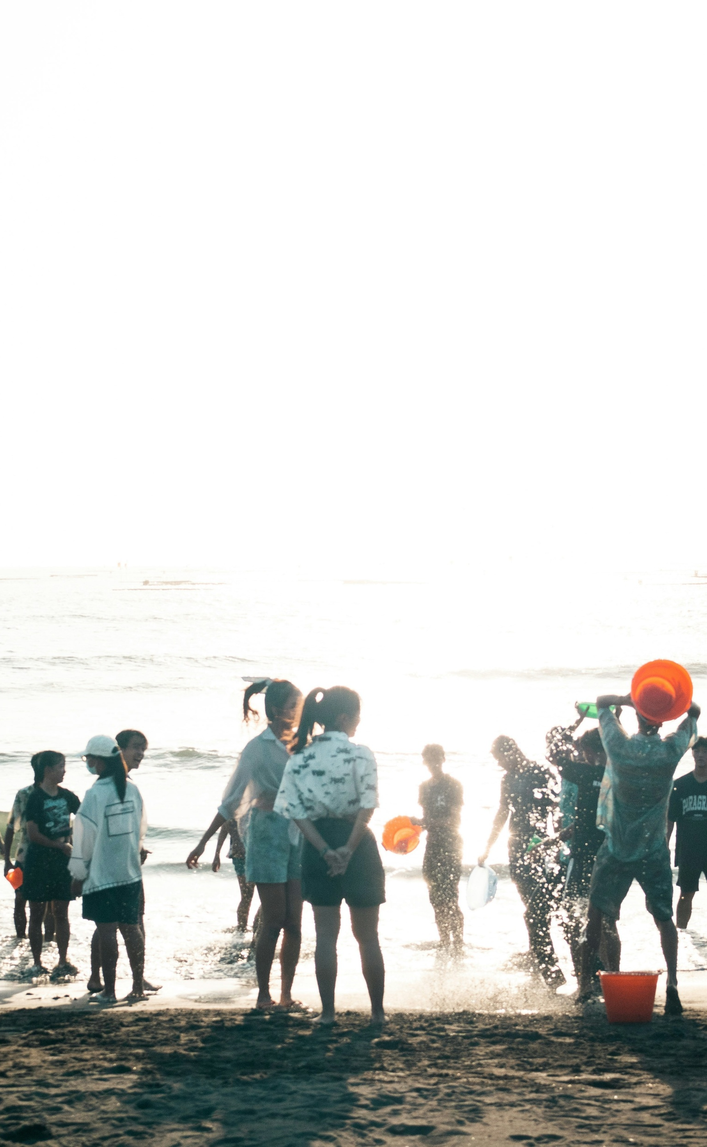

Finding your thing, your people
Ask a trusted adult or go online to find out what is happening where you live.
Information to help you get started is available:
healthyholidayshull.org/
Activities taking place in Hull during the school holidays for school aged children and young people.
Looking for
something positive
to get involved in?
livewellnorthlincolnshire.org.uk/
A wide range of organisations, support groups, community groups, events and activities to support you to live your best life.
discovernortheastlincolnshire.co.uk/
Useful information from visitor essentials to top attractions, best beaches and discovering wildfire.
eastridingculture.co.uk/active-communities/
Empowering the East Riding of Yorkshire to be active, healthy and connected.

Slide 42
Recap
We have covered:
What grooming is and the tactics used.
How child sexual exploitation works.
How child criminal exploitation works.
How to reduce risk and get help.
Can you name 5 things we have learned today?

Slide 43
Do you have any questions
or comments?

Slide 44
Reminder of websites
Anonymous reporting
www.fearless.org
More info on staying safe www.notinourcommunity.org

