Slide 1



INTRODUCTION
TO WEAPONS & KNIFE CRIME
Recommended for:
Key stage 3, 4 and above
Warning: contains content some viewers might find upsetting.

Slide 2

Learning Outcomes
The facts about weapons and knives.
Why people carry weapons and knives.
What the law says.
How to reduce risk and get help.

Slide 3

Trigger warning!
Content on violent
use of weapons
If any content causes
distress, a safe place to
go is…
Session Expectations
No personal questions or comments.
Listen to each other.
Treat each other with respect, even if you disagree.
Engage with and try to enjoy the learning.

Slide 4


Part One The facts
1. What is the definition of an offensive weapon?
2. What types of things could be used as a weapon?

Slide 5


An offensive weapon is anything made or adapted to cause injury:
Specifically designed to
cause harm, such as swords,
guns or nun chucks.
Everyday items carried with the
intention to cause injury, such as a
hammer or a baseball bat.
An item adapted to cause injury,
such as a broken bottle or
sharpened door keys.
Acid or a
corrosive substance
Knives (currently the
most common).

Slide 6
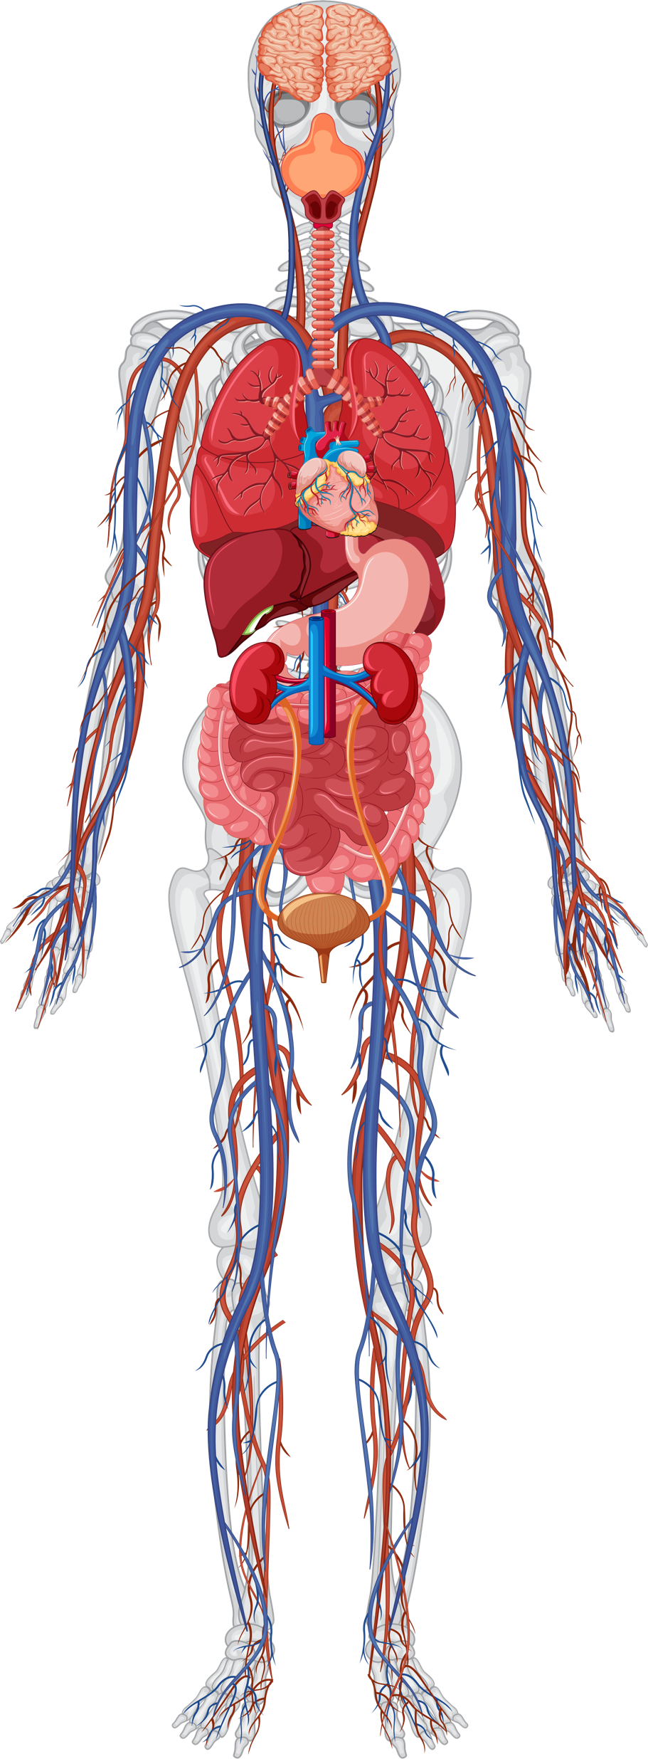
Is there a safe place to stab someone?
No!
There is no ‘safe place’ to stab someone.
All our blood is kept inside our organs, arteries and veins.
If a knife enters the body, through an artery such as in the arm or leg, or in an organ we will lose blood.
If we don’t have enough blood going to the brain it can fail and you can die within five minutes.

Slide 7

Part Two Why people carry
weapons & knives
We are now going to watch a short film from
the Circle North series.
Features actors, though based on a true story.
If you're having trouble accessing the video, here's a direct link: Joint Enterprise
Trigger warning!
This film features a serious knife attack.

Slide 8

Play to 10.00

Slide 9
1. Why did Jamie carry a knife?
2. What other reasons might young people give for carrying a knife or weapon?

Slide 10

Common reasons people give to carry a weapon include:
FEEL UNABLE TO HAVE A FIST FIGHT, A WEAPON WILL HELP
PROTECTION
FEAR
BEING BULLIED
TO LOOK HARD
TO FEEL SAFE
BE THE
ALPHA DOG
THEY BELIEVE EVERYONE ELSE IS
BEING EXPLOITED
We’re going to look at
these reasons together

Slide 11
Reason: For protection
This is the most common reason. However, truth is that carrying a knife or weapon puts you at more risk.
Studies have shown
Carrying a knife makes you three times more likely to be a victim of stabbing.
X 3
Carrying a weapon can make you a target for others.
Here is a real-life example >>

Slide 12
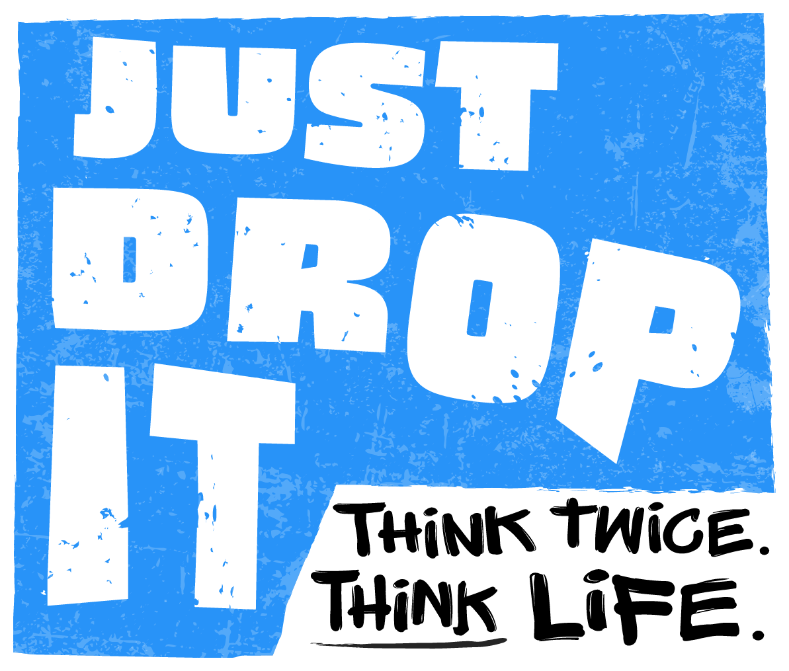

AJ’s Story AJ was never in trouble, never part of a gang. He was previously attacked in a case of mistaken identity and spent 3 months recovering in hospital from his injuries. Because of fear it could happen again, he made the decision to carry a knife for his own protection. He had no intention of using it, it was just to scare people off so he would not get hurt again. Revealing that he had a knife led to AJ’s life being tragically cut short at just 18 years old while he was out walking with his girlfriend, Shannon. We’re now going to hear from his mum and friend.
The following film is a true story, featuring real people.
Trigger warning!
This film features a description of a fatal knife attack.
If you're having trouble accessing the video, here's a direct link: AJ story

Slide 13
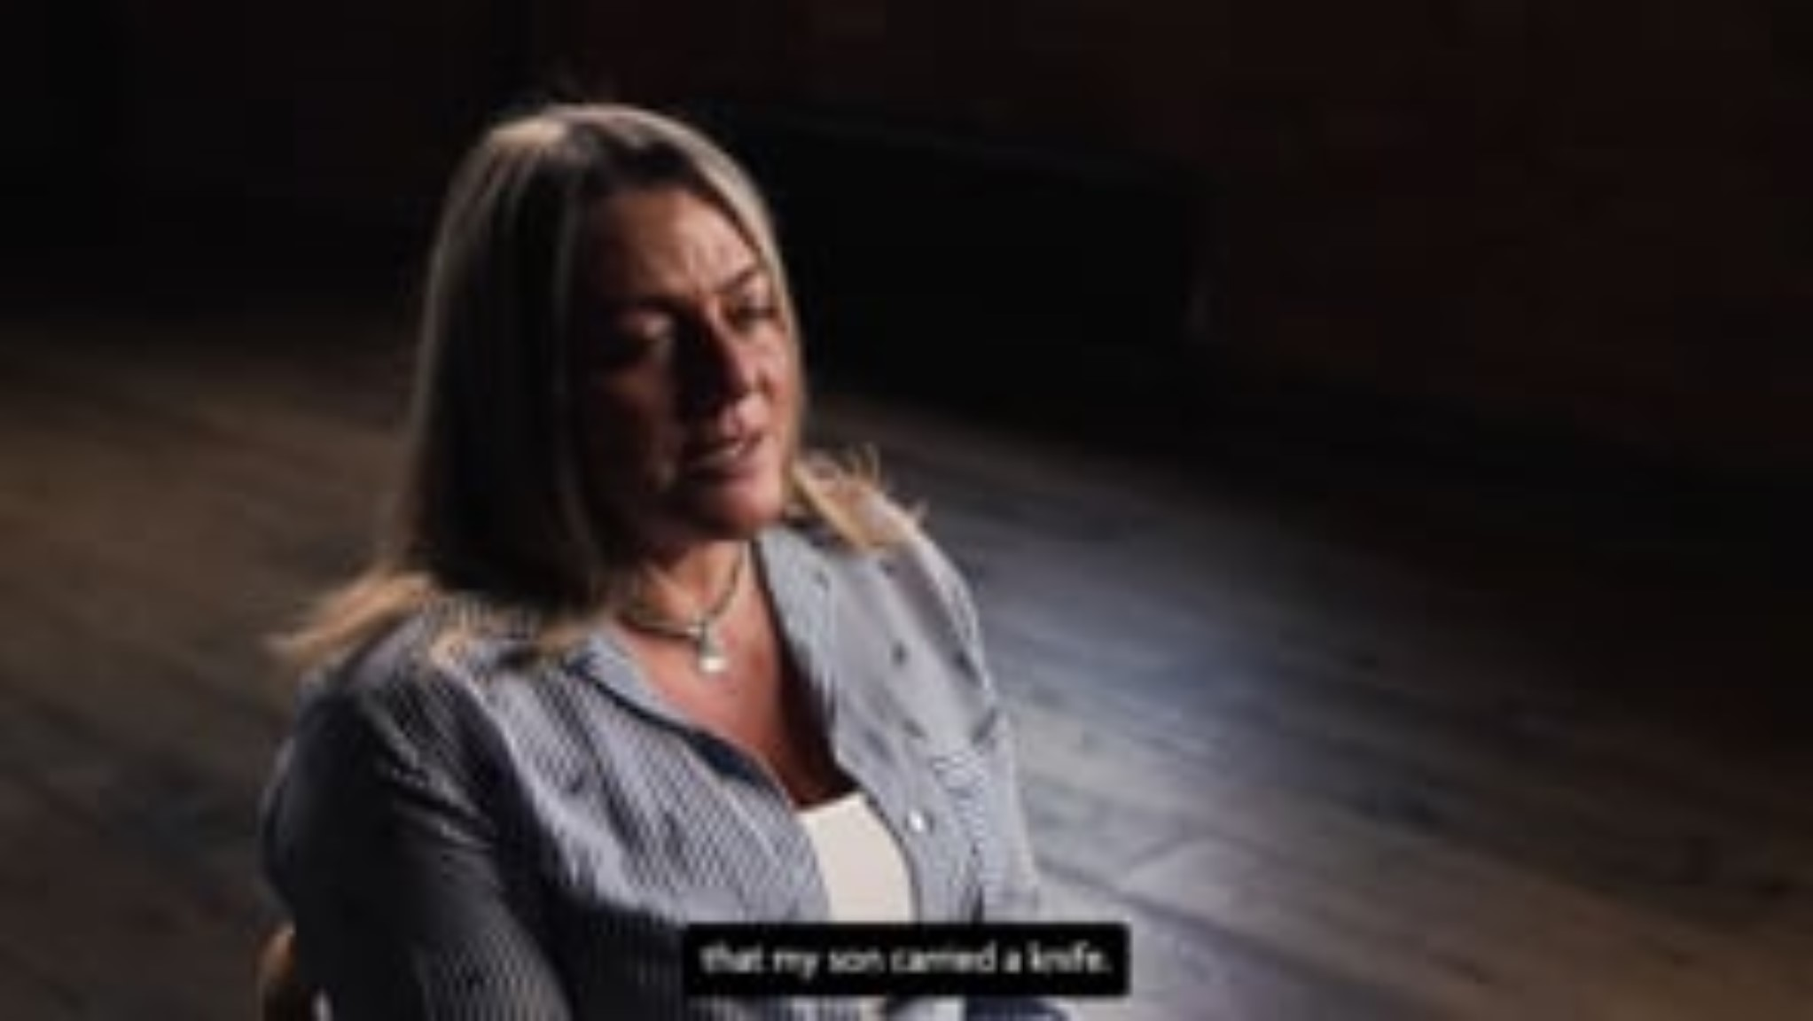

Slide 14
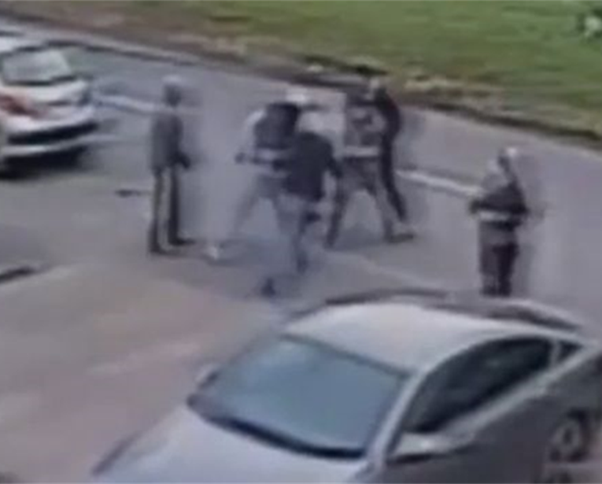
Outcome
All 4 boys involved in the murder of AJ were given prison sentences.
16 years
Life sentence
11 years
1 was given a minimum of 16 years for murder.
2 of them
were given life sentences.
The driver was given
11 years under the
Joint Enterprise rule.
So many lives were ruined that day.
Carrying a knife or weapon provides you protection is a myth (not true).

Slide 15
Who is affected by a tragic case like this?
Click for suggestions if needed.
FRIENDS
EMERGENCY WORKERS
THE PERPETRATOR’S FAMILY
VICTIM
PEOPLE WHO
BECAME AFRAID
THE COMMUNITY
PARTNER
SCHOOL
FAMILY
COLLEGE
THE PERPETRATOR

Slide 16
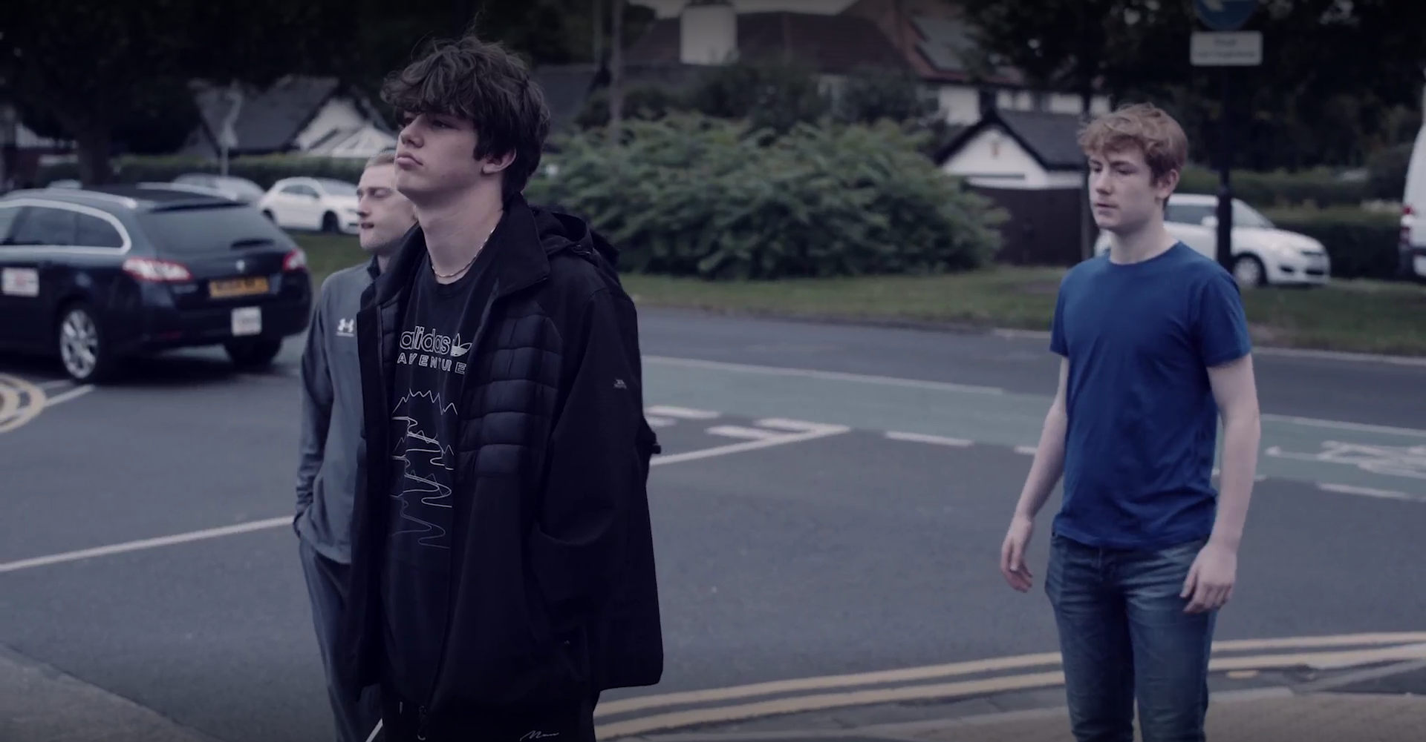

Reason: “Because everyone else
is carrying.”
In the first film Ben and Jamie had been influenced by peers to believe that carrying a knife was normal.
Additionally, studies show media, music, gaming, and social media can lead young people to believe that weapons are more common than they really are.
Here‘s a question >>

Slide 17

Imagine 100 young people (aged 13 to 17) - On average, how many say they carry a knife?
Two
This means 98% of young people don’t carry a knife or weapon.
In the Humber area it could be even lower.
“Because everyone else is carrying” is a myth (not true).
Source: Youth Endowment Fund survey of 7,500 in England & Wales 2023

Slide 18
Offences in the Humber area
Humberside’s rate for serious knife or sharp object offences was 95 offences per 100,000 population.
1 in 1000 people
This means 99.9% of people have not been found to commit an offence.
Source: Humberside Police
Young people are being caught In schools in the Humber area between September 2022 and July 2023 there were a total of 199 suspensions and 21 exclusions for the “use or threat of an offensive weapon or prohibited item”.

Slide 19
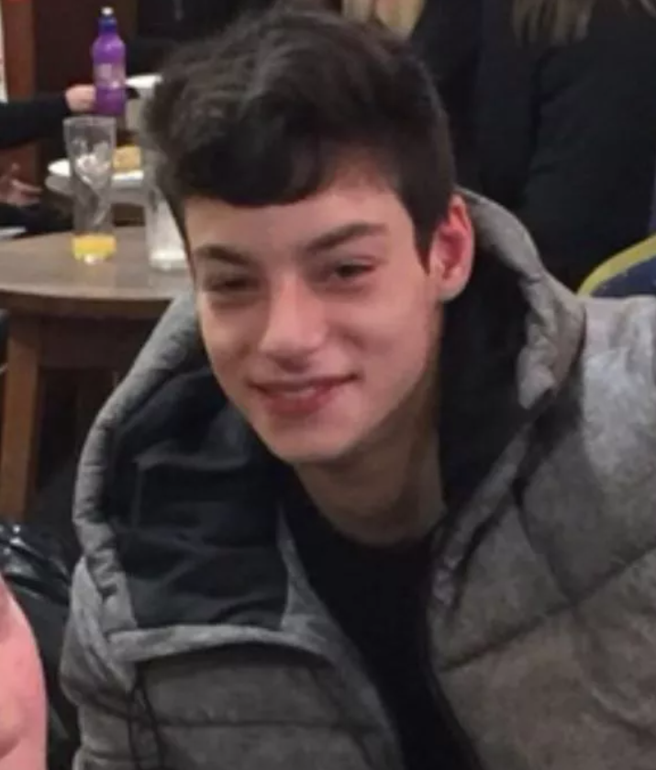
Reason: “Fear” and “To feel safe.”
Because AJ had been attacked before he was afraid.
He knew carrying a knife was wrong, but he thought that it helped him.
Here‘s a clip of AJ’s mum and friend explaining >>
If you're having trouble accessing the video, here's a direct link:
advice on weapons

Slide 20
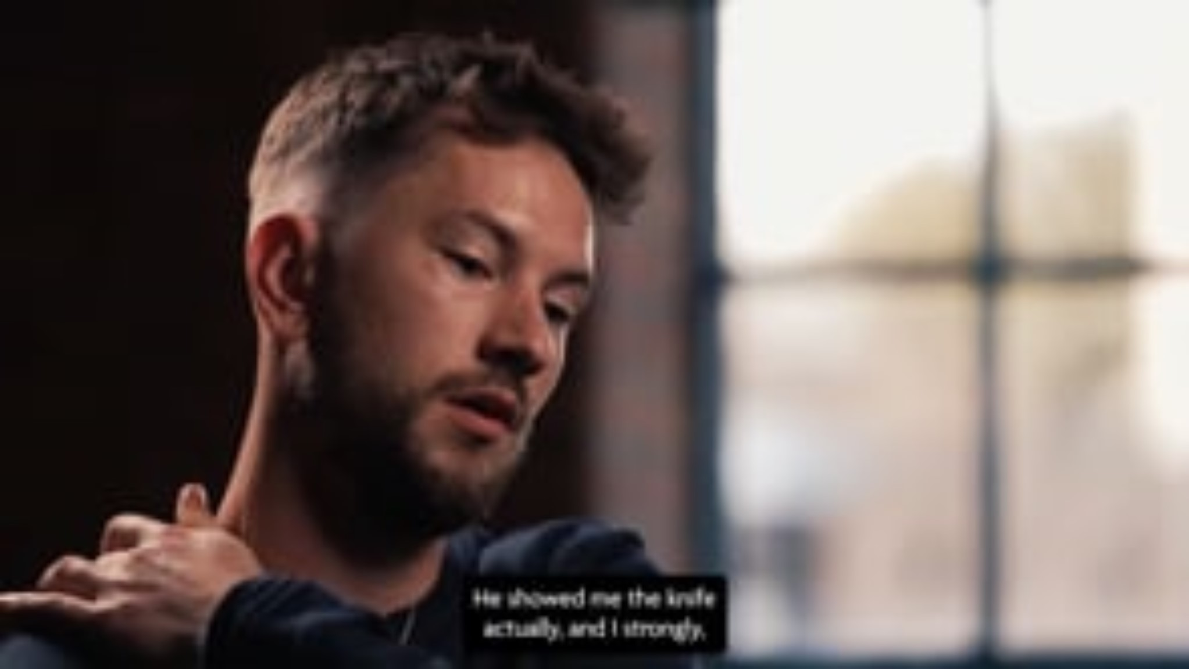

Slide 21
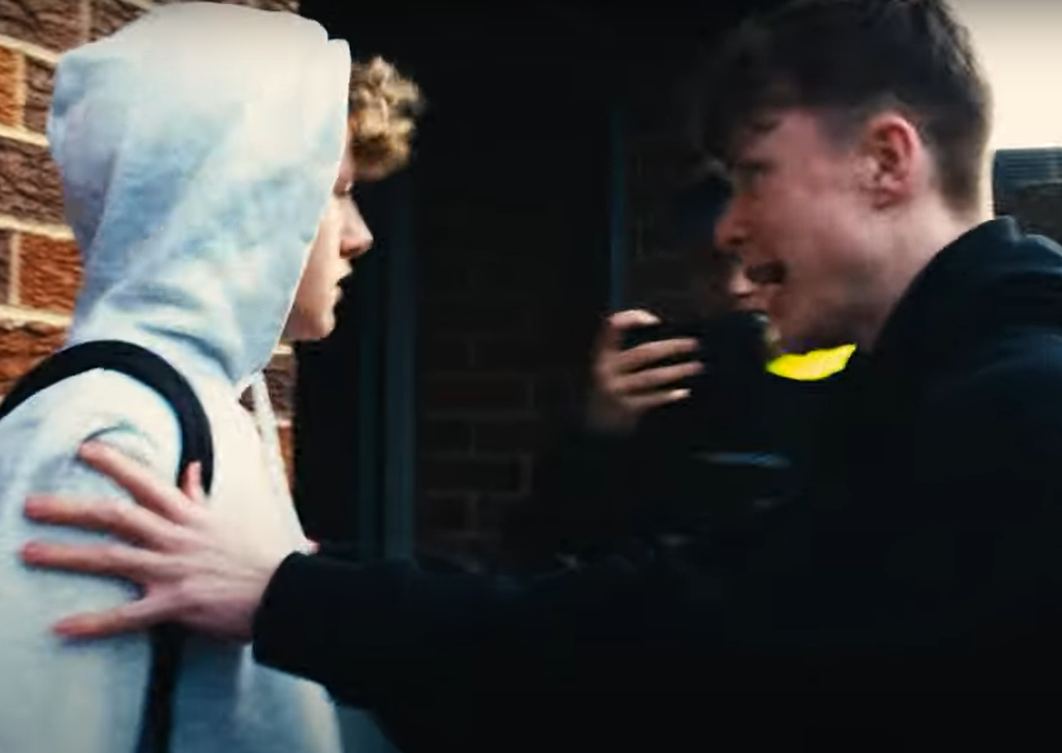
Reason: “Being bullied” and “Feel unable to have a fist fight and a weapon will help.”
Having a knife or weapon is a lose-lose situation!
It could be used against you.
You could use it – making you guilty of serious assault or murder. Being bullied is not a defence.
They might come after you for revenge.

Slide 22
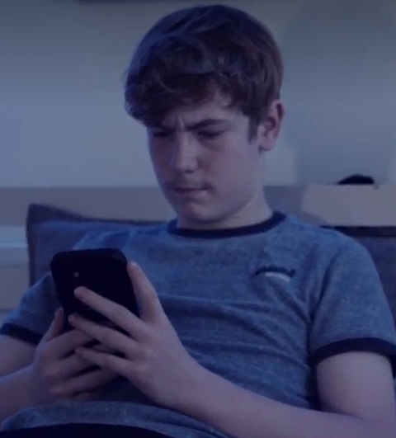
Reason: “To look hard” and
“Be the leader.”
The truth is that it makes you look weaker as though you can’t defend yourself.
You could lose your real friends.
They know being friends with someone who carries puts them at risk.
It can make you a target for people with bigger weapons or working as a group.

Slide 23
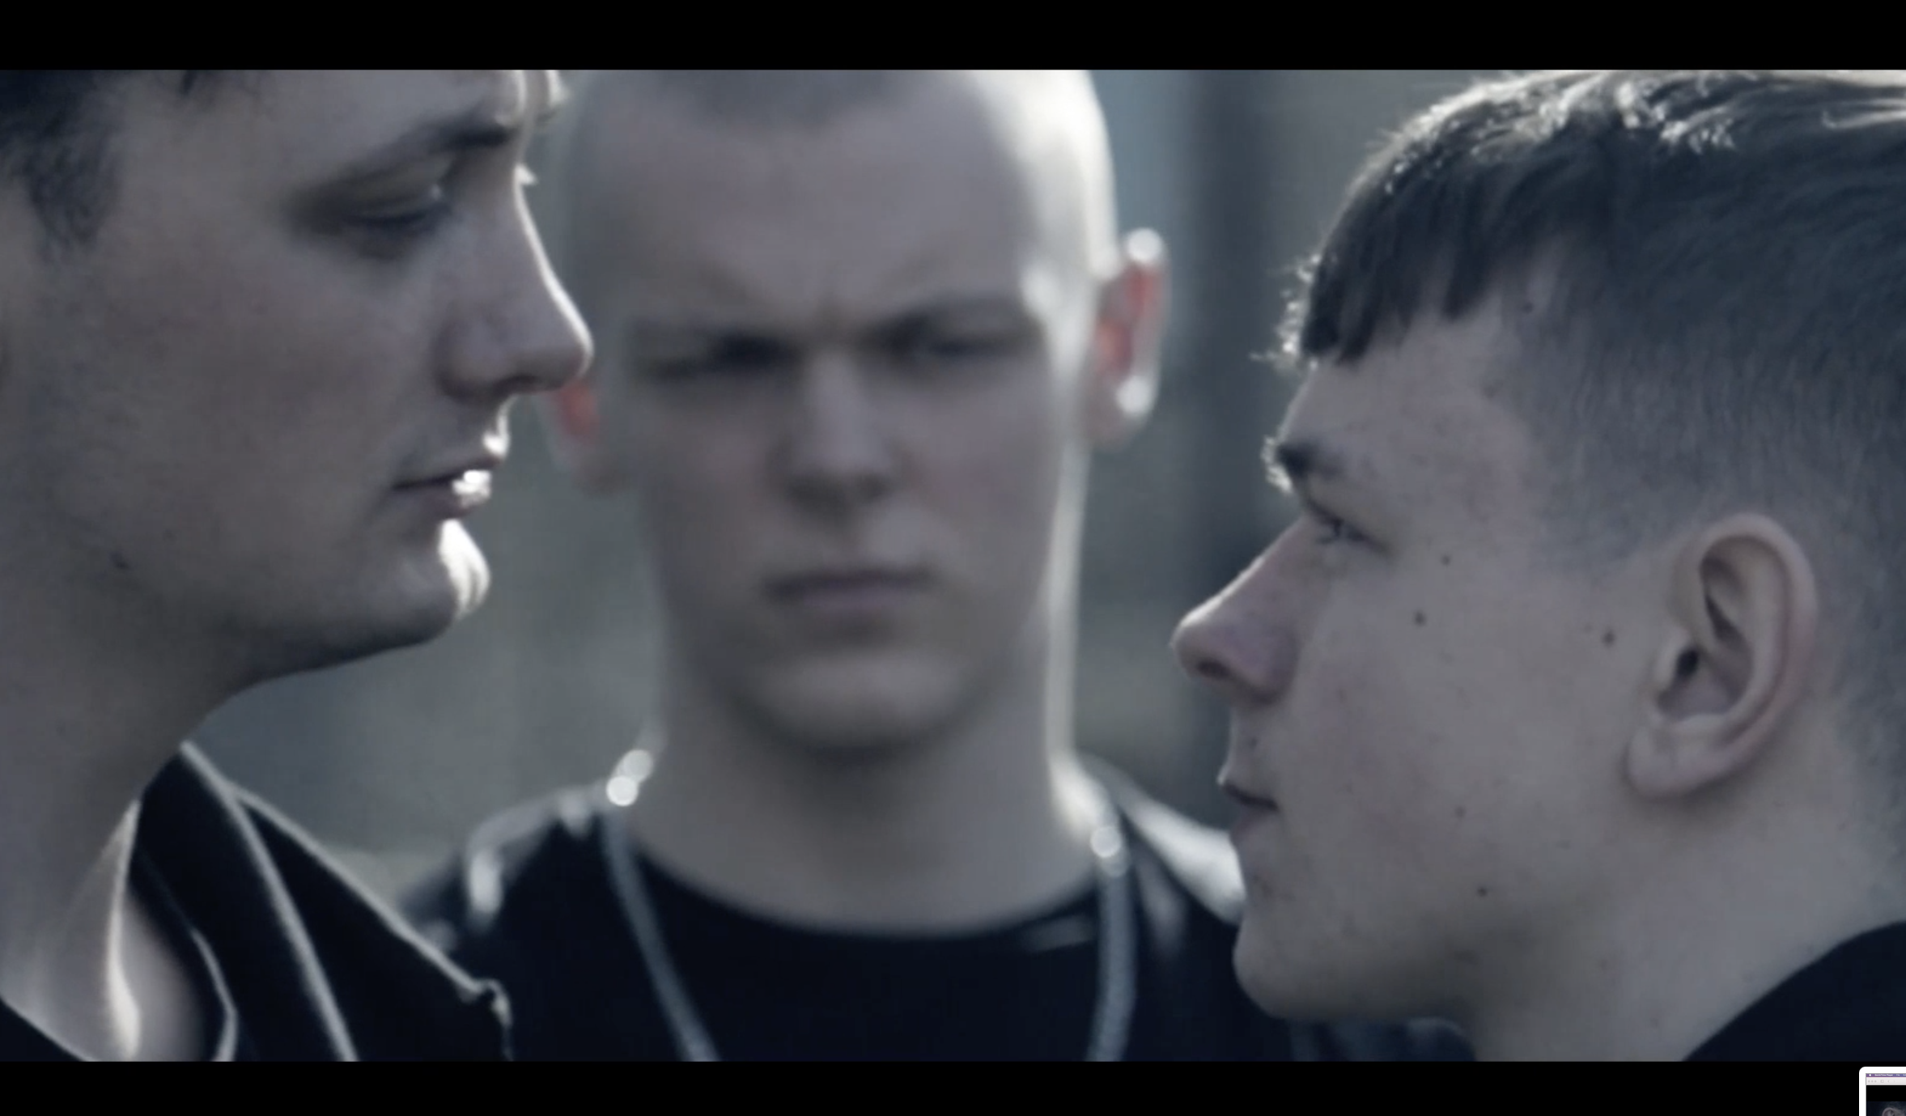
Reason: “You are being exploited.”
This reason is different to the others as you might not be in control of your choices.
For example: an adult or gang member might make you move weapons, carry them, or even use them.
In this situation you must speak with a trusted adult or call the Police or Crimestoppers to get help.
More on this later.

Slide 24
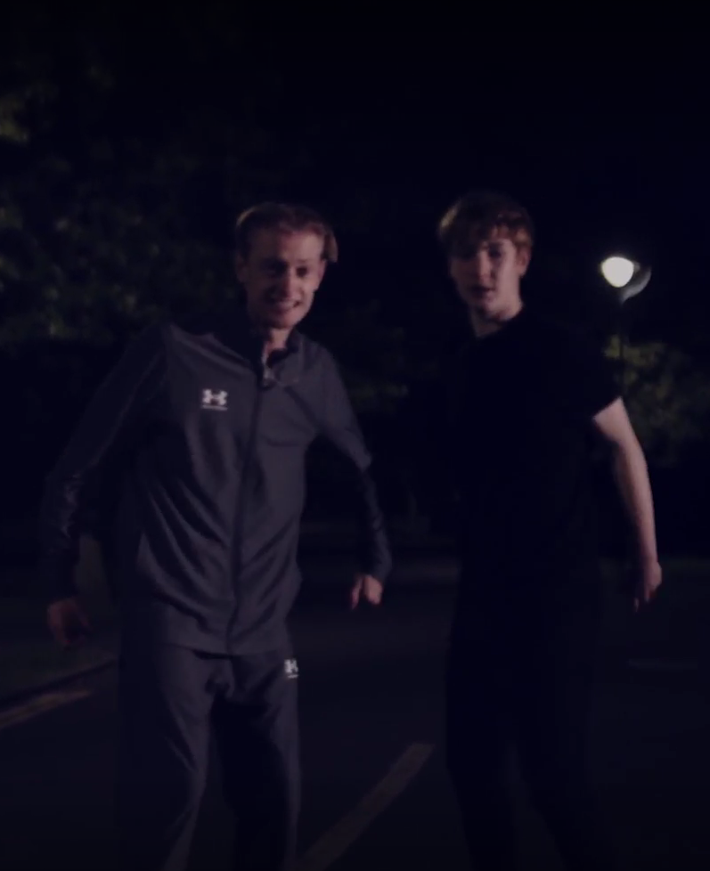
Part Three What the law says
Knife Crime includes:
Trying to buy a knife if you are under 18 years of age.
Threatening someone with a knife.
Owning a banned knife.
Injuring or fatally wounding someone with a knife.
Intending to injure or harm someone with a knife.
A robbery or burglary where a knife was carried as a weapon.

Slide 25
What does the law say about weapons?
Section 1: Prevention of Crime Act 1953 – Having an offensive weapon in a public place
It is an offense to carry an offensive weapon in a public place without lawful authority or reasonable excuse, as defined by Section 1 of the Prevention of Crime Act 1953.
Additionally, it is an offense under Section 139 of the Criminal Justice Act 1988 to carry an article with a blade or point in a public place without lawful authority or good reason.

Slide 26

Quiz Time
True or false
If you are caught with a knife and you haven’t used it, you'll only get a caution.
False - Carrying a knife can mean prison time

Slide 27
Quiz Time
What do you think is the longest sentence possible for having an offensive weapon that has not been used?
Answer: Having an offensive weapon can mean a maximum 4-year prison sentence.

Slide 28
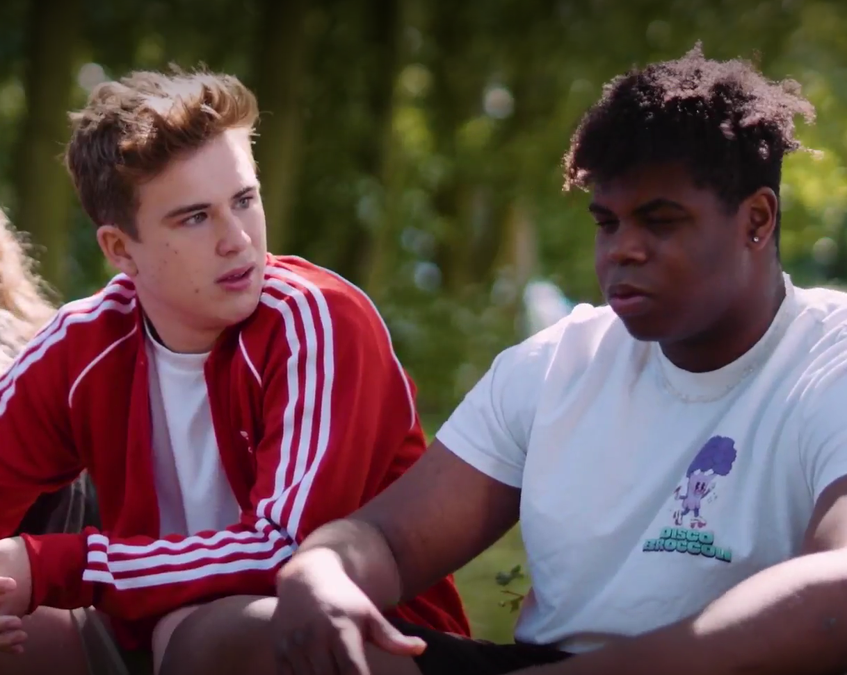
Quiz Time
What is the name of the section of the law which allows two or more people to be convicted of the same crime, potentially receiving the same sentence, even if they had differing levels of involvement?
Hint: it has been mentioned earlier.
Answer: Joint Enterprise (more on next slide)

Slide 29
Joint Enterprise
For example, if a murder has taken place and there is evidence that 5 people were involved, but it is difficult to determine which of those 5 dealt the fatal blow, they could all be convicted of murder under Joint Enterprise.

Slide 30
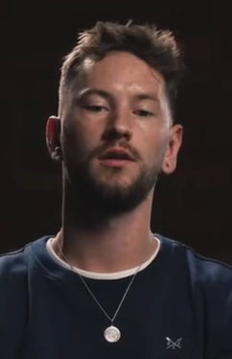
Part Four Ways to reduce risks around weapons for you and your friends.
AJ’s friend Darren tried to talk him out of carrying a knife.
He explains in the following clip.
Aj's friend
If you're having trouble accessing the video, here's a direct link:

Slide 31
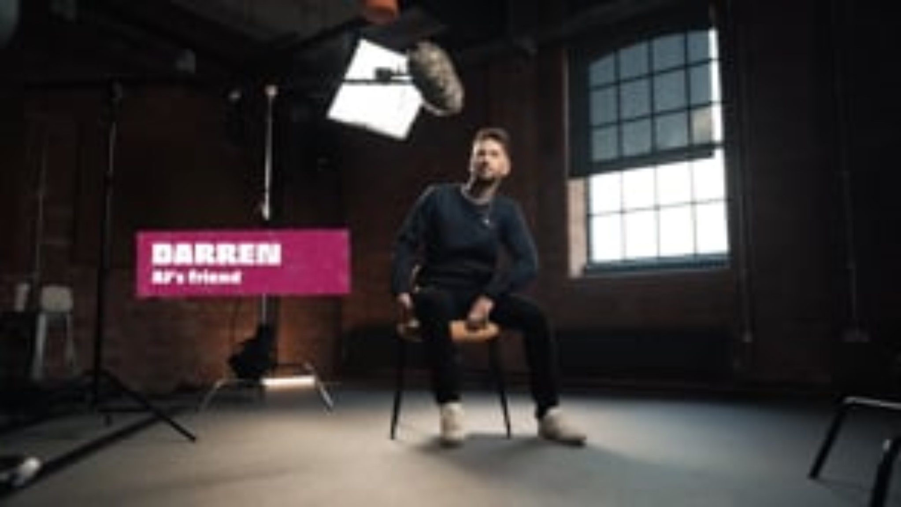

Slide 32
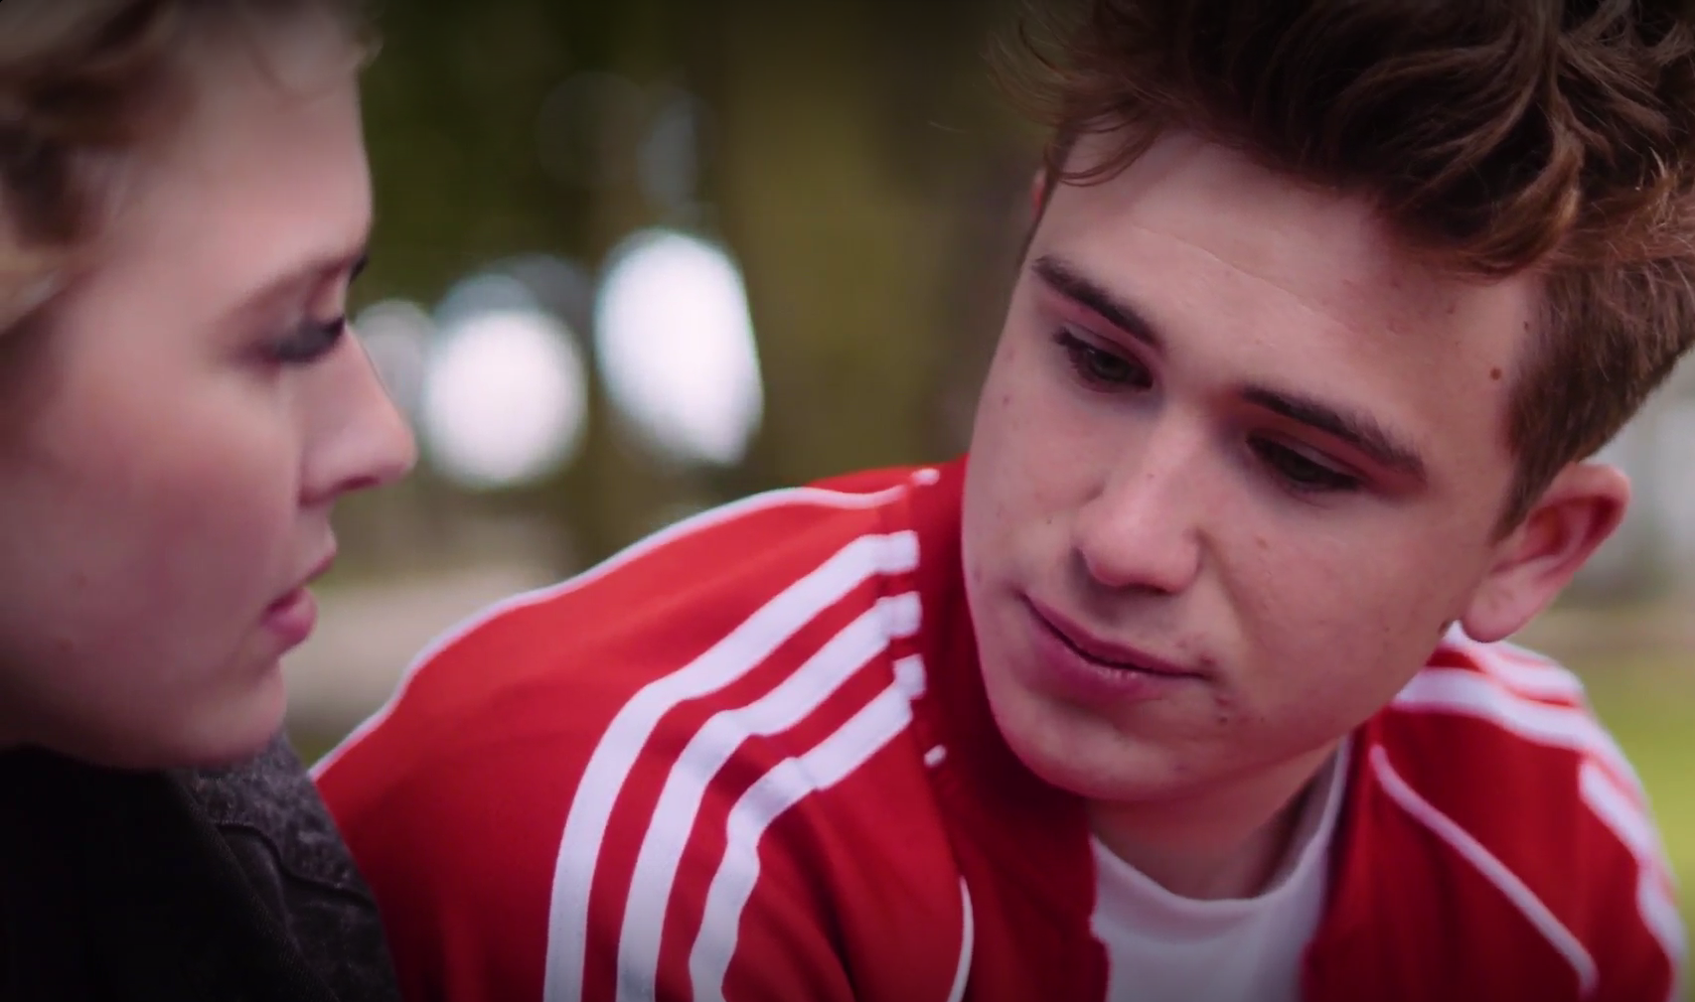
Part Four Ways to reduce risks around weapons for you and your friends.
Darren tried, and possibly still lives with the wish that he could have convinced AJ.
In the other film…
Fortunately, Ben trusted his friend, Summer, to help get him out of his situation with the knife.

Slide 33
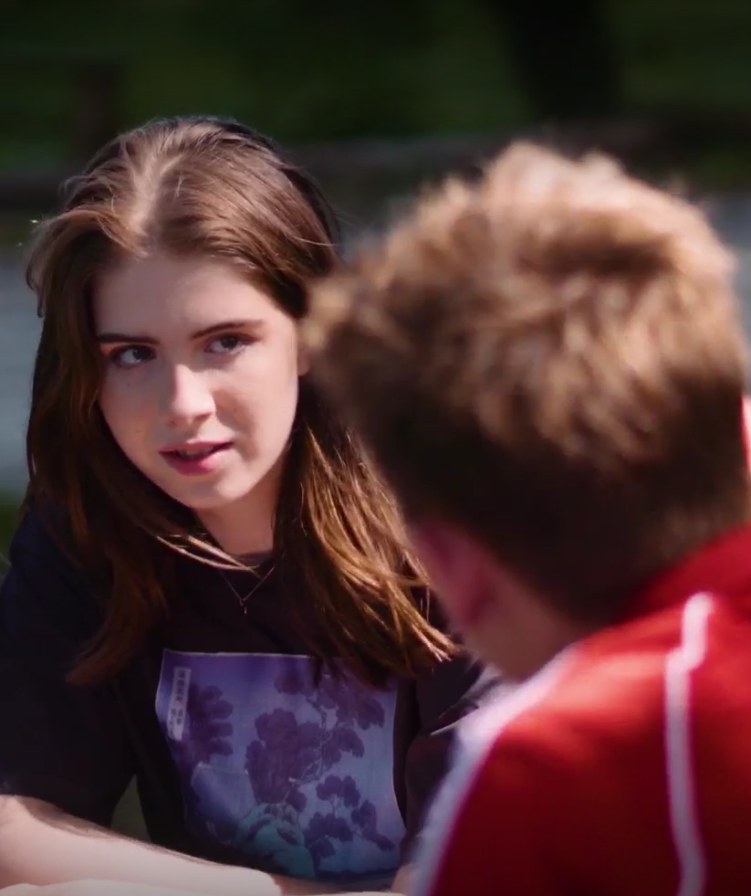
Extended
Activity
Negotiation activity:
Split into small groups.
In your groups, decide which one of you is playing the part of someone carrying a knife.
The challenge for the others is to try to convince them to safely dispose of it.
Consider what your arguments against carrying knives are and what you might say to convince them.
Good luck!

Slide 35

Safely disposing of a weapon
Please take care when bringing a weapon to a surrender location.
Consider
wrapping a
bladed item in cardboard or
a tea towel.
Where safe and possible, it should be safely disposed of.
You can contact your police force on 111 anonymously or search online to find out how weapons can be surrendered to the police. Often this can be done without the need for giving any personal details.

Slide 36


Finding your thing, your people
Ask a trusted adult or go online to find out what is happening where you live.
Information to help you get started is available:
healthyholidayshull.org/
Activities taking place in Hull during the school holidays for school aged children and young people.
Looking for something positive to get involved in?
livewellnorthlincolnshire.org.uk/
A wide range of organisations, support groups, community groups, events and activities to support you to live your best life.
discovernortheastlincolnshire.co.uk/
Useful information from visitor essentials to top attractions, best beaches and discovering wildfire.
eastridingculture.co.uk/active-communities/
Empowering the East Riding of Yorkshire to be active, healthy and connected.

Slide 37
with Mikey?
This short film has some tips on how to help yourself and others in a risky situation.
Click for video
Staying Safe
If you're having trouble accessing the video, here's a direct link:

Slide 38


Slide 39
Can you name
7 things we have
learned today?

Slide 40


Getting help
Trusted adult, e.g. parents, carers, teachers, youth workers.
Anonymous reporting via www.fearless.org or Crimestoppers.
More info at www.notinourcommunity.org
If there is immediate danger call 999

