Slide 1




Introduction to Anti-Social Behaviour
Recommended for:
Key stage 3, 4 and above
Warning: contains content some viewers might find upsetting.

Slide 2
Learning Outcomes
What anti-social behaviour (ASB) is, and how it affects the community.
The law and anti-social behaviour.
What we can do about anti-social behaviour.

Slide 3
Trigger warning!
Content discusses violent behaviour
If any content causes distress, a safe place to go is…
Session Expectations
No personal questions or comments.
Listen to each other.
Treat each other with respect, even if you disagree.
Engage with and try to enjoy the learning.
RULES

Slide 4
Quiz time - Hands up, call it out!
Q) Which of these do you think is anti-social behaviour?
Vandalism
Loud disturbances
Hanging out in groups
Littering
Getting the bus late at night
HANDS
UP
Answer: A, B and D are
C (Hanging out in groups) and E (getting a late bus) aren’t ASB themselves, though if you are doing something like swearing, littering, being intimidating to others, then it is!
Click for answers

Slide 5
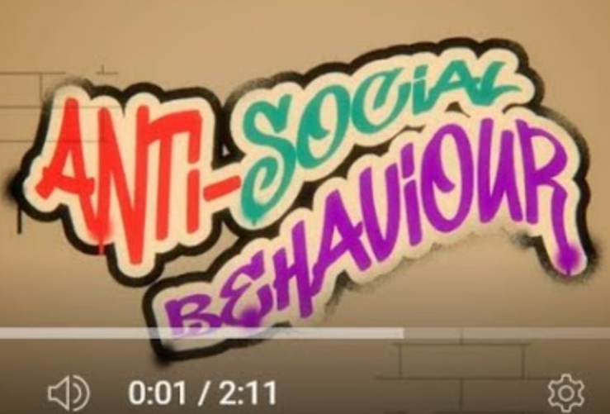
We’re now going to watch a short clip on what anti-social behaviour is.
If you're having trouble accessing the video, click on the direct link: Anti Social Behaviour Animation

Slide 6

Quiz Time
Which of the following statements about the community is true?
a) Anti-social behaviour makes areas feel more welcoming. b) Anti-social behaviour creates fear and anxiety for a lot people. c) Anti-social behaviour improves neighbourhood relationships. d) Anti-social behaviour has no significant impact.
Answer: b)
How anti-social behaviour affects people and what we can do about that is the basis of this session.

Slide 7
Being a victim of anti-social behaviour at home
Click for hints
What could you do if you were the one being disturbed by the noise?
Hints: ask them to turn it down, call the council, pick a time to go and explain the problem.
What would you want the people making the noise to consider?
Hints: how it negatively affects you, how they might not realise how loud it is for others.
Put yourself in their shoes
After a long day at school, you’re ready to rest for an important test tomorrow. But as you lie down, loud music from a nearby house shakes the walls. The noise goes on for hours, making it impossible to relax or sleep.
How would you feel if this happened every night?
Hints: tired, frustrated, anxious, angry?

Slide 8
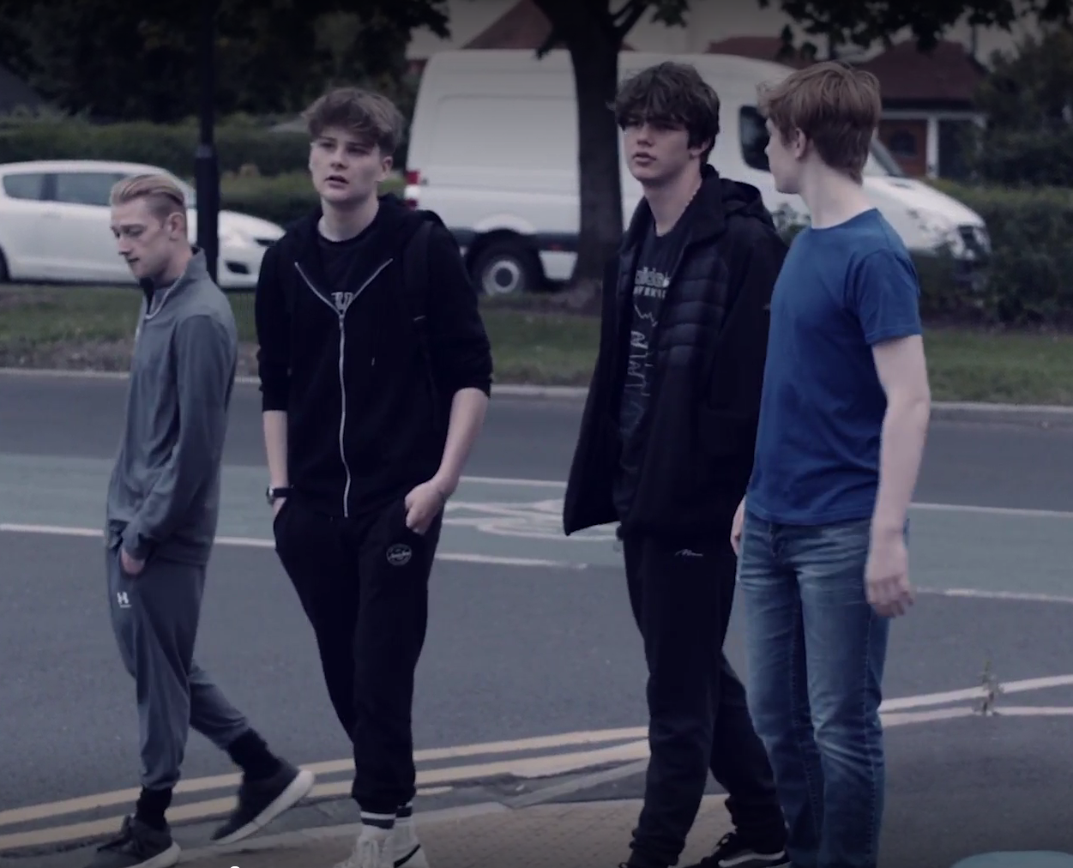
Perceptions
What do you see?

Slide 9
Perceptions
Click for suggestions
Imagine these are your friends.
What might you see?
Suggestion: you probably see no risk and would be happy to see them!

Slide 10
Click for suggestions
Perceptions
Imagine you are an elderly person who was robbed by a group not that far from here.
What might they see?
Suggestion: they might be frightened or even angry as they associate the group with negative feelings

Slide 11
What do you think? Discussion
Do you think young people are judged negatively just for being out and about?
Has this ever happened to you?
How does it feel?
Is it fair?

Slide 12
If young people are unfairly judged, what can we do about it?
Hands up with suggestions
Click for hints
Two general options:
Option 1
Option 2
We accept it.
We might complain or get angry about it.
Nothing really changes.
We prove the haters wrong.
We can be helpful and friendly.
We can be considerate and aware of perceptions that some people might misjudge.

Slide 13

Positively Changing Perceptions
Click for suggestions
Instead of swearing and being overly loud >
Have an actual conversation.
Instead of blocking a pavement or shop doorway >
Move out the way.
Instead of taking up more space than you need on a bus >
Give up your seat to someone who needs it.
Instead of dropping rubbish >
Put it in the bin.
Instead of hanging out where there is litter or vandalism > (people might think you did it)
Choose a nicer space, a nearby bin might be handy!
Click to see more examples on the next slide

Slide 14
Positively Changing Perceptions
Click for suggestions
Instead of looking at people as they pass you >
Give them space or maybe offer a friendly “hi,” without being intimidating.
Instead of riding your bike on the pavement or using scooters dangerously >
Be safe and sensible about it.
Instead of playing loud music >
Play it so that you can hear it, but so that everyone else doesn’t have to!
Instead of spitting >
Keep your saliva in your mouth! It doesn’t do anything for you to spit.

Slide 15

Who is affected by anti-social behaviour?
Local shops
Children
Young people
Vulnerable people
People who are different
It affects everyone!
Schools
Older people
Communities
Residents

Slide 16
Anti social-behaviour isn’t just about young people!
Drunk and disorderly behaviour
(causing unsafe streets).
Loud parties late at night
(disturbing residents).
Vandalism & littering
(ruining public spaces).
Aggressive behaviour in shops
(creating hostile environments).
Some people assume it only refers to teenagers, but adults are more likely to be responsible for:

Slide 17
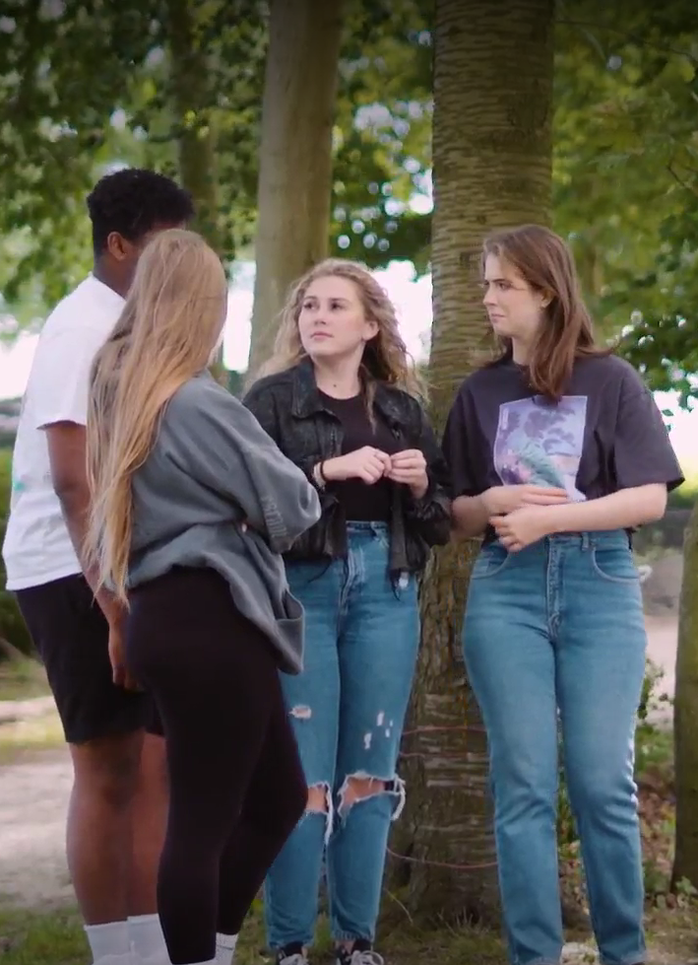
Anti-social behaviour isn’t just about young people…
…but sometimes, it is.
If others can do it, so can we. We all need to work together.
Small actions change communities.

Slide 18
Why do you think some young people commit anti-social behaviour?
Click for some suggestions:
Feeling bored or having nothing fun or positive to do.
Struggling to show emotions like frustration or feeling like no one ‘gets’ you.
Wanting to feel powerful by breaking rules or challenging adults.
Feeling left out or different, so joining groups that display anti-social behaviour in order to fit in.
A quick fix that causes harm; it might feel good at first but leads to bad consequences later.

Slide 19
What can we do when young people are responsible for anti-social behaviour?
Click for suggestions
Don’t give them attention.
If someone starts vandalising something, ignoring them takes their audience away.
Challenge them.
E.g. call it out for being immature; ask them not to as: “we’re trying to make the area better / keep it nice.”
Stop them?
You can do this if you know them as a friend and know that they will respond well and safely.
Example 1) Someone starts trying to vandalise a play park.
What could you say?
What could you do?
Example 2) Someone drops litter.
What could you say?
What could you do?

Slide 20
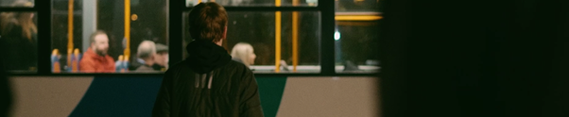
The impact on communities
If you are involved in anti-social behaviour, it affects you negatively.
Anti-social behaviour :
Scares people
Wrecks places like parks or streets
Makes life worse for locals
Can lead to bigger crimes
It can ruin your reputation:
What does wanting to make someone else feel upset or afraid say about you?
Your parents or guardians might be disappointed or embarrassed.
Your younger siblings could be judged because of your actions—people might assume they’ll behave the same way.
Your friends might stop hanging out with you to avoid getting into trouble.

Slide 21
When messing about goes seriously wrong.
Click to watch
Based on a true story.
If you're having trouble accessing the video, here's a direct link: Thrown Away Pt 1
Trigger warning!
This film features scenes of explicit content that some might find upsetting.

Slide 22
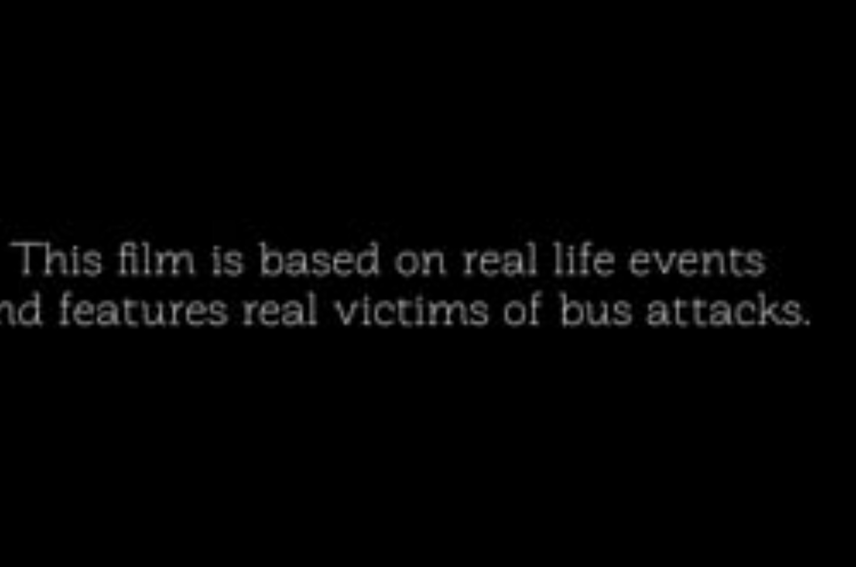
https://vimeo.com/1057866970/350a283d6a

Slide 23
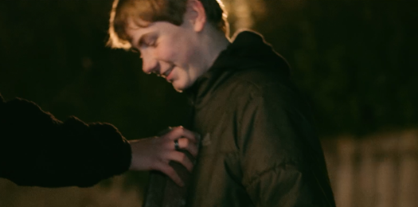
He didn’t want to throw it, but he did.
Why do you think he did it?

Slide 24
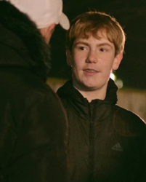
Peer Pressure
Peer pressure makes saying no hard, especially if you want to fit in.
If a group you are in sees anti-social behaviour as normal ore expected, it might feel like you have to join in. Even if you know it’s wrong, you might worry about being left out.
Real strength is recognising pressure and having the guts to say no.

Slide 25
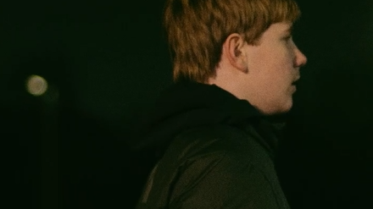
What do you think?
Discuss
What could happen from the boy throwing the brick at the bus?
What impact could it have for the people on the bus?
What could the consequences be for the boy who threw it?

Slide 26
Let’s see what happened…
Click to watch
If you're having trouble accessing the video, here's a direct link:
Thrown Away Pt 2

Slide 27
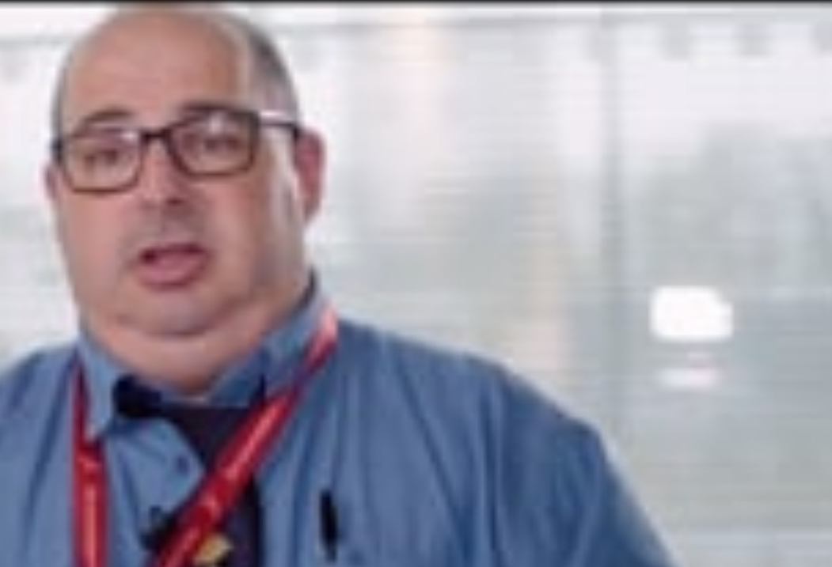
https://vimeo.com/1057870147/d8e77296d5

Slide 28
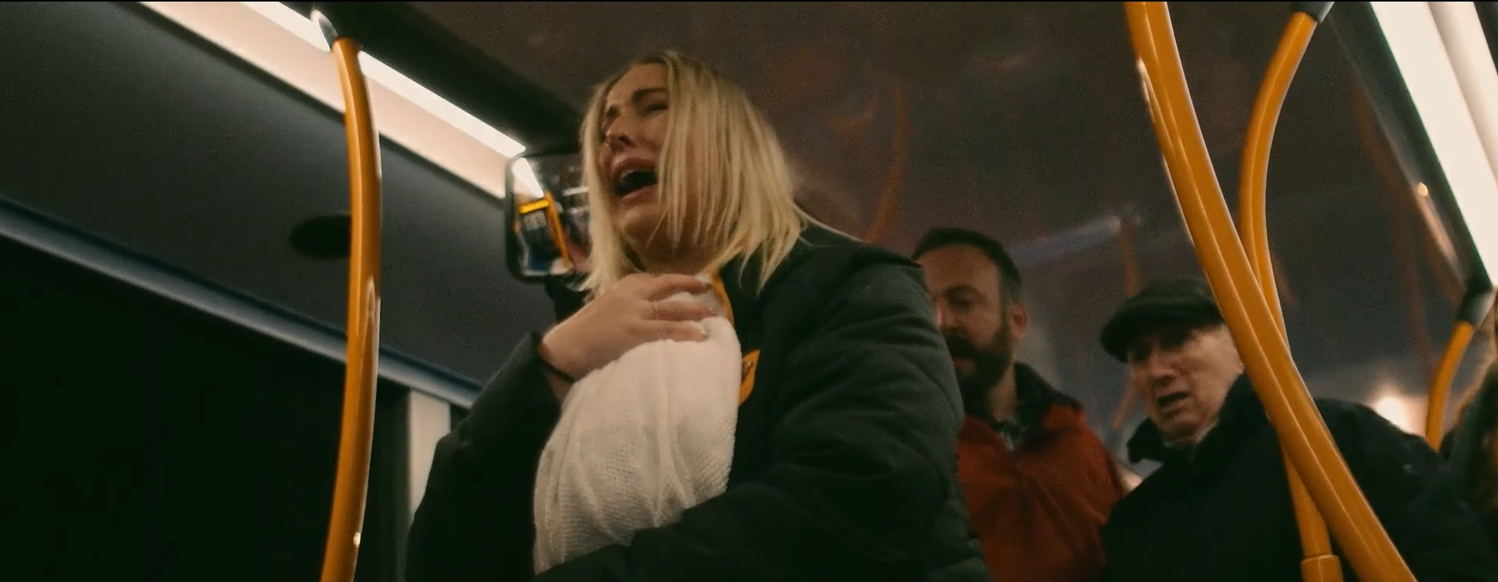
How do you feel about what happened?

Slide 29

The Consequences
The film showed an extreme outcome that would lead to legal consequences.
Not all anti-social behaviour is against the law, but if you are aged under 18 you can be given an ABC (Acceptable Behaviour Contract) that contains an agreement on what you can and cannot do.
If you break your contract, you could go to court.
If it gets worse or becomes a crime, you could face prosecution.

Slide 30
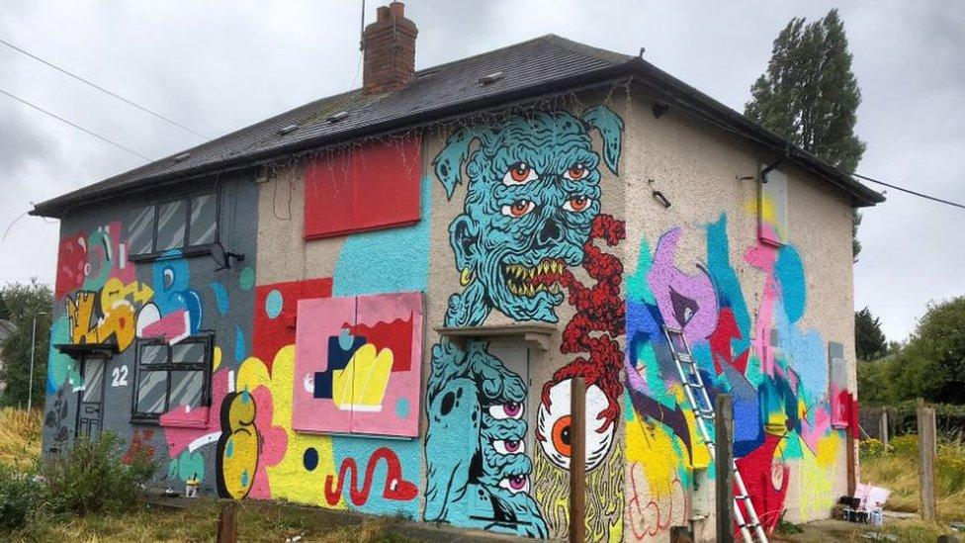
What would you do?
Discuss in pairs or groups
If your friends started vandalising a wall with graffiti while hanging out, what would you do?
Join in and add your own graffiti to fit in.
Watch them, but don’t get involved.
Tell them to stop and suggest doing something else
There is a difference between illegal graffiti and graffiti art.
Why does graffiti normally class as illegal?
Let’s take a closer look →

Slide 31
Graffiti Art or Anti-social Behaviour?
Graffiti without permission is seen as anti-social behaviour because it damages property and costs a lot to remove.
But for some, it’s a way to express themselves, especially if they don’t have access to art classes.
Some places have legal walls for street art, so people can create without causing problems.
Community murals let people share their art in a way that benefits everyone.
Would you be interested in a free space to graffiti in your area?
You can google or ask an adult to find out where your nearest graffiti place is!

Slide 32
What to do instead of Anti-social behaviour
Sports or any other physical activities. Even just a kickabout with your friends in the park, is a better way to spend your time
Talk to friends or trusted adults if you’re feeling frustrated or excluded. It’s okay to talk about your feelings
Music, drama, dance or art clubs where you can freely express yourself
If you had a choice of anywhere to meet up, what would it be?
What do you wish to be locally?
Volunteer for groups to connect with others
Community clean up, planting a garden or creating murals in approved spaces

Slide 33
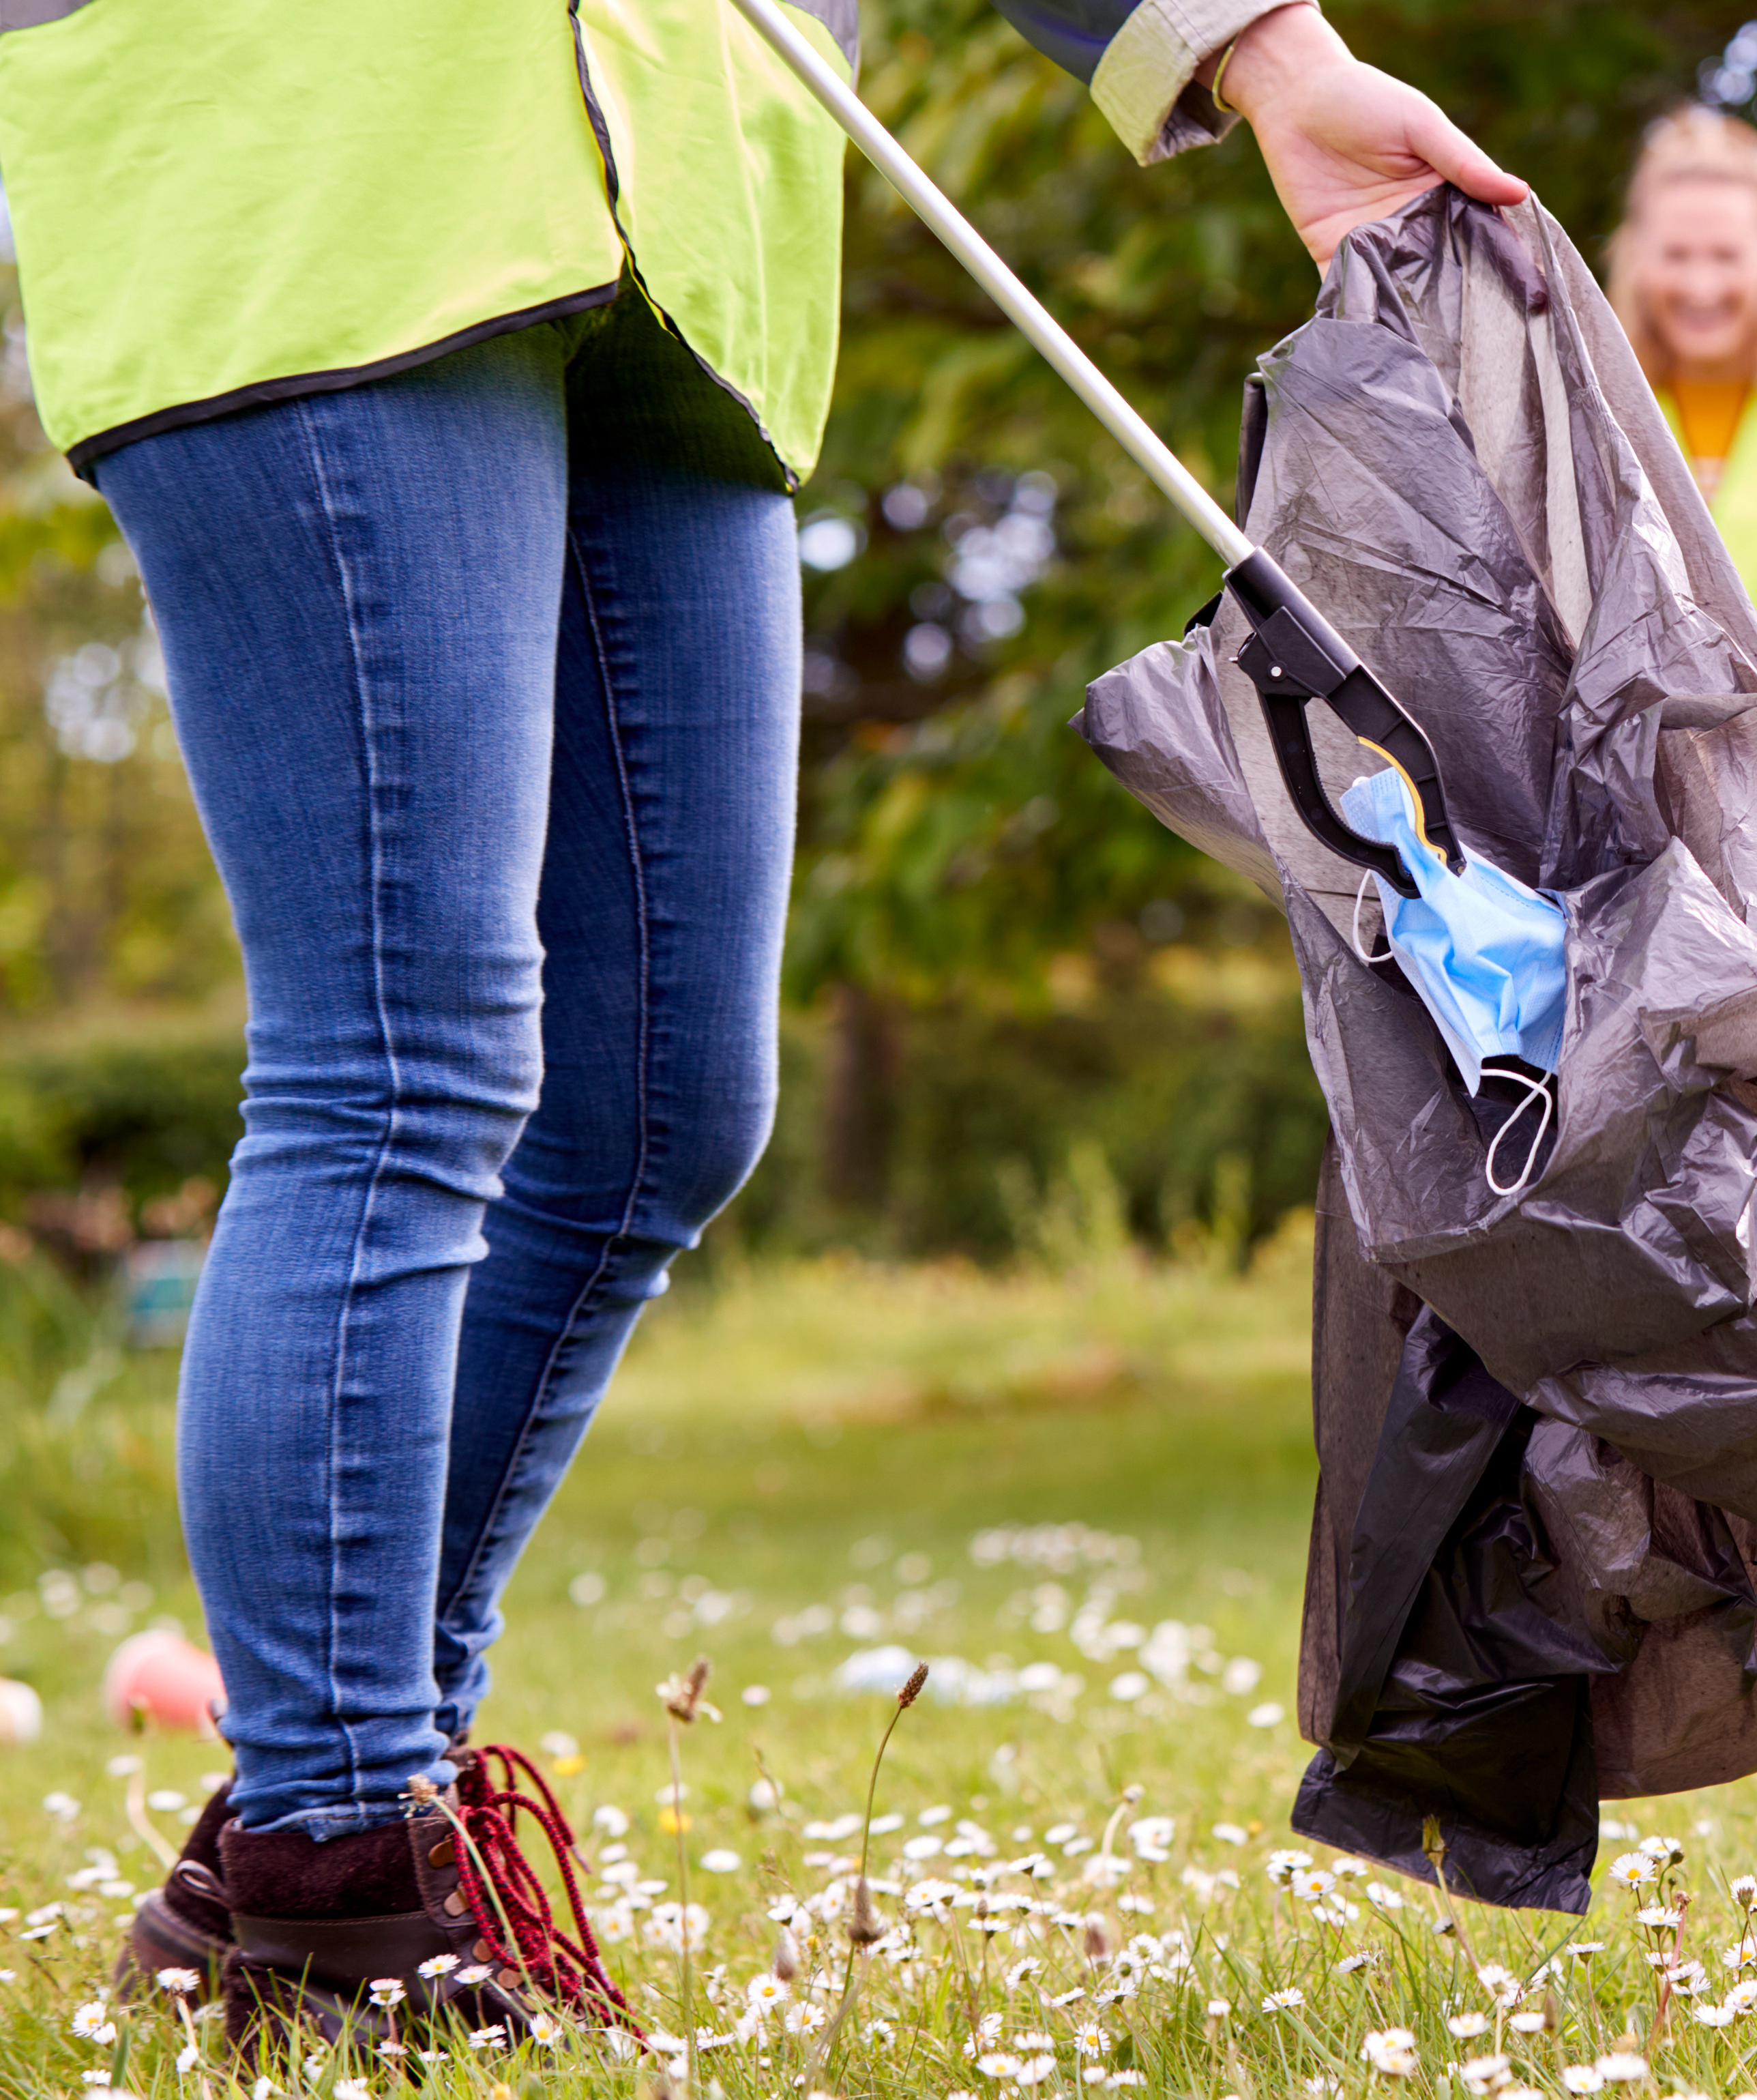
You are better than this!
You don’t need anti-social behaviour hanging over you or leading you to worse consequences.
Here comes the experiment!
Together we can be pro-social in behaviour

Slide 34
Pro-social behaviour experiment
Let’s set a one-week challenge for everyone!
Let us know what you’ve managed to do!
Ideas:
Make an effort to say hello to an elderly neighbour.
Pick up litter when you see it.
Try hanging out somewhere different than usual.
Look out for how people react.
Is it positive or negative?
Checklist

Slide 35
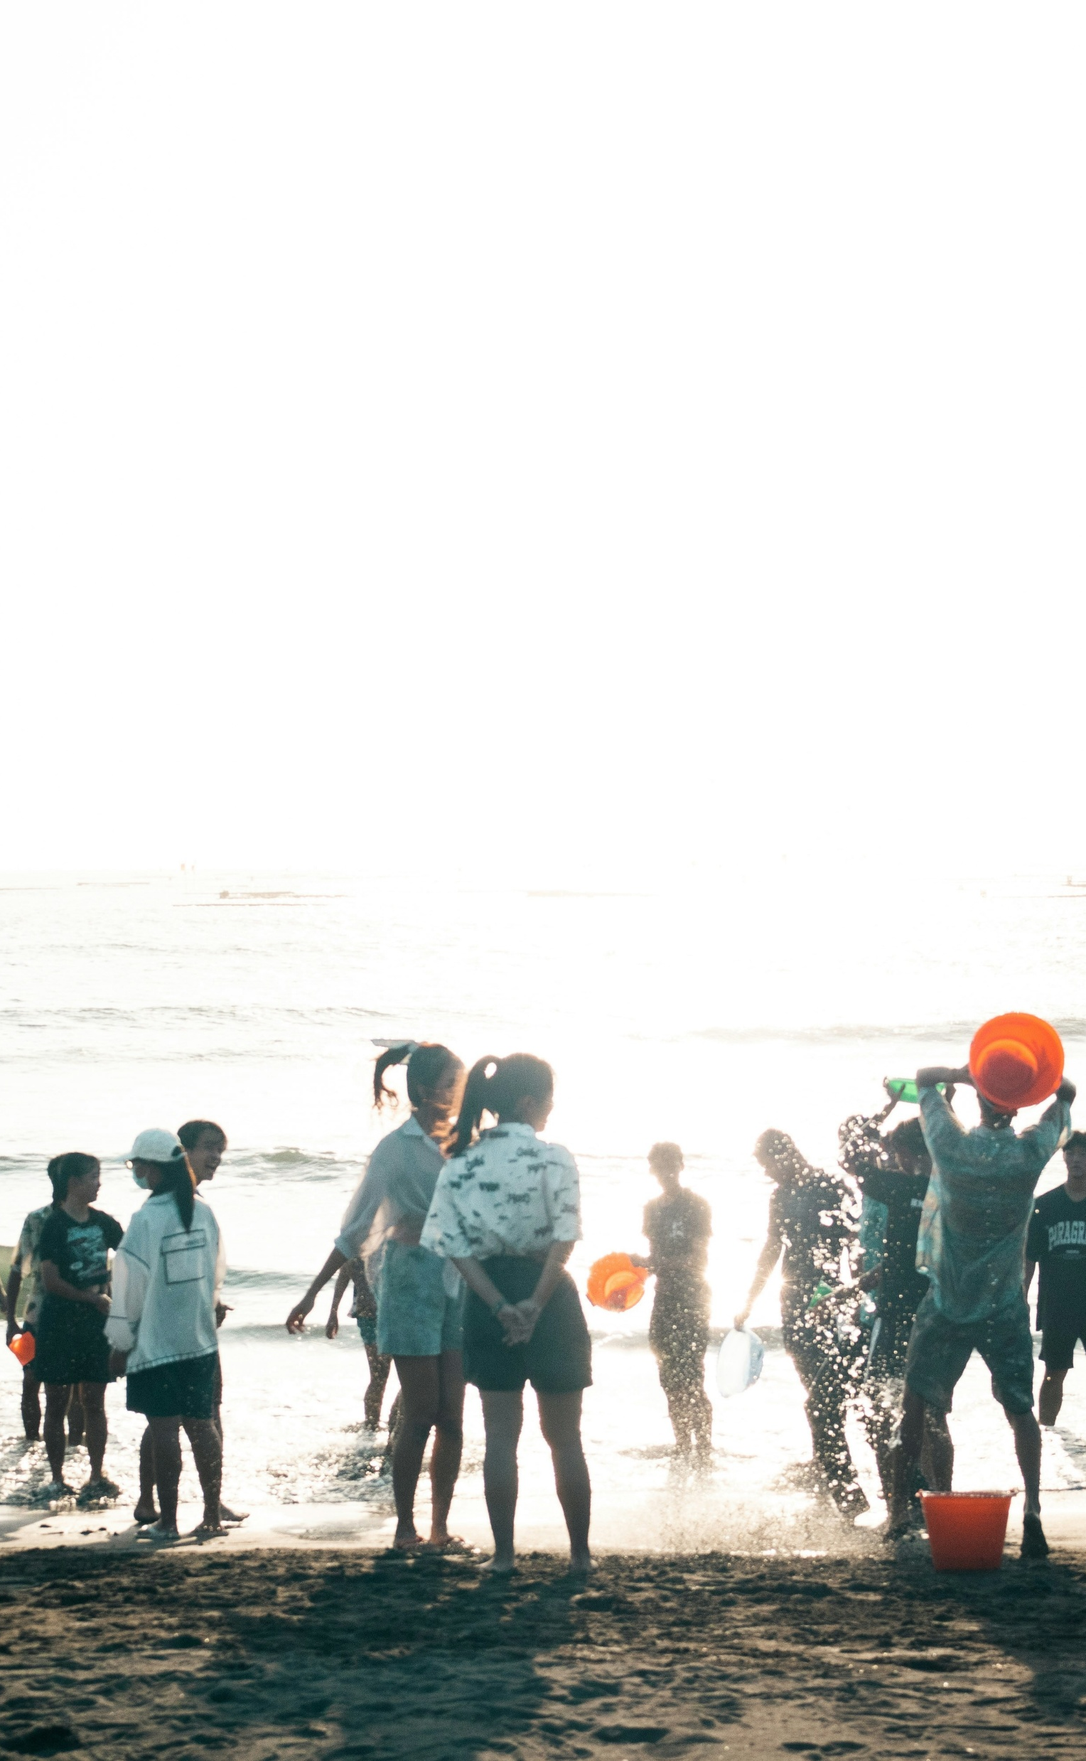

Finding your thing, your people
Ask a trusted adult or go online to find out what is happening where you live.
Information to help you get started is available:
healthyholidayshull.org/
Activities taking place in Hull during the school holidays for school aged children and young people.
Looking for something positive to get involved in?
livewellnorthlincolnshire.org.uk/
A wide range of organisations, support groups, community groups, events and activities to support you to live your best life.
discovernortheastlincolnshire.co.uk/
Useful information from visitor essentials to top attractions, best beaches and discovering wildfire.
eastridingculture.co.uk/active-communities/
Empowering the East Riding of Yorkshire to be active, healthy and connected.

Slide 36
Can you name 3 things you’ve learnt today?

Slide 37
Getting help and support
Trusted adult, e.g. parents, carers, teachers, youth workers
Report ASB to Humberside Police on telephone number 101
Report crime or anything suspicious anonymously on https://crimestoppers-uk.org/fearless
Childline – 08001111

