Slide 1




This is a NEW
Not In Our Community resource being tested
Feedback on what we can change or improve is very welcome.
Please email mail@notinourcommunity.org with comments or to a request a call.
Thank you for your support.

Slide 2
Prevent and Protect
Women & Girls against
Sexual Harassment
Part 2
Recommended for:
Key stage 3 and 4
Warning: contains content some viewers might find upsetting

Slide 3

Learning Outcomes
1. What is sexual harassment?
Why focus on harassment of girls and women?
2. Why is sexual harassment such a big problem?
3. What can we do to safely challenge sexual harassment?
4. How to get more help.

Slide 4

Session Expectations
Trigger warning!
Content on sexual
harassment
If any content causes
distress, a safe place to
go is…
No personal questions or comments.
Listen to each other.
Treat each other with respect, even if you disagree.
Engage with and try to enjoy the learning.
RULES

Slide 5
Let’s recap - Part 1
What is Sexual Harassment?
Unwanted behaviour that makes someone feel upset, scared, or embarrassed. This could be verbal (e.g. sexual jokes), physical (e.g. unwanted touching), or visual (e.g. sending explicit images).
Why is Sexual Harassment a Problem?
Many young people experience it. 27% of teenage girls face harassment. It makes victims feel unsafe and lowers self-esteem. It's linked to bigger issues like sexist attitudes and violence against women and girls.
Why Does This Matter?
Challenging harassment makes schools and communities safer. Ignoring or laughing along means you're part of the problem. Speaking up helps to support victims and creates change.
How Can We Challenge It?
Can you remember what the letters of C.A.R.E. stand for?
(Answers on next slide) →

Slide 6
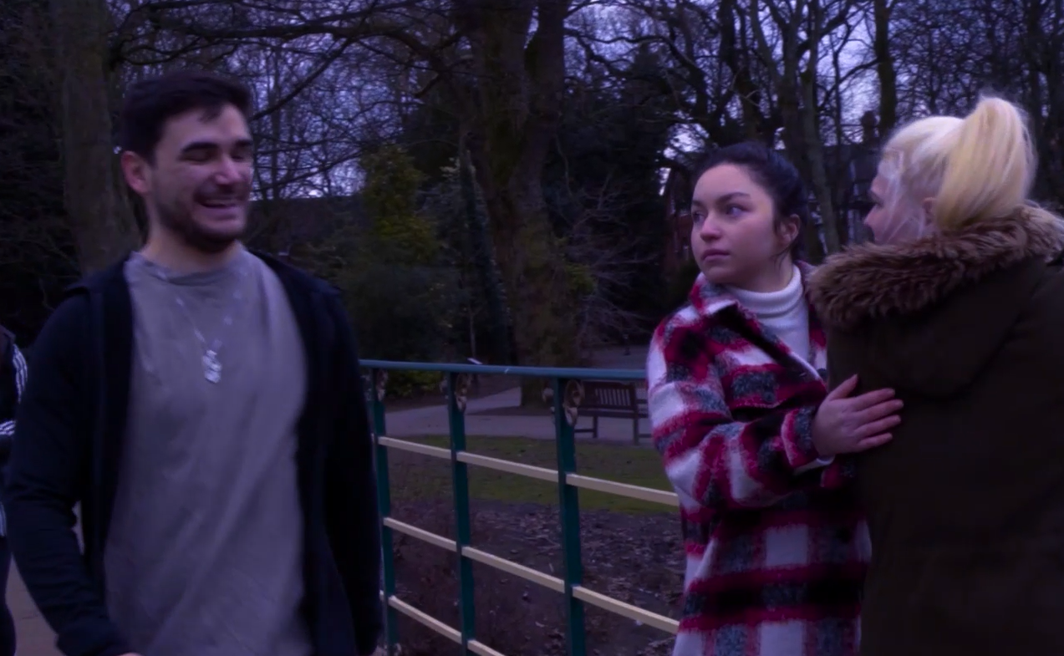
Take C.A.R.E
Call it out!
Ask authorities
Remain present!
Enlist others!
If you feel safe, call out the behaviour by asking if the person needs help or telling the perpetrator: “That’s not OK.” You can also ‘call it in’ later to see if the person is alright or let the wrongdoer know their behaviour was wrong.
Tell a teacher or another adult what happened. If you or others are in danger and no help is around, call 999.
If it's safe, stay at the scene—having people around can help. If you feel confident, create a distraction, like asking for the time.
If you see harassment, get others to help—safety in numbers makes it harder for the perpetrator to continue.

Slide 7

Sexual harassment outside of school
Reminder: Not all boys and men are the problem; however, all boys and men can be part of the solution.
Of women of all ages in the UK have experienced sexual harassment in a public space and most women blame themselves.
71%
Regardless of your gender, how could you respond to be an ally to
girls and women in situations like the examples on the next slide? →

Slide 8


Challenge:
What could you do to help without putting yourself or others in danger?
1
As a girl walks past, your male friend comments on her body and tells her to smile.
A boy or man sits next to a girl on the bus even though there are empty seats.
A man keeps making comments to a girl on a train even though she doesn’t want to talk to him.
Some men in a car shout sexual comments to a girl (catcalling).
A man approaches a girl in the street and won’t let her past.
2
Work together to see what approaches you can come up with.
Some suggestions are on the following slides →
3
4
5

Slide 9
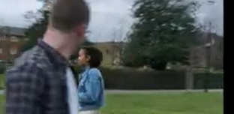
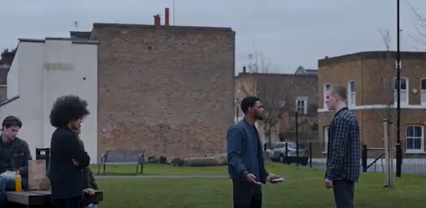
A) As a girl walks past, your friend comments on her body and tells her to smile.
Click for hints
What did you come up with?
If it is a friend, call them out and tell them it’s not OK.
You shouldn’t be aggressive, but you do need to make them feel uncomfortable enough to realise it is disrespectful.
Perhaps remind them that they wouldn’t like if someone did that to their mum / sister / cousin / friend.

Slide 10
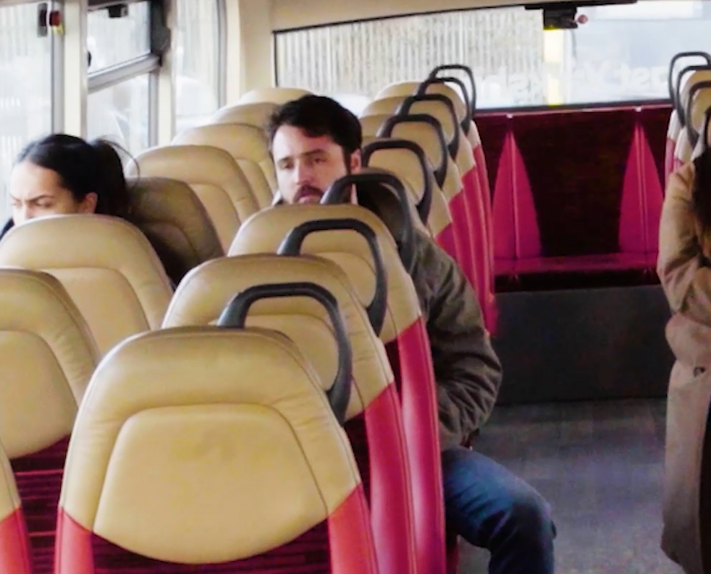
B) A boy or man sits next to a girl on the bus, even though there are empty seats.
Click for hints
What did you come up with?
If there are people older than you on the bus you could quietly point out the situation to them and together encourage them to take a different seat in a non-embarrassing or threatening way.
Try not to make a scene as this could make the situation dangerous.
If you are unsure what to do the safest thing to do is to speak with the driver to make them aware (they are the authority).

Slide 11

C) On a train, a boy or man keeps making comments to a girl, even though she doesn’t want to talk to him.
Click for hints
What did you come up with?
In a friendly way, ask the girl if she is OK. She might prefer to handle the situation herself by asking him not to speak with her or moving seats.
If the boy or man engages with you in an aggressive or concerning way the safest thing to do is to report this to the train conductor who has the authority and training to deal with the situation without it getting worse.

Slide 12
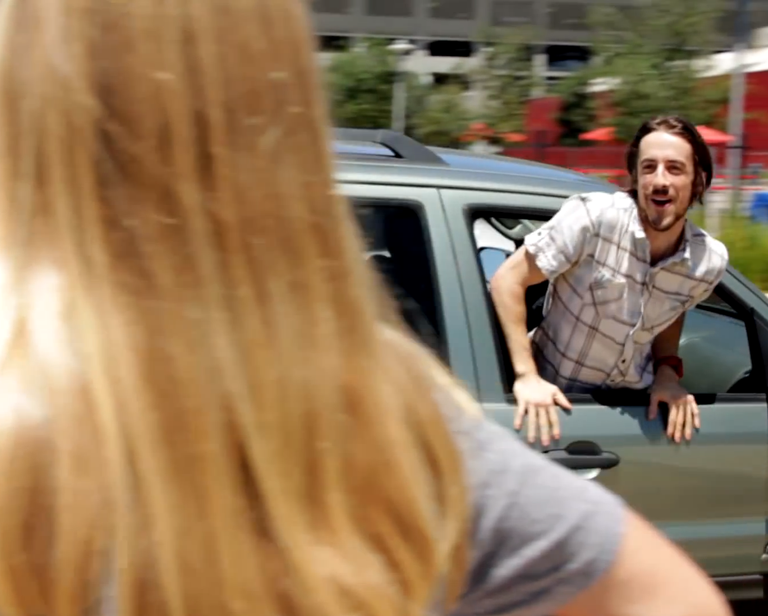
D) Some men in a car shout sexual comments to a girl (catcalling).
Click for hints
What did you come up with?
In these situations, calling out and reasoning with the offenders is unlikely to help the victim at the time.
If you witness sexual comments check in with the victim that they are OK. Show empathy and that you are sorry that this has happened to them. It is understandable that they might not want to talk to you, but by doing this you have shown that they are seen as a person, and it is not their fault.

Slide 13
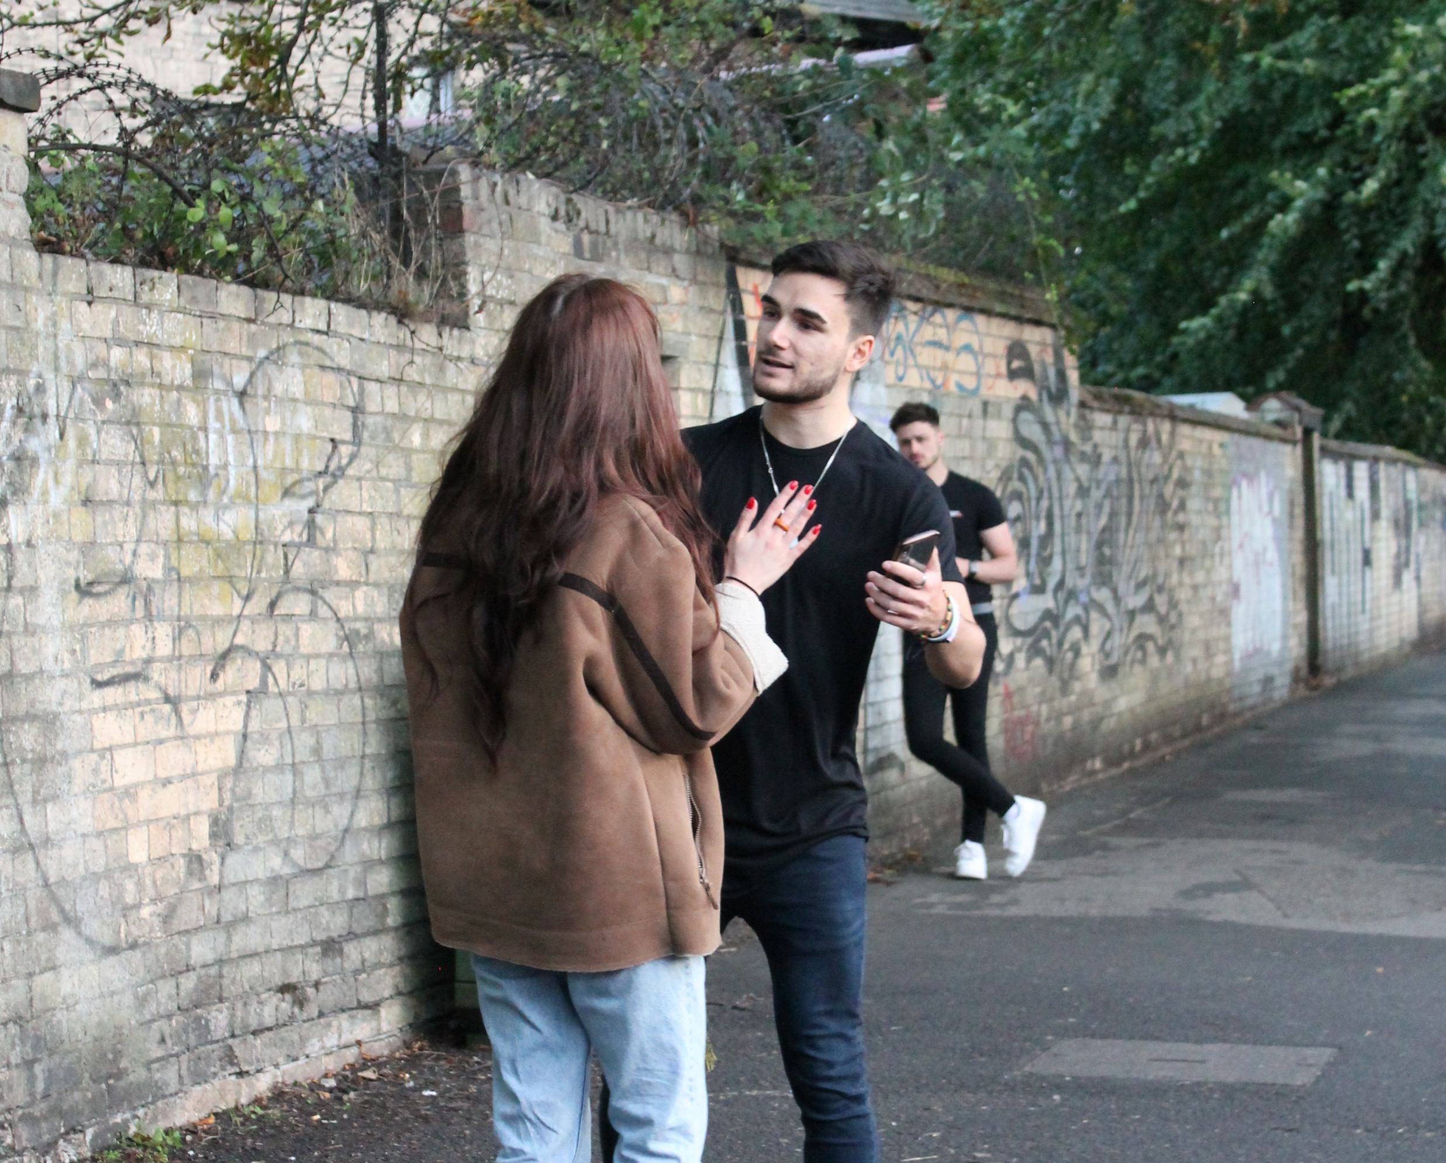
E) A man approaches a girl in the street and won’t let her past.
Click for hints
What did you come up with?
If an offender is present, it is important not to create more danger. If the victim gets away you can make sure they get away safely, if he pursues you can ask adults to help or call the police on 999 as the girl could be in immediate danger.
It's safer to get two or more adults involved, as a group is more likely to stop the situation before it gets worse.
You don't have to handle everything yourself, but if you can help safely with others, it can make a big difference for someone in need.

Slide 14

Are there any other examples of sexual harassment that you can think of?
How could you help the victim?
How could you make sure you are safe?

Slide 15

Getting more help
Speak to an adult such as a parent, teacher or another adult that you trust about what has happened and what should be done to stop it from continuing.
Some schools have people appointed to anti-bullying roles. If your school has one, that person could be a great person to seek guidance from.
If you are being sexually harassed by an adult, it is extremely important that you let another adult know right away.

Slide 16
Before reporting it to your school, who else could you ask for help from?
Before you decide to report an issue with your school, if you can, let your parents or carers know what is going on.
The school will likely contact your parents/carers after speaking with you.
Ask them if they will help you speak to your teacher or other authority figure if you’re uncomfortable doing it alone.

Slide 17
If you are being harassed at school
Speaking to a teacher is often the first step to reporting sexual harassment in a school environment.
If it is your teacher harassing you, speak to another teacher you trust, your Head of Year or Headteacher.
If you have been keeping a record of the harassment, bring that with you when you go to speak to the teacher.
Make sure you explain what you have already done to prevent the harassment from continuing.
The school will have a sexual harassment policy if the person harassing is at your school or college.

Slide 18
Sexual harassment outside of school
Where possible find someone in a position of authority, such as someone working, security or a police officer.
If a situation poses immediate danger call 999.
For less urgent and anonymous advice
Childline: call 0800 1111, or sign up so you can online chat (9am - midnight)

