Slide 1

This is a NEW
Not In Our Community resource being tested
Feedback on what we can change or improve is very welcome.
Please email mail@notinourcommunity.org with comments or to a request a call.
Thank you for your support.

Slide 2



Prevent and Protect
Women & Girls against
Sexual Harassment
Part 1
might find upsetting
Recommended for:
Key stage 3 and 4
Warning: contains content some viewers might find upsetting

Slide 3

Learning Outcomes
1. What is sexual harassment?
Why focus on harassment of girls and women?
2. Why is sexual harassment such a big problem?
3. What can we do to safely challenge sexual harassment?
4. How to get more help.
Notes:
The second point branches off from learning outcome 1

Slide 4

Session Expectations
i
Trigger warning!
Content on Sexual
Harassment
If any content causes
distress, a safe place to
go is…
No personal questions or comments.
Listen to each other.
Treat each other with respect, even if you disagree.
Engage with and try to enjoy the learning.
RULES

Slide 5

Sexual harassment is…
Any unwanted behaviour that makes someone feel:
upset
scared
offended
humiliated
or is meant to make them feel that way.
FILL IN THE BLANKS
FOR EXAMPLES OF SEXUAL HARASSMENT
Sexual harassment can be verbal, physical or visual.

Slide 6

Fill in the blanks for examples of sexual harassment:
Sexual jokes, comments or suggestions
Sexual jo__s, comments, or sug____ns
St__ing at someone
Unwanted to____ing
Calling someone n___s like “slut”
Showing or sending s____l images
Offering rewards for s____l acts
St___t harra____t
Cat_____ng
Repeatedly questioning someone’s g___er
Staring at someone
Unwanted touching
Calling someone names like “slut”
Showing or sending sexual images
Offering rewards for sexual acts
Street harassment
Catcalling
Repeatedly questioning someone’s gender

Slide 7
How do you think being sexually harassed makes the victim feel?
Hint: we’ve seen some examples in the definition, though there are others, too.
Dirty
Angry
Scared
Upset
Lowered self-esteem
Humiliated
Embarrassed
Unsafe

Slide 8




Why is sexual harassment such a big problem?
According to a BBC survey of 2,000 young people aged 13-18 in 2023:
More than a quarter of girls (27%) said they had experienced sexual harassment.
Nearly half of girls (44%) said they do not feel safe on the street.
The main cause amongst both groups was fear of other boys.
Almost a quarter of teenage boys (24%) also said they do not feel safe on the street

Slide 9
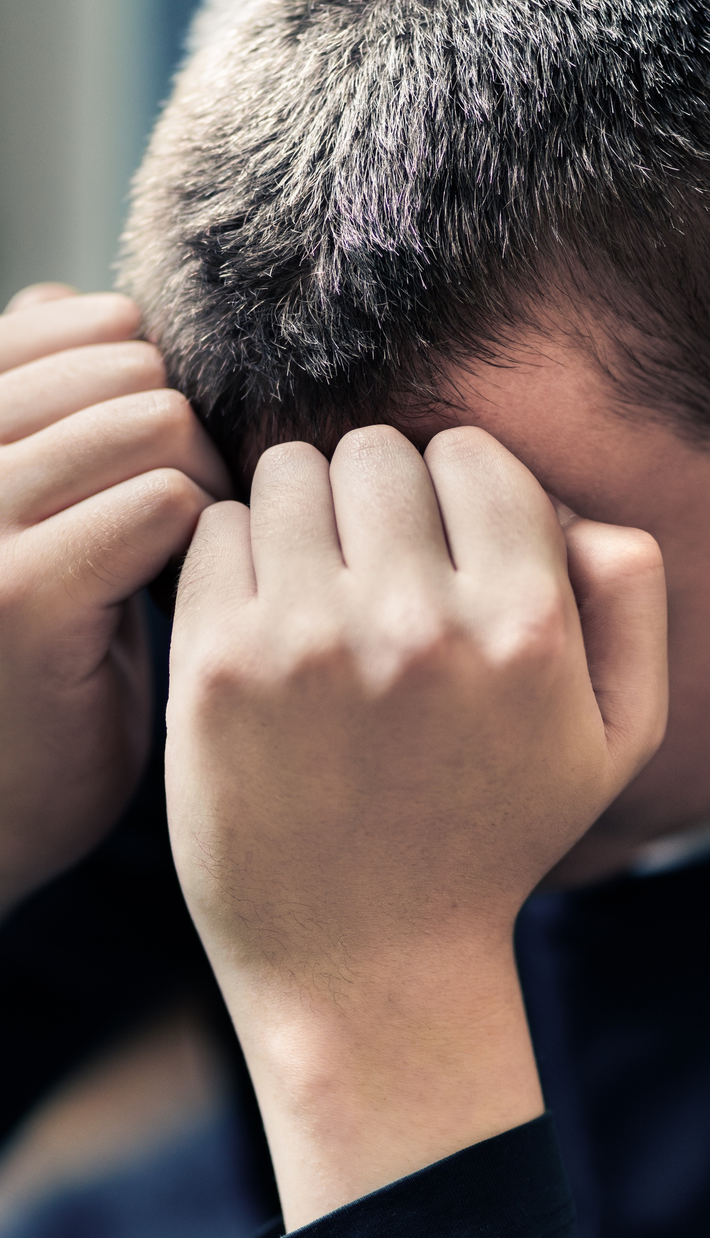

Why are we talking about harms against women and girls?
“Yes, and everything we’ll discuss can also be applied to male victims.
The reality is that most sexual harassment and related crimes are carried out by men and boys with women and girls as the victim.”
“Boys can be victims of harassment too!”

Slide 10

Why are we talking about harms against women and girls?
“Yes, and the boys and men who care can be part of the solution here.”
“It’s not all men!”
Reminder
This is one of several Not In Our Community presentations,
including ones that focus on protecting boys.

Slide 11
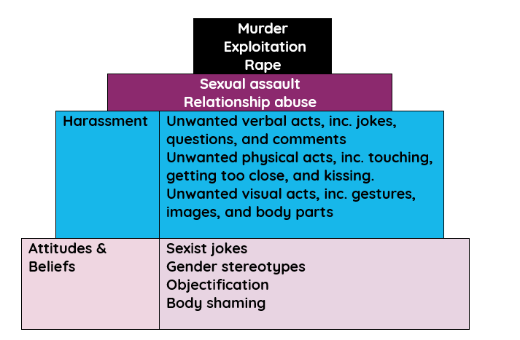
Pyramid of Violence Against
Women & Girls
“There’s a big difference between making a joke about a woman and murdering her!”
“Yes, and if we allow sexist attitudes and beliefs to go unchallenged it could lead to harassment.
If harassment becomes “normalised” we will get more assault and abuse.
If we don’t put a stop to assault and abuse, terrible things like murder will happen.”

Slide 12
Pyramid of Violence Against Women & Girls
It is on all of us to do something about the things lower in the pyramid to try to prevent some of the terrible things at the top from happening.
Not all boys and men are the problem; however, all boys and men can be part of the solution.

Slide 13



What can we do to safely challenge sexist attitudes and beliefs?
In school example
From White Ribbon’s “Change the Story” resource.
(Slightly adapted.)
Activity: Students can take turns reading this aloud
Margaret is a 14-year-old girl.
Margaret is a friendly and intelligent young person, who is quite shy and prefers to hang out with her close friends at school.
Darren is a boy in the year above Margaret and first noticed her when they went on a cross-year school trip.

Slide 14








On the trip, Darren told Margaret, in front of a group of students, that he and his friends had decided that Margaret has “the weirdest body in the school” and made jokes about what she’d look like undressed.
Margaret has continued to receive similar comments following the trip, at school.
Darren has even stated that he has ‘found a picture of Margaret’ that he plans to use for a deepfake sexual image to send around school.
Click to continue the story →

Slide 15




Margaret has started dreading going to school and keeps trying to get days off sick.
Things turned physical last week when Darren slapped Margaret’s bum and made a derogatory comment about her in the corridor before class.
Other students including Margaret’s friends saw this incident.
Margaret feels too embarrassed to go to a teacher or her parents to tell them about what has been happening.
She thinks that she will make the situation worse if she talks to anyone, and fears that no-one will believe her as Darren is seen as one of the high achieving, popular students.

Slide 16




How has Darren sexually harassed Margaret?
Call it out!
Verbal
he made comments and jokes about her body.
HANDS UP
Physical
he slapped her bum.
Visual
he has a photo of her and may have made it sexual.
Click for hints

Slide 17




How did this situation make you feel?
Sad
Shocked
Angry
Concerned
How do you feel about Darren?
How do you feel about Margaret?

Slide 18
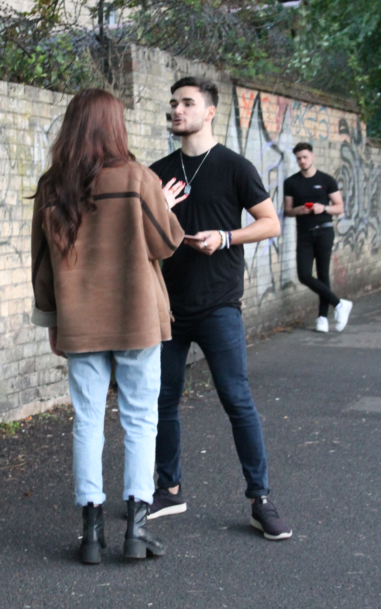

How would you feel as a bystander?
Bystander = a person who is present at an event or incident but does not take part.
How would you feel if you were Margaret’s friend?
How would you feel if you were Darren’s friend?
How would you feel if you didn’t know Margaret or Darren but were aware of what was happening?
What could you do if you were a bystander?
TIPS ON THE
NEXT SLIDE
18

Slide 19
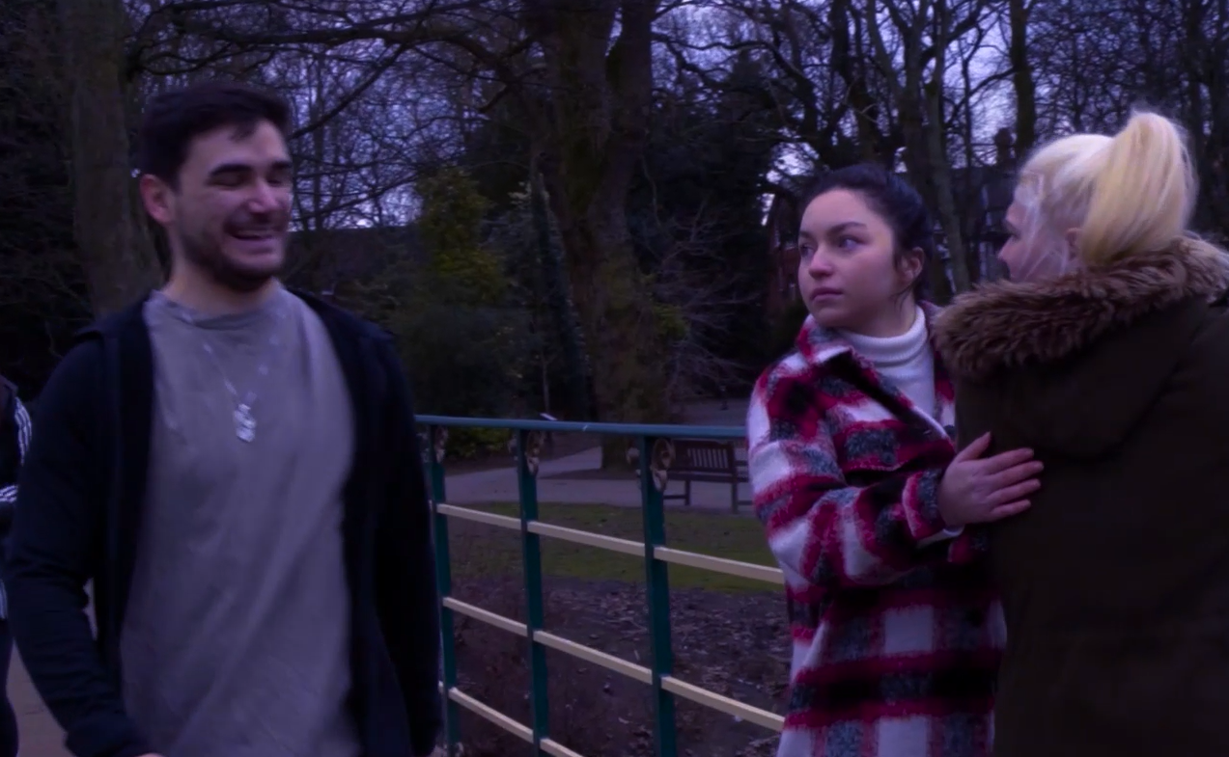
Take C.A.R.E
Call it out!
Ask authorities
Remain present!
Enlist others!
If you feel safe, call out the behaviour by asking if the person needs help or telling the perpetrator: “That’s not OK.” You can also ‘call it in’ later to see if the person is alright or let the wrongdoer know their behaviour was wrong.
Tell a teacher or another adult what happened. If you or others are in danger and no help is around, call 999.
If it's safe, stay at the scene—having people around can help. If you feel confident, create a distraction, like asking for the time.
If you see harassment, get others to help—safety in numbers makes it harder for the perpetrator to continue.

Slide 20
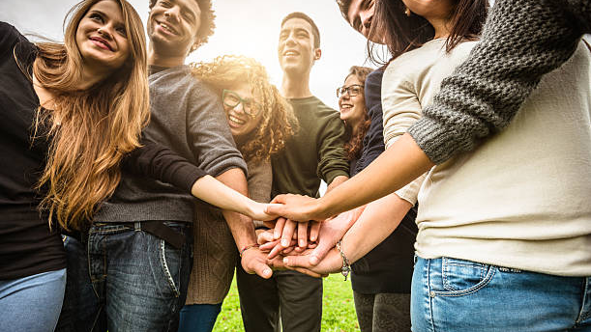
Students can ‘Take C.A.R.E’ of each other with these bystander strategies to aid in peer support and allyship in situations of harassment and abuse.
If you feel comfortable and safe to do so, ‘call out’ the behaviour at the time it is happening by either asking directly if the person being harassed needs help, or by telling the perpetrator ‘I’m not OK with that.’

Slide 21


Let’s see what happened next in Margaret’s story…
An older student saw what Darren did to Margaret and approached them. He asked if Margaret needed help and told Darren that his behaviour was not OK. Darren looked embarrassed and made a quick exit to class.
The older student told a teacher what he had seen shortly afterwards.
Click to continue the story →

Slide 22
One of Darren’s friends later heard about the incident and felt uncomfortable.
Darren’s friend spoke to his other friends, explaining he wasn’t OK with Darren’s recent behaviour towards Margaret.
The other friends agreed but expressed that they felt uncomfortable saying something at the time.
They decided together that they would tell Darren what they thought of his behaviour and that if it continued, they wouldn’t hang around with him anymore as they didn’t want to be associated with it.
Continue →

Slide 23


Several students who had been in the corridor also reported the incident to different teachers.
Some of the students sought out Margaret later in the day to check if she was OK.
Margaret felt better that other students were willing to help her and cared about the impact the behaviour was having on her. She felt validated that people thought the behaviour was wrong.
Margaret also felt empowered to report Darren’s behaviour towards her now she knew other students supported her.
Darren faced the punishment from school and socially because of what he had done.

Slide 24
Out of school examples
Challenge
:
Who would you speak to?
What would you say?
If you were/are male, how could you respond to
be an ally to girls and women in situations like these,
for example:
A)
A male friend in a group chat body shames your female friend for wearing a low-cut top.
A male friend jokes that women should be in the kitchen, not playing football.
A male friend shares an upskirt he recorded of a girl.
B)
Hints on next slide →
C)

Slide 25
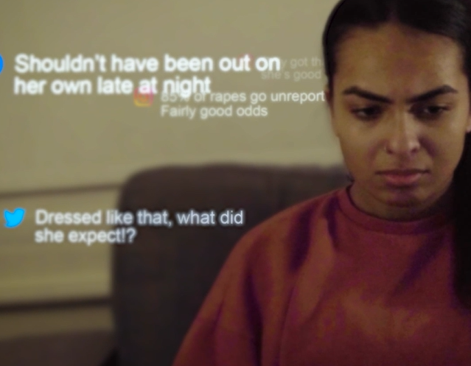
A male friend body shames your female friend for wearing a low-cut top.
A)
Click for hints
Calling them out in a group shows that it is not acceptable.
Alternatively, if it is a good friend, you might want to message them separately so as not to embarrass them.
You can do this in non-aggressive ways:
“She’s our friend, you shouldn’t comment on her like that.”
“Why is it anything to do with you? You sound really creepy commenting.”

Slide 26
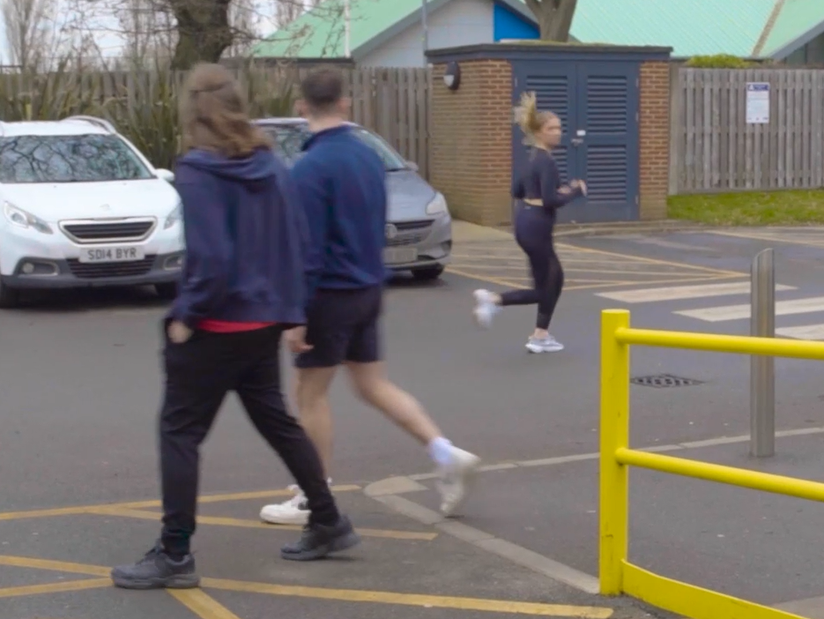
B)
A male friend jokes that women should be in the kitchen, not playing football, at your weekly kickabout.
Click for hints
Call it out either in the group, or individually if you think that is a better option, e.g.:
“Grow up and stop living in the past, mate.”
“Women’s football gets better every year.”
And if you feel you need to stay friendly, you can add a light joke, such as:
“We’re all growing up mate, make sure you keep up!”
“They’re all miles better players than you, anyway!”

Slide 27

Doing the right thing to do is not always easy…
Calling it out is being a good ally, but if you don’t feel confident calling it out or are worried about what will happen to you, then you can just say nothing.
Joining in or going along with an emoji is sexist behaviour and makes you part of the problem, rather than the solution.
27
Click to continue with the challenge →

Slide 28
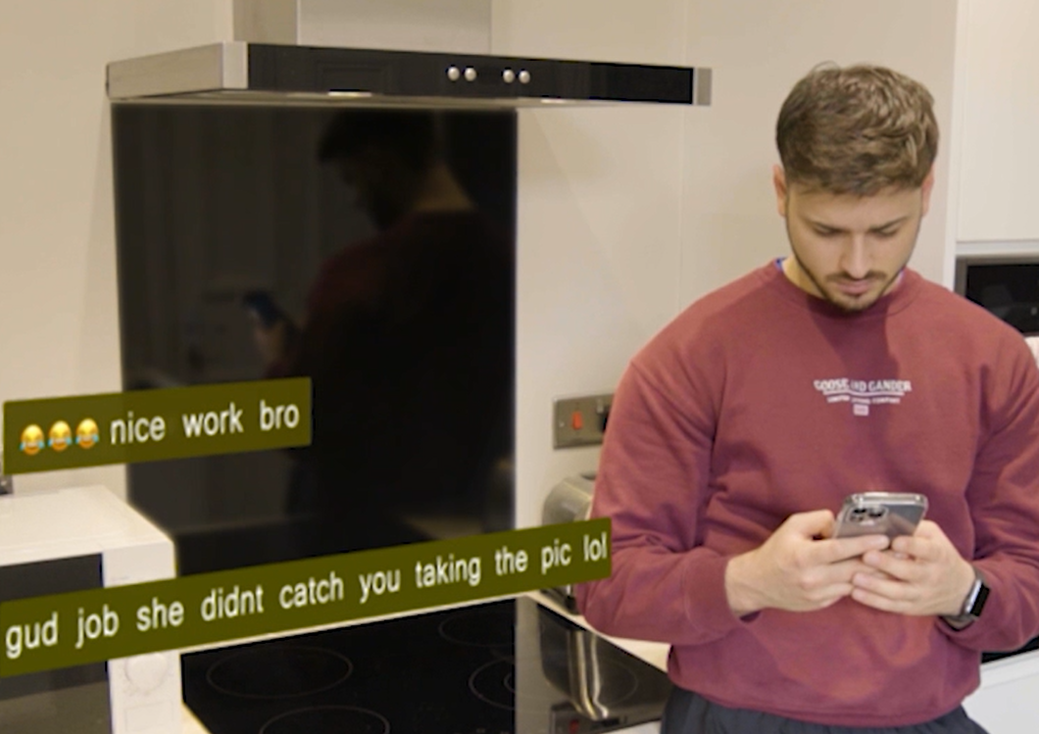
A male friend shares an upskirt he photographed of a girl.
C)
Click for hints
This is a crime and serious situation.
If you are worried that this person is a danger to girls and women, you should speak with a trusted adult.
If it’s a mate who doesn’t realise how serious and wrong this is, you might want to speak or message them individually.
Let them know that it is illegal and they’d get into lots of trouble if anyone found out what they were doing.
If the image is sexual you need to delete it as otherwise you could get in trouble too.
Note: even if an image is not real, such as a deepfake sexual image, this is against the law.

Slide 29
What do you think about calling out sexism?
Group discussion
HANDS UP
How could you feel if you call out sexism?
How could you feel if you don’t?
What could go wrong?
What good could it do?
29

Slide 30

Getting help – end of part 1
This is part one of this session.
In part two we look in more detail at ways of dealing with sexual harassment outside of school.
Speak to an adult such as a parent, teacher or another adult you trust about what has happened, and what should be done to stop it from continuing.
Some schools have people appointed to anti-bullying roles. If your school has one, that person could be a great person to seek guidance from.
If you are being sexually harassed by an adult, it is extremely important that you let another adult know right away.
30

Slide 31
Sexual harassment outside of school
Where possible find someone in a position of authority, such as someone working, security or a police officer.
If a situation poses immediate danger call 999.
For less urgent and anonymous advice
Childline: call 0800 1111, or sign up so you can
online chat (9am - midnight)
Other reporting options on the next slide →
31

Slide 32


Reporting sexual harassment
Strut Safe - https://strutsafe.org
Hollie Guard – personal safety app (Free
app option) https://hollieguard.com
If you believe someone is going to act in a way to cause immediate harm to others, such as carry out an attack call 999.

