Slide 1

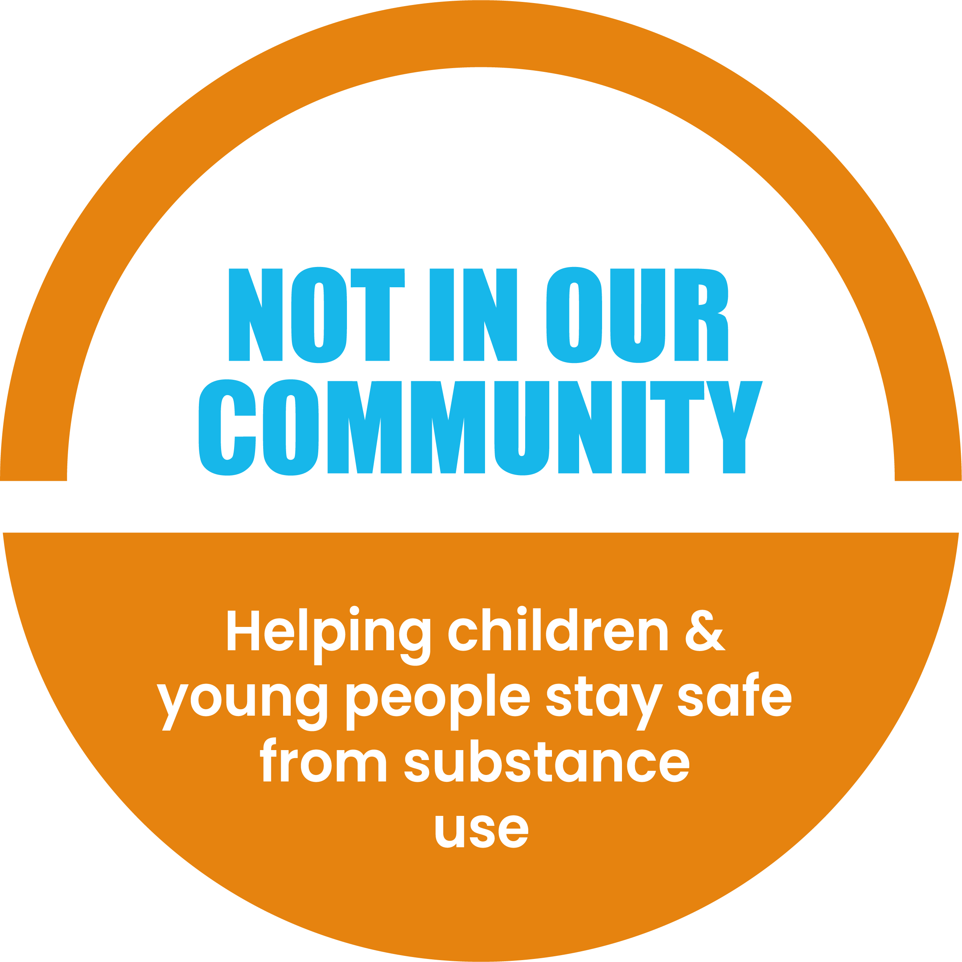



This is a NEW
Not In Our Community resource being tested
Feedback on what we can change or improve is very welcome.
Please email mail@notinourcommunity.org with comments or to a request a call. Thank you for your support.

Slide 2
Introduction to Substance Use
Part 1
Recommended for:
Key stage 3, 4 and above

Slide 3

Learning Outcomes
Understand types and effects of substances.
Explore the risks of substance use.
Ways of protecting yourself and your friends.
How to get help.

Slide 4
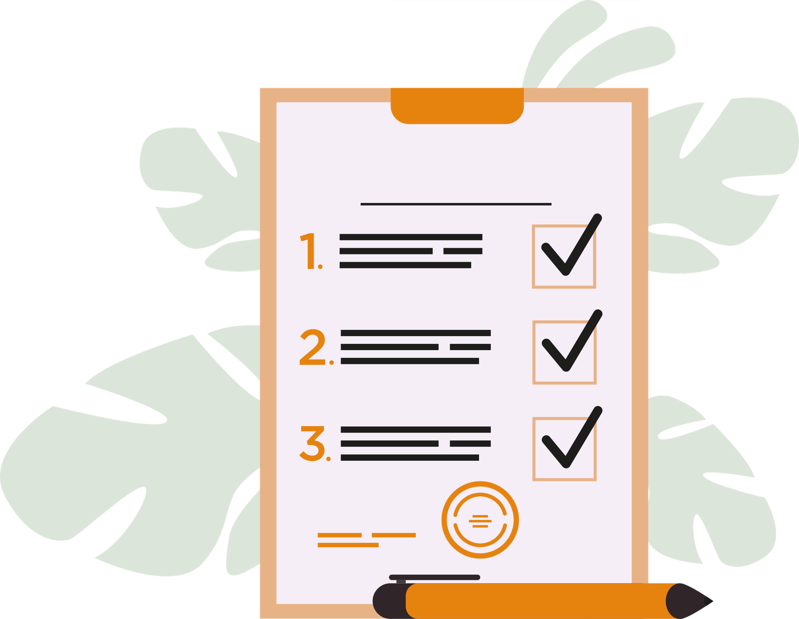
Trigger warning!
Content on addiction, substance misuse and criminal activity.
If any content causes
distress, a safe place to
go is…
Session Expectations
No personal questions or comments.
Listen to each other.
Treat each other with respect, even if you disagree.
Engage with and try to enjoy the learning.
RULES

Slide 5


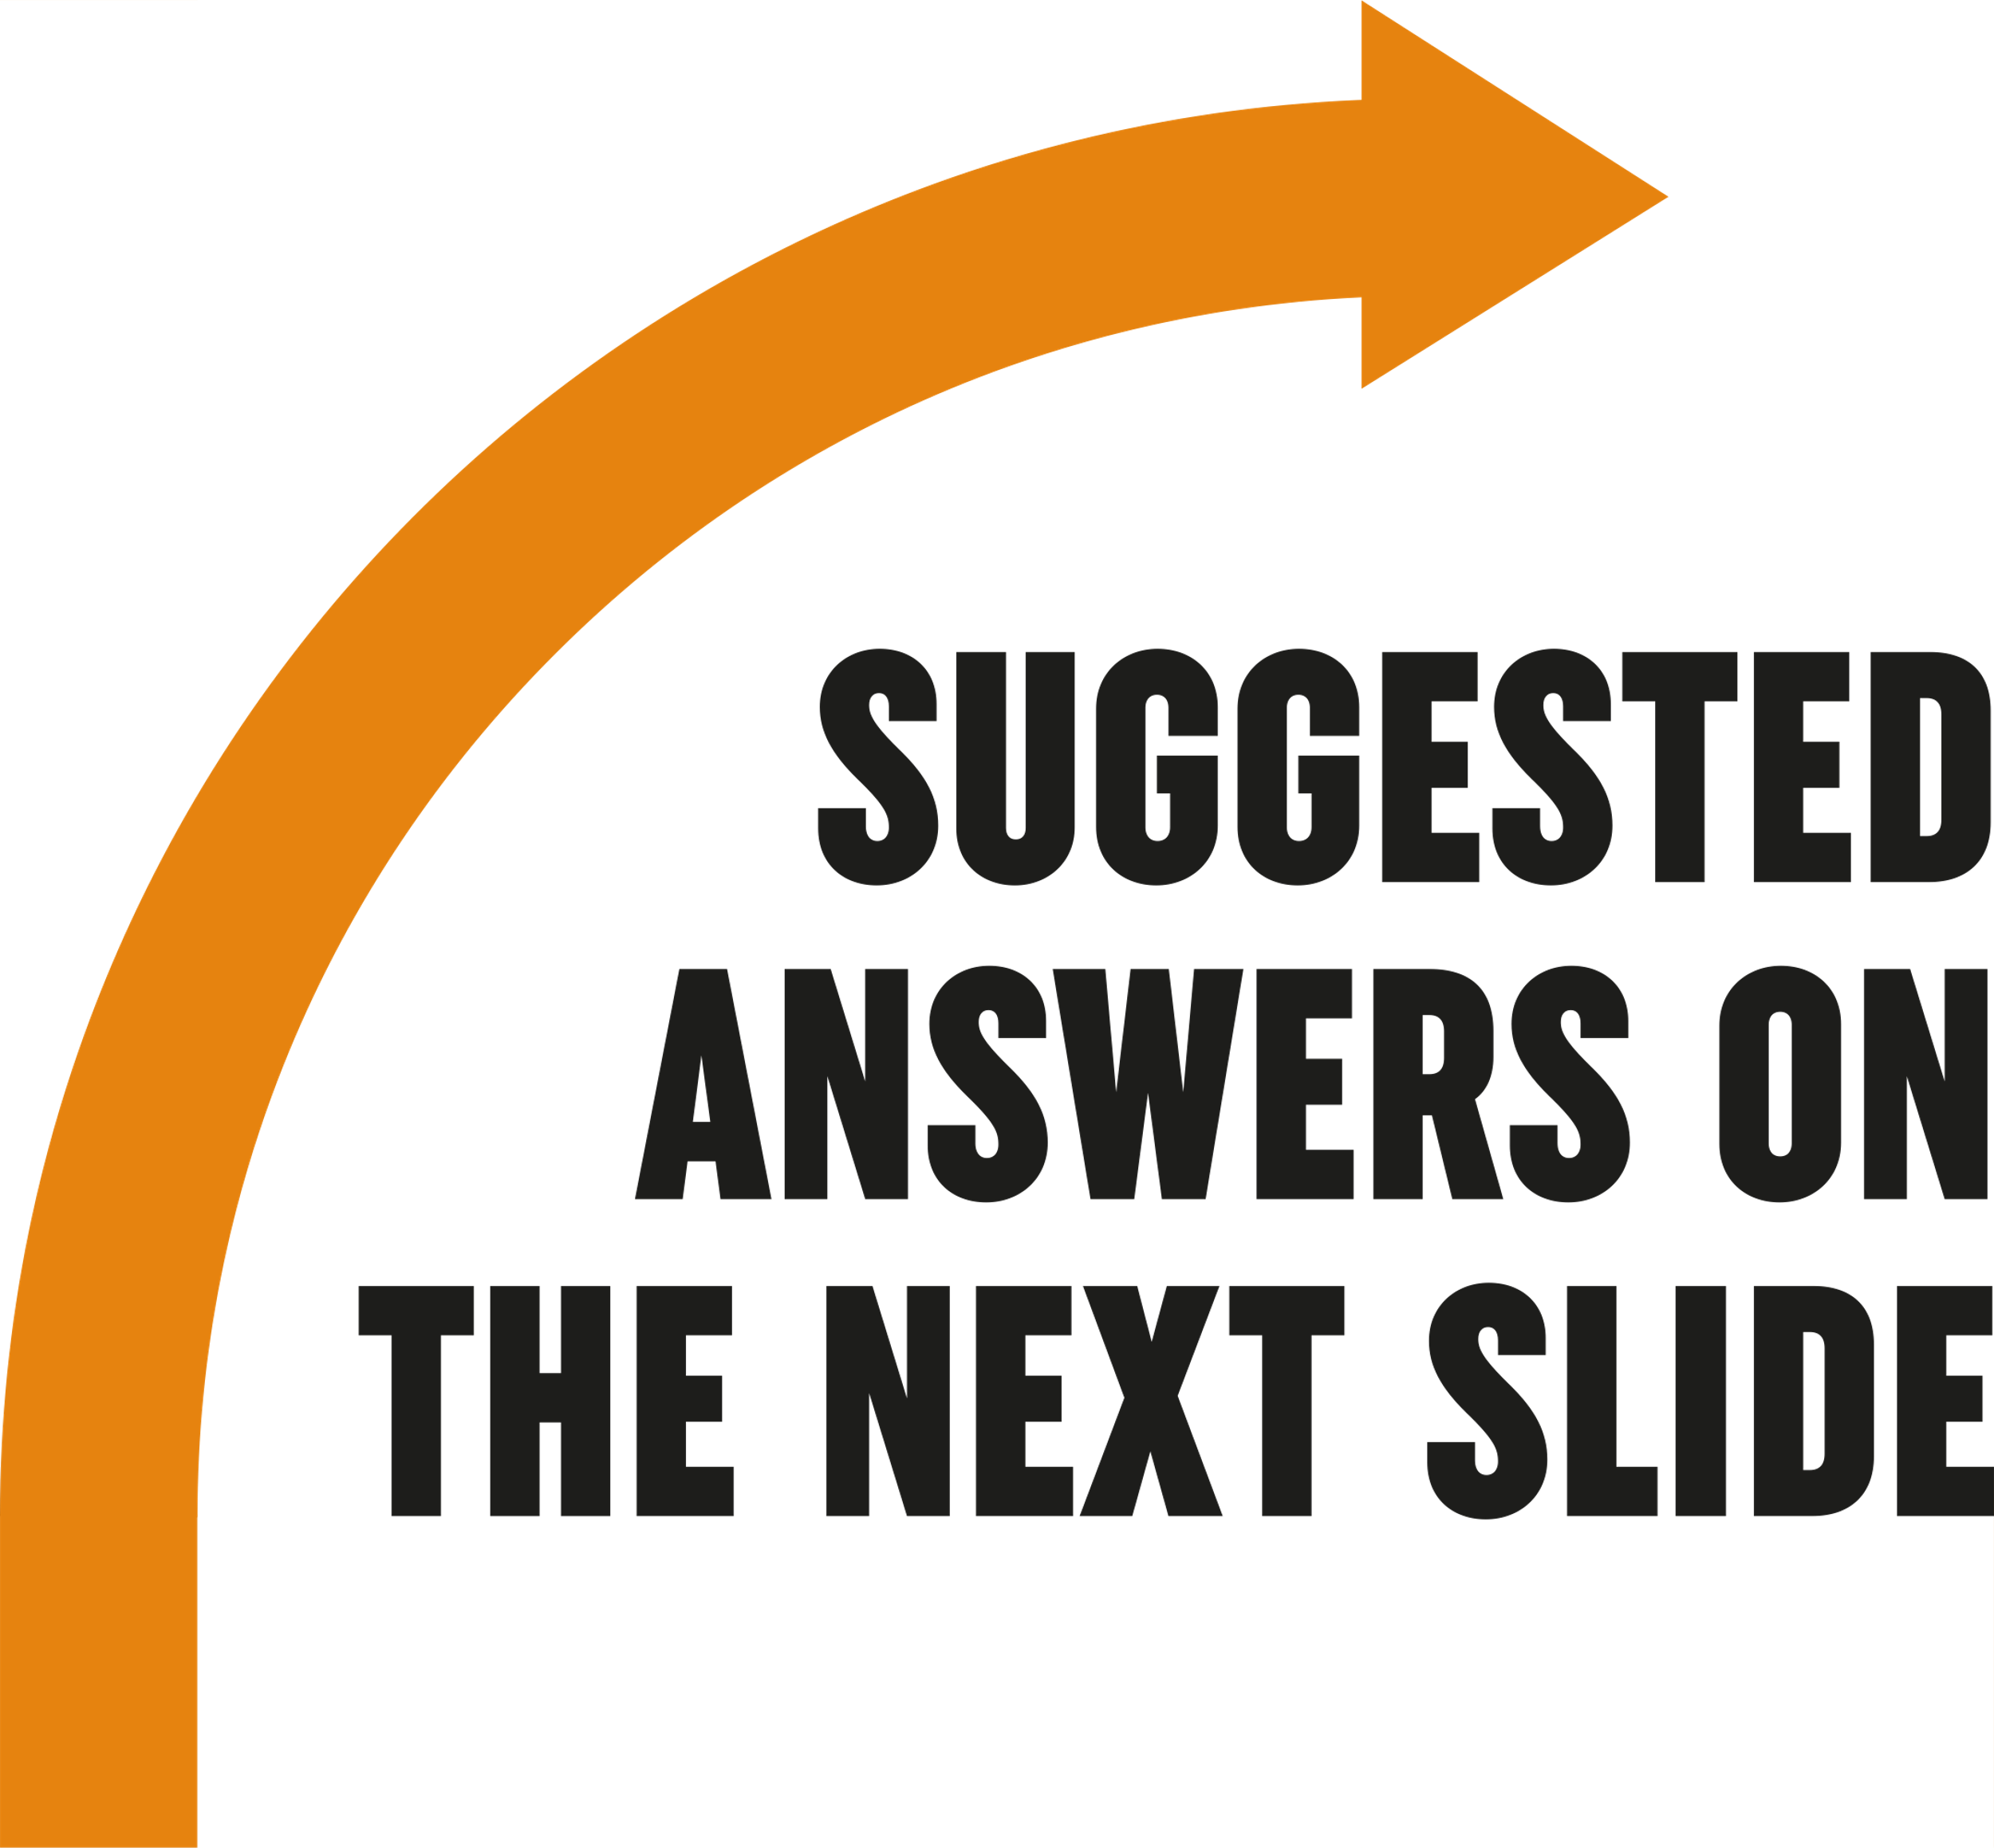
Challenge:
What do you think are the most common substances young people use?

Slide 6

Which substances are commonly used in the UK?
Most common
Less common
Alcohol
Cannabis (weed)
Cocaine
Nitrous Oxide (laughing gas)
Ecstasy
Hallucinogens
Ketamine
Substances come in different types and groups, and they don’t affect everyone in the same way. Let’s look at the drug wheel on the next slide →

Slide 7
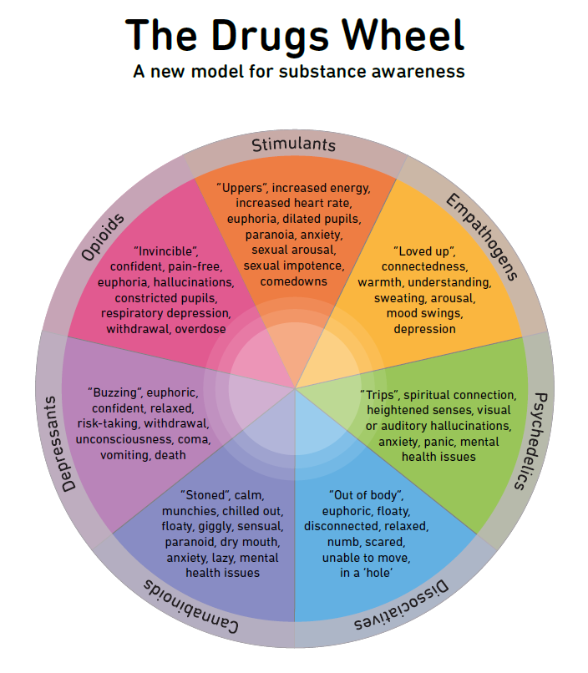
This is a drug wheel showing how substances fit into categories and what effect they have on our mind and body.
Hint: most of these drugs are illegal and can get you into trouble with the law if you are caught carrying, possessing or selling these.

Slide 8
Activity time: Myth or Fact?
Myth: Move right Fact: Move left
Let’s play a quick game where you move to different sides of the room based upon whether you think the statements are myths or facts.
It can affect mental health and memory
MYTH
“Cannabis is completely safe to use.”
It can still harm your lungs and increase addiction risk
MYTH
“Vaping is harmless.”
It makes your brain depends on it to feel good
“You can get addicted to alcohol.”
FACT

Slide 9

Social media & drug dealing
Dealers advertise on platforms like Snapchat, WhatsApp, and Telegram because messages disappear, and accounts are easy to fake.
Why is this dangerous?
You never really know who you’re talking to or what you’re buying. Drugs sold this way can be mixed with dangerous stuff, and people selling them often don’t care about your safety.
Stay safe
Be cautious of suspicious accounts or messages offering drugs.
Never engage in illegal activities or share personal information with unknown contacts.
Potential legal consequences and safety risks of buying drugs online.
Click for tips

Slide 10

Ketamine – have you heard of it?
Drug dealers use social media to sell drugs.
One substance of increasing concern, particularly among students, is ketamine.
Why do you think this is the case?
HANDS UP!
Click for answers next slide →

Slide 11
Ketamine – a growing concern
A recent study found that more young people are now getting treatment for Ketamine use than for Cocaine.
Why?
Ketamine is cheaper than Cocaine, but the risks are huge. Long-term use can lead to serious health problems like ‘bladder rot’ (yes, it is as bad as it sounds), kidney damage, and liver issues.
It’s often seen as a party drug; it makes you feel out of touch with reality and causes hallucinations in some cases, but the long-term effects can be life-changing — and not in a good way.
Given these dangers, why do people choose to use substances like ketamine or any other drug? →

Slide 12
Why do people use substances?
Click for suggestions
Why do you think people your age might try substances?
Boredom
Curiosity
To feel good or escape stress
Influence from social media or family members
Easy access
To fit in or feel ‘grown up’

Slide 13
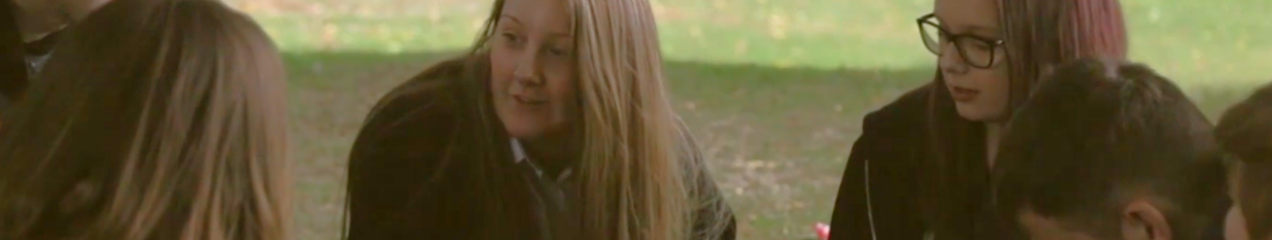




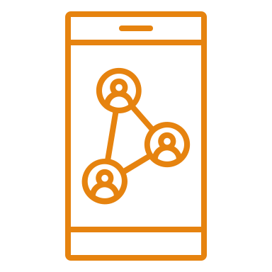

Why do people use substances?
Click for suggestions
In which type of situations / environments could substances be seen as “normal” to take?
In family homes
Media and pop culture (in songs you listen to)
In friendship groups
Parties
Social media and influence culture
Stressful or High-Pressure Situations

Slide 14
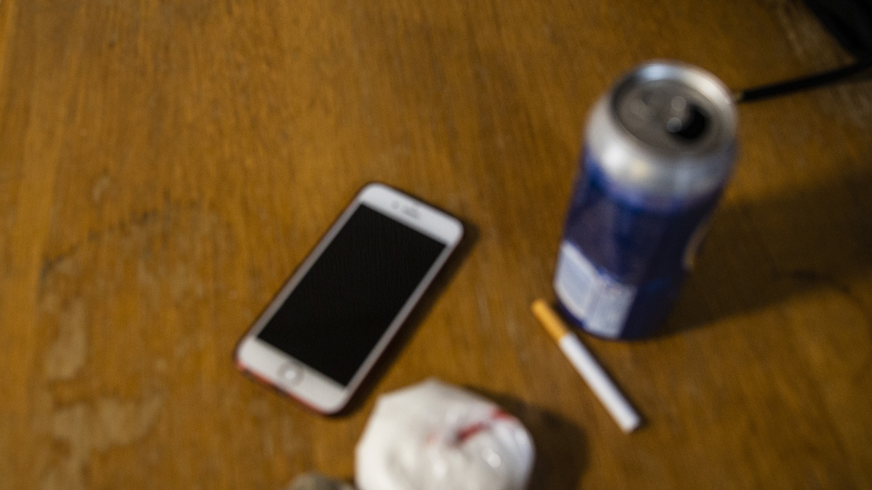

Understanding the root causes
Escaping stress
Hiding emotional pain
No better options
"I didn’t know how else to cope with everything I was feeling. Without healthy ways to deal with it, I ended up turning to alcohol."
“I started using because things at home were so stressful, and school felt like too much.”
“I used drugs and alcohol to block out my feelings. It was like a quick escape from sadness and anger.”

Slide 15
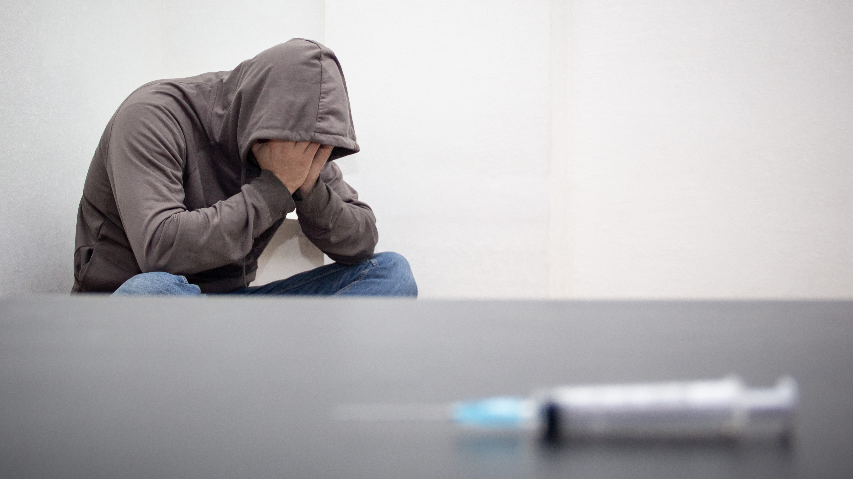
Understanding the root causes
What if it just feels good?
Brain chemistry
“At first, it was just fun and made me feel good. But after a while, I started needing more to feel the same way. It’s like you’re chasing that first feeling, but it gets harder to reach”
“With ADHD, everything just felt way too much, and using stuff helped me feel better fast. I didn’t get how much it could mess me up and make me more likely to get addicted.”
Let’s have a look at an example →

Slide 16
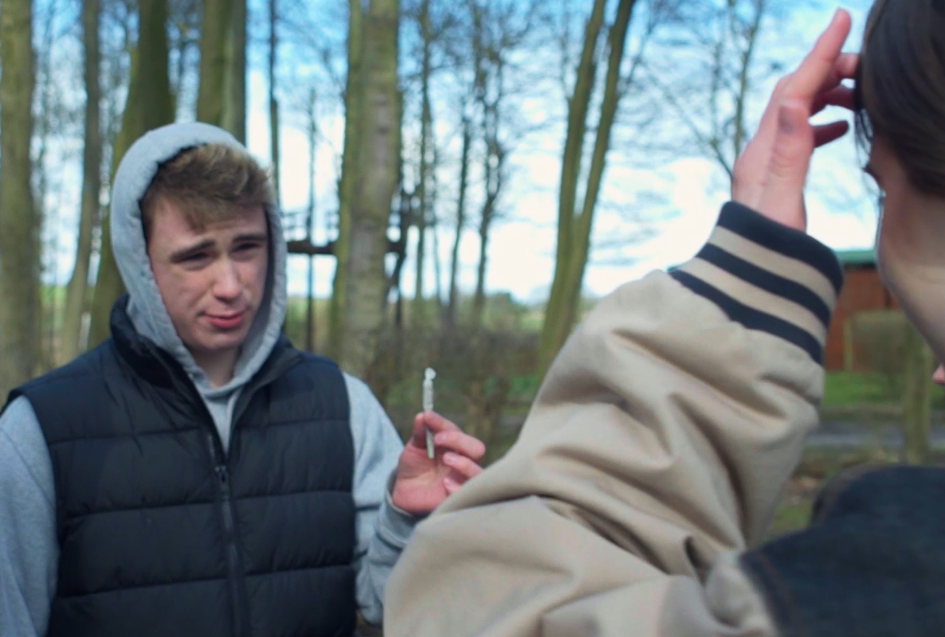
The effects of cannabis
Many people say smoking cannabis makes them feel good, but have you thought about how it can affect your body and mind?
Before we watch the video on the next slide, what do you already know about cannabis?
If you're having trouble accessing the video, here's a direct link:
The Effects of Weed on Teenage Brains
Click for Video

Slide 17
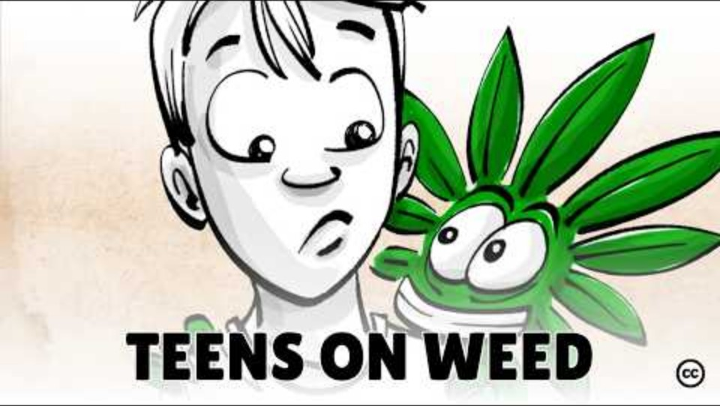

Slide 18
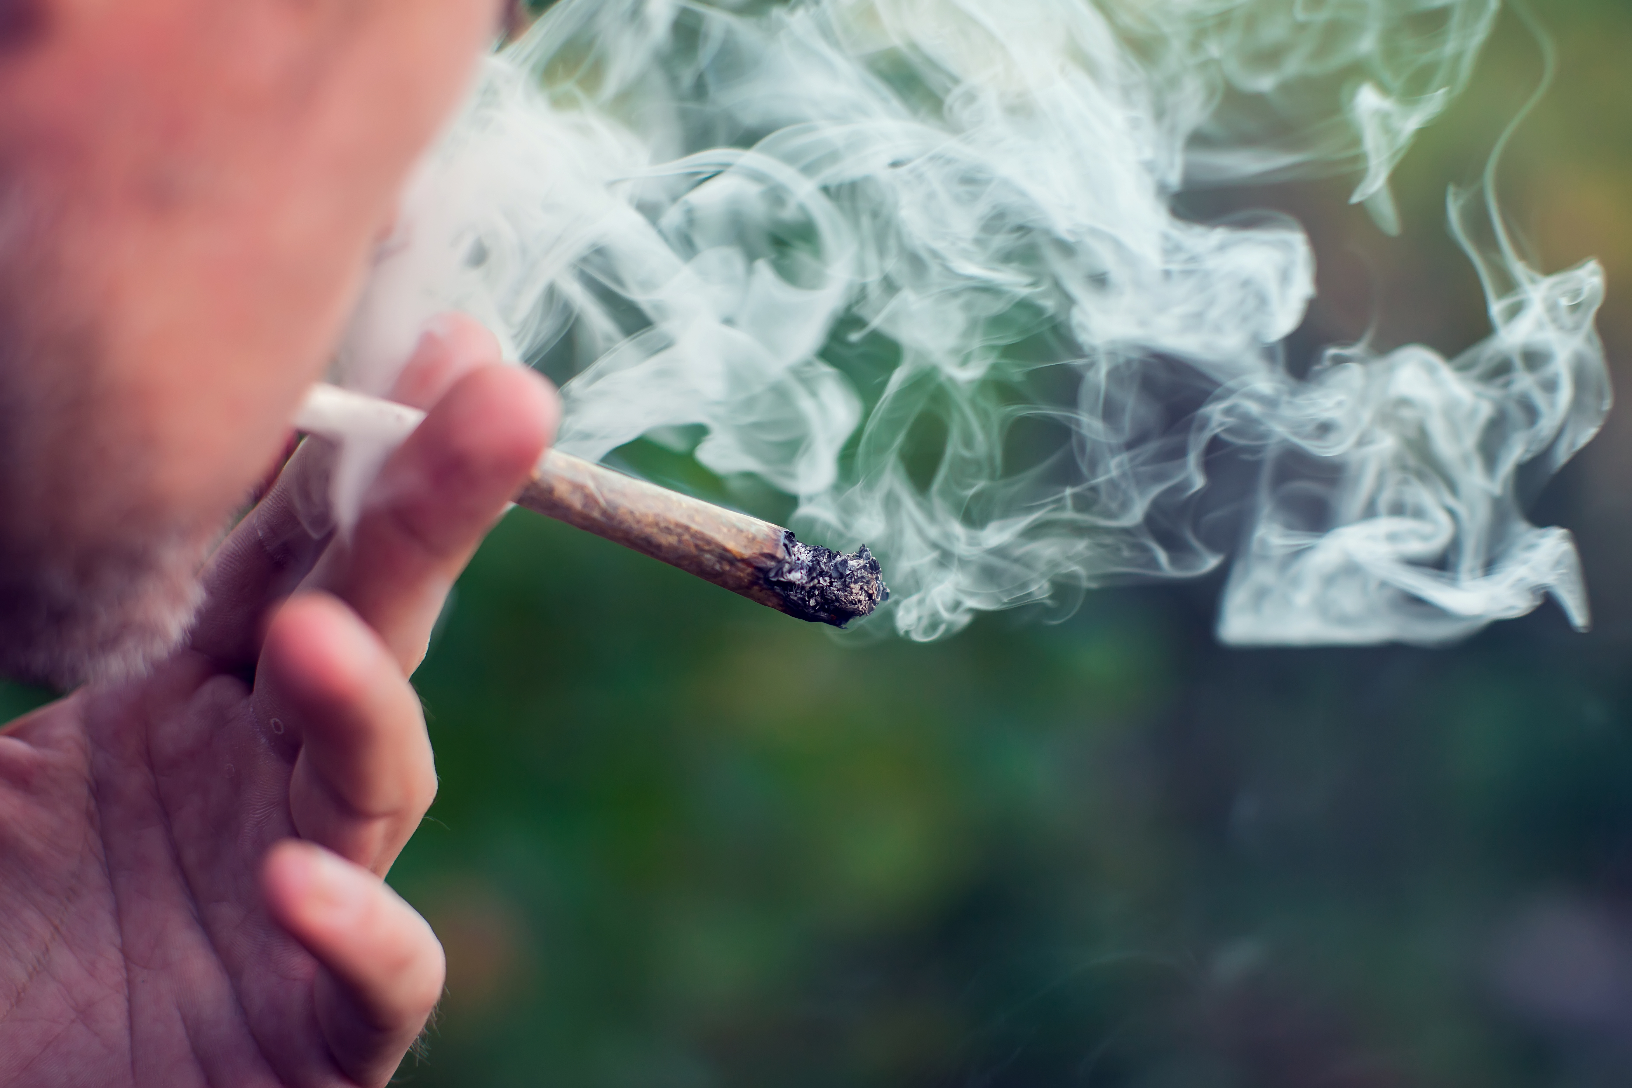
Group discussion
Has this video changed your view on cannabis use?
If so, how?

Slide 19

Brain development
Click for answers
Decision making
Managing emotions
Handling stress
Here’s the deal: your brain’s still in upgrade mode until you’re about 25.
Using substances like weed now can have an impact with how it develops!
Long-Term Risks:
Lower self-control
Difficulty thinking clearly
Emotional problems
Can you guess how it would have an effect?
Now that we've explored cannabis, let's look at vaping and alcohol →

Slide 20
Is vaping a substance?
Yes
Most vape liquids contain nicotine so yes, they are.
They also contain propylene glycol and flavourings which can be toxic when heated, resulting in irritation of your lungs.
Illegal vapes or vapes that have been tampered with can include other harmful and addictive substances.
Next slide for video on vaping →
If you're having trouble accessing the video, here's a direct link:
Vaping: The Facts

Slide 21


Slide 22
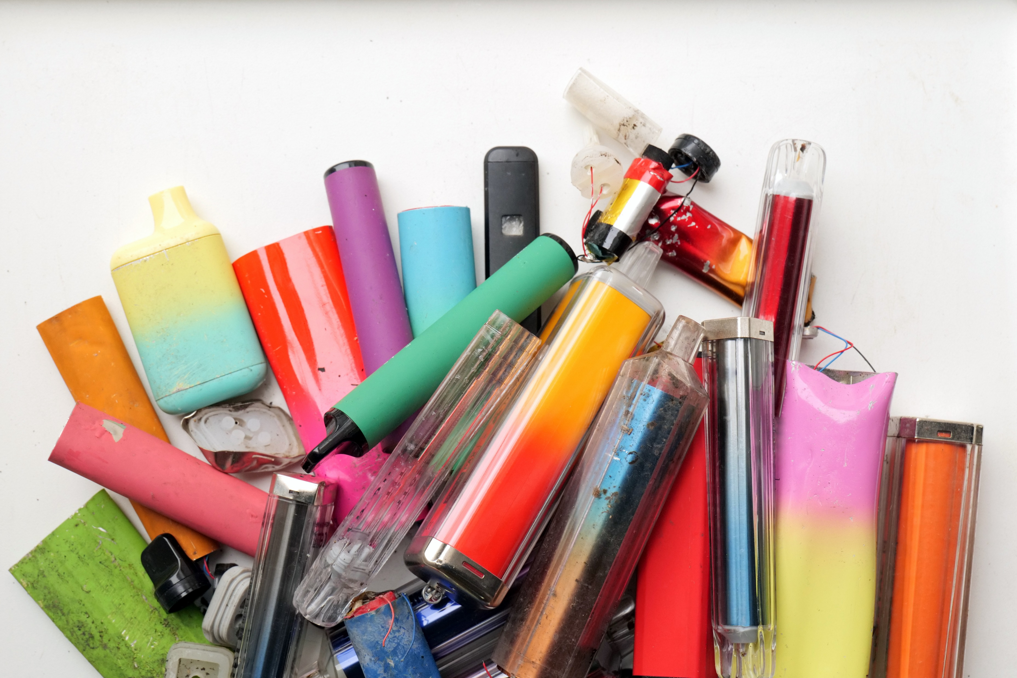

Vapes aren’t always what you think
Not all vapes are just nicotine and flavouring – some contain drugs without you even knowing!
What are the risks?
Spice and other drugs – some vapes have been laced with spice (a dangerous synthetic drug). This can cause panic attacks, hallucinations, and even make people pass out.
Unknown chemicals – fake vapes can contain anything, including dangerous drugs like fentanyl which can be deadly.
Sold on snapchat and other apps – dealers sell dodgy vapes on social media, making them seem safe or ‘normal’ but you have no clue what’s actually in them.
Click for tips on how to stay safe
22

Slide 23
Tips on staying safe
What would you do if someone handed you a vape and you weren't sure what was in it?
Don’t share vapes
Even if a mate offers, you don’t know what’s inside.
Avoid buying vapes on social media
If it’s not from a proper shop, it could be fake.
Listen to your body
If a vape makes you feel weird, sick or dizzy, tell someone straight away.

Slide 24
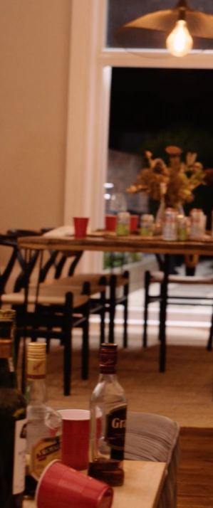
Alcohol and the teenage brain
Like other substances, drinking alcohol can have an impact on the development of your brain in the early years. Let’s find out how:
Memory and learning - alcohol slows brain function, making it harder to focus/remember.
Mood swings - can worsen mood swings and increase anxiety or depression.
Risk taking - lower inhibitions, leading to risky behaviours like fighting.
Brain development - it can delay brain maturity, affects decisions and problem solving.
Extra brain effort!! - simple tasks feel harder.
How do you think drinking alcohol as a teen could affect your future?
24

Slide 25
Everyone is different
Mood
If you’re feeling sad, stressed, or anxious, substances might make it worse. If you’re happy, they might feel different.
Place
Taking something in a safe, calm place is different from being somewhere busy or chaotic.
People
Being with supportive people can help, but being with those who pressure you can make things risky.
As we previously mentioned, substances can affect everyone differently.
How do you think substances might affect someone differently if they’re feeling stressed vs happy?
Does it matter who you’re with or where you are?
The risks are always unpredictable. It’s not just about what you take but about how, where, and why you take it.
Click for suggestions →

Slide 26



Everyone is different
Plot twist:
Here's the tricky part: the line between these stages can be blurry. It's not always obvious when you've crossed from one to another.
Remember:
Everyone's path is different. Not everyone who experiments will become dependent, but it's a risk to be aware of.
Here’s a quick story about two teens and how smoking weed turned out totally different for each of them →

Slide 27
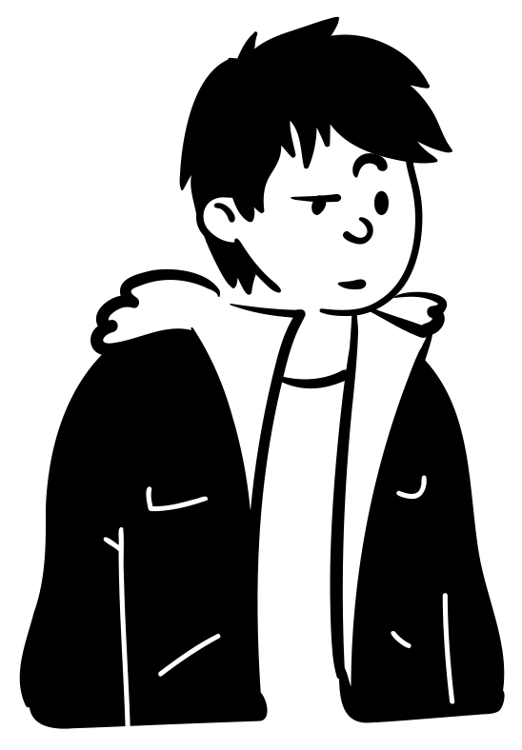
A Tale of two teens: Jake and Mia
Jake's Story:
Jake, 15, tries weed at a kickabout with his friends. It makes the conversations and football feel more fun.
Over time, he starts using it more often. He stops attending the kickabouts, choosing to stay home and smoke weed instead.
Now, Jake relies on weed to help him sleep and get through the day. It's become a habit that's affecting his routine and interests.

Slide 28

Mia's Story:
Mia, 16, starts drinking at parties with friends, just for fun.
Over time, she drinks more often – at gatherings, in the park, even sneaking drinks at school.
She starts relying on alcohol to feel confident and escape stress.
One night, after drinking too much, she makes a risky choice getting into a car with a drunk friend, she begins to wonder if her drinking is becoming a habit.
A Tale of two teens: Jake and Mia

Slide 29
Reflect on how their choices shaped their lives:
What might have they done differently?
What advice could you give Jake and Mia if they were your friends?

Slide 30

END OF PART ONE
Let’s recap our learning: part one
Types of Substances – A look at common substances used in the UK, like alcohol, cannabis, cocaine, nitrous oxide, ecstasy, and hallucinogens.
Why Do People Use? – Exploring reasons young people might try substances—curiosity, fitting in, stress, boredom, social media, or even family influence.
How It Affects Your Brain and Body – Substances can mess with brain development (especially under 25), memory, mental health, and decision-making. We broke down how things like cannabis, vaping, and alcohol impact the teenage brain.
The Risks – It’s not just about what you take, but how, where, and why. Substance use is unpredictable, and things can go wrong fast.
Real Stories – We followed Jake and Mia’s experiences to see how substance use can spiral differently for different people, showing how the line between trying it and relying on it isn’t always clear
In part 2 we will cover addiction, impact on mental health, legal consequences to substance use and ways to deal with peer pressure.

Slide 31
Options on help and advice
Talk to teachers / school nurses
Contact your GP or speak with a trusted adult like a family member
Report crime or anything suspicious anonymously on https://crimestoppers-uk.org/fearless
Childline – 08001111
Local services for young people:
ReFresh (Hull) – 01482 331059
WithYou (North East Lincolnshire) 01472 86890
WithYou (North Lincolnshire) 01724 857633
DELTA (North Lincolnshire) 01724-298528
Youth and Family Support (East Riding) – 01482 391700

