Slide 1

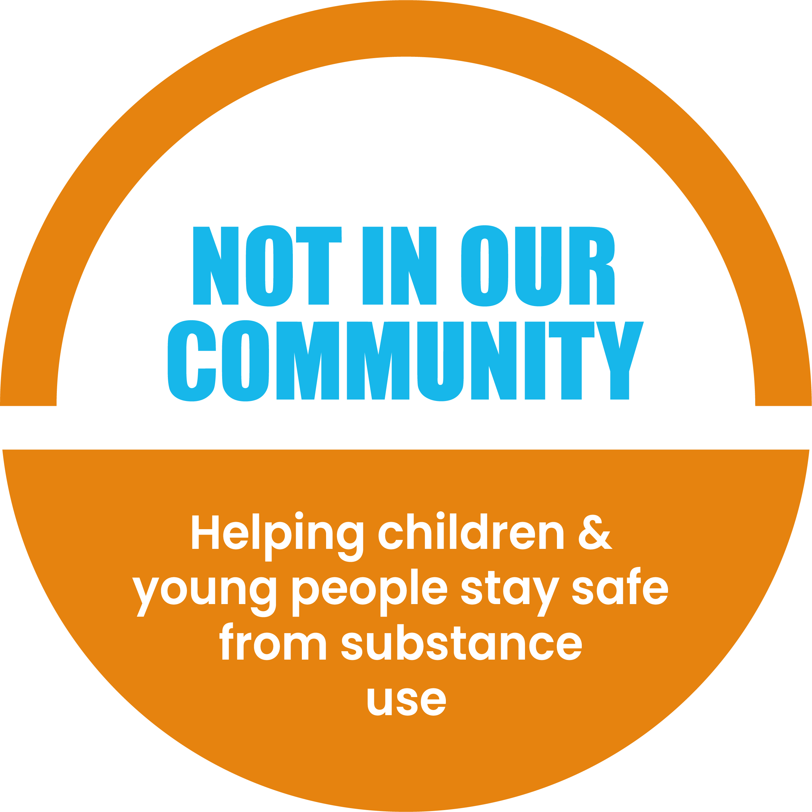



This is a NEW
Not In Our Community resource being tested
Feedback on what we can change or improve is very welcome.
Please email mail@notinourcommunity.org with comments or to a request a call.
Thank you for your support.

Slide 2
Introduction to Substance Use
Part 2
Recommended for:
Key stage 3, 4 and above

Slide 3

Learning
Outcomes
Understand types and effects of substances.
Explore risks of substance use.
Ways of protecting yourself and your friends.
How to get help.

Slide 4
Types of Substances
A look at common substances used in the UK, like alcohol, cannabis, cocaine, nitrous oxide, ecstasy, and hallucinogens.
Why Do People Use?
Exploring reasons young people might try substances—curiosity, fitting in, stress, boredom, social media, or even family influence.
How It Affects Your Brain and Body
Substances can affect your brain, memory, mental health, and decisions, especially if you're under 25. We looked at how cannabis, vaping, and alcohol can change the way your brain works.
The Risks
It's not just about what you take, it’s also how, where, and why. Substance use is unpredictable, and things can go wrong quickly. Jake and Mia’s stories showed how experimenting can turn into dependence without your realising.
Let’s Recap
Part 1
Let's recap Part 1

Slide 5

What is addiction?
Addiction is like having an intense, unhealthy relationship with a substance or behaviour where:
You can’t easily stop, even when you want to.
It starts causing problems in your life.
You keep doing it despite knowing its harmful.
You need more and more to feel the same effect.
It’s like being on a roller-coaster you can’t get off – it seems fun for now, and you know it might be dangerous, but something keeps pulling you back.
Imagine your brain getting stuck on something that makes you feel good, but then starts causing problems in your life
So how does this happen?
Let’s have a look at the slippery slope of substance use →

Slide 6
Impact on mental health
Click for examples
Substance use changes how your brain works, making it harder to enjoy everyday things like hobbies or friends.
Anxiety and depression
Psychosis
Stress
Substances can worsen this over time.
Some drugs can cause hallucinations or paranoia.
Using substances for an ‘escapism’ often creates more stress later.
Can you think of a time when you or someone you know used
something to cope with stress, and it didn't really help?

Slide 7
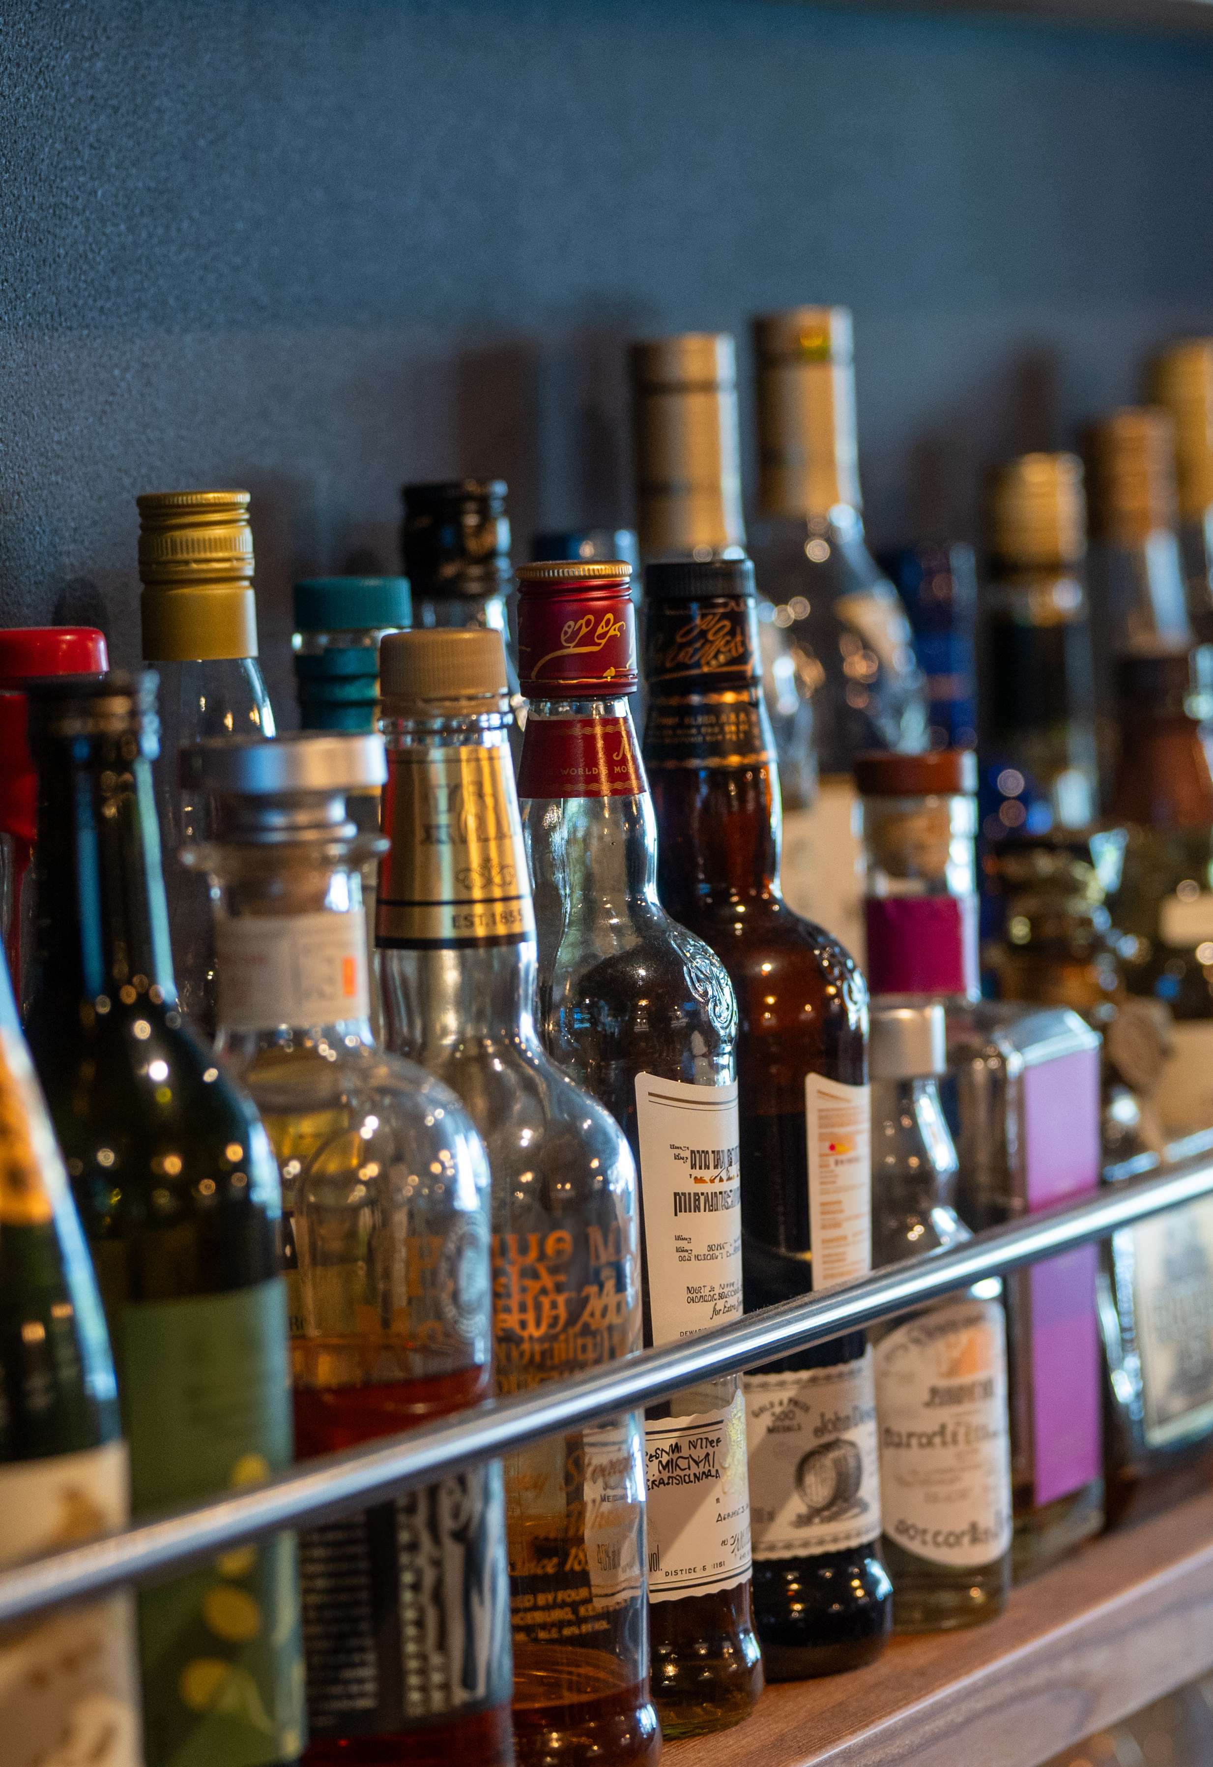

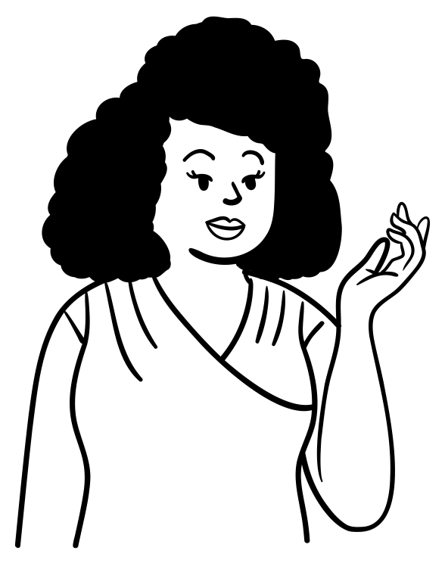
Escapism
Ever noticed adults saying:
'I need a drink after this week'
Some people use substances to cope with stress or feeling down because they can temporarily change how the brain feels.
This is called ‘self-medicating’, but it’s not a healthy fix and can cause bigger problems later.
This is a common form of stress management, using substances as an 'escape’.
In UK’s culture it is very much normalised to have a few drinks at the weekend to relax and unwind but for some it can have risks and consequences. It isn’t exactly a healthy long-term strategy for managing stress.

Slide 8


The bigger risks of substance use
Career Restrictions
If you have a drug offence, can you work in healthcare?
Yes
No
Answer: B
Some careers require a clean record, jobs like teaching and healthcare need a clean DBS check.
CLICK NEXT SLIDE FOR MORE

Slide 9

The bigger risks of substance use
Involvement in crime
If you’re caught with drugs, what could happen?
Warning from the police
Criminal record
Answer: A and B
Depends on the situation, using or buying substances connects you to illegal activity.

Slide 10

Group discussion
Picture this:
You're about to land your dream job, but your employer spots a drug related conviction on your record.
How do you think this might affect your chances?

Slide 11
What alternatives can you think of instead of using substances because you think they might ‘help you’ ?
Group discussion / call it out
Click for suggestions:
Talk to someone
Feeling off? Chat with a friend, family member or teacher. Just saying I’m having a bad day’ can help.
Learn to say no
Know your triggers. If offered something you don’t want, simply say ‘no thanks, I’m good.’
Try hobbies or sport and get good sleep
Find activities you enjoy – like football or drawing. A good night’s sleep can also help you feel better.
Set small goals
Start with easy wins, like a 10-minute walk each day. It’ll help clear your head.
Practice mindfulness
Take a few minutes to focus on your breath or listen to relaxing music. It helps calm your mind.
Get help from a professional
If you’re struggling, talk to a counsellor or GP. They can guide you and offer support.

Slide 12
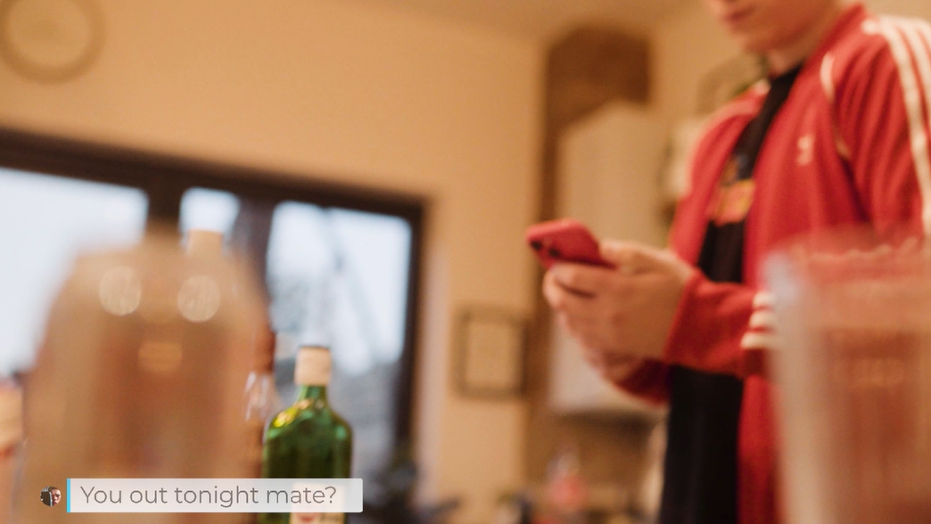
Feeling pressured to say yes to doing drugs?
Here are 5 tips to help you
→

Slide 13
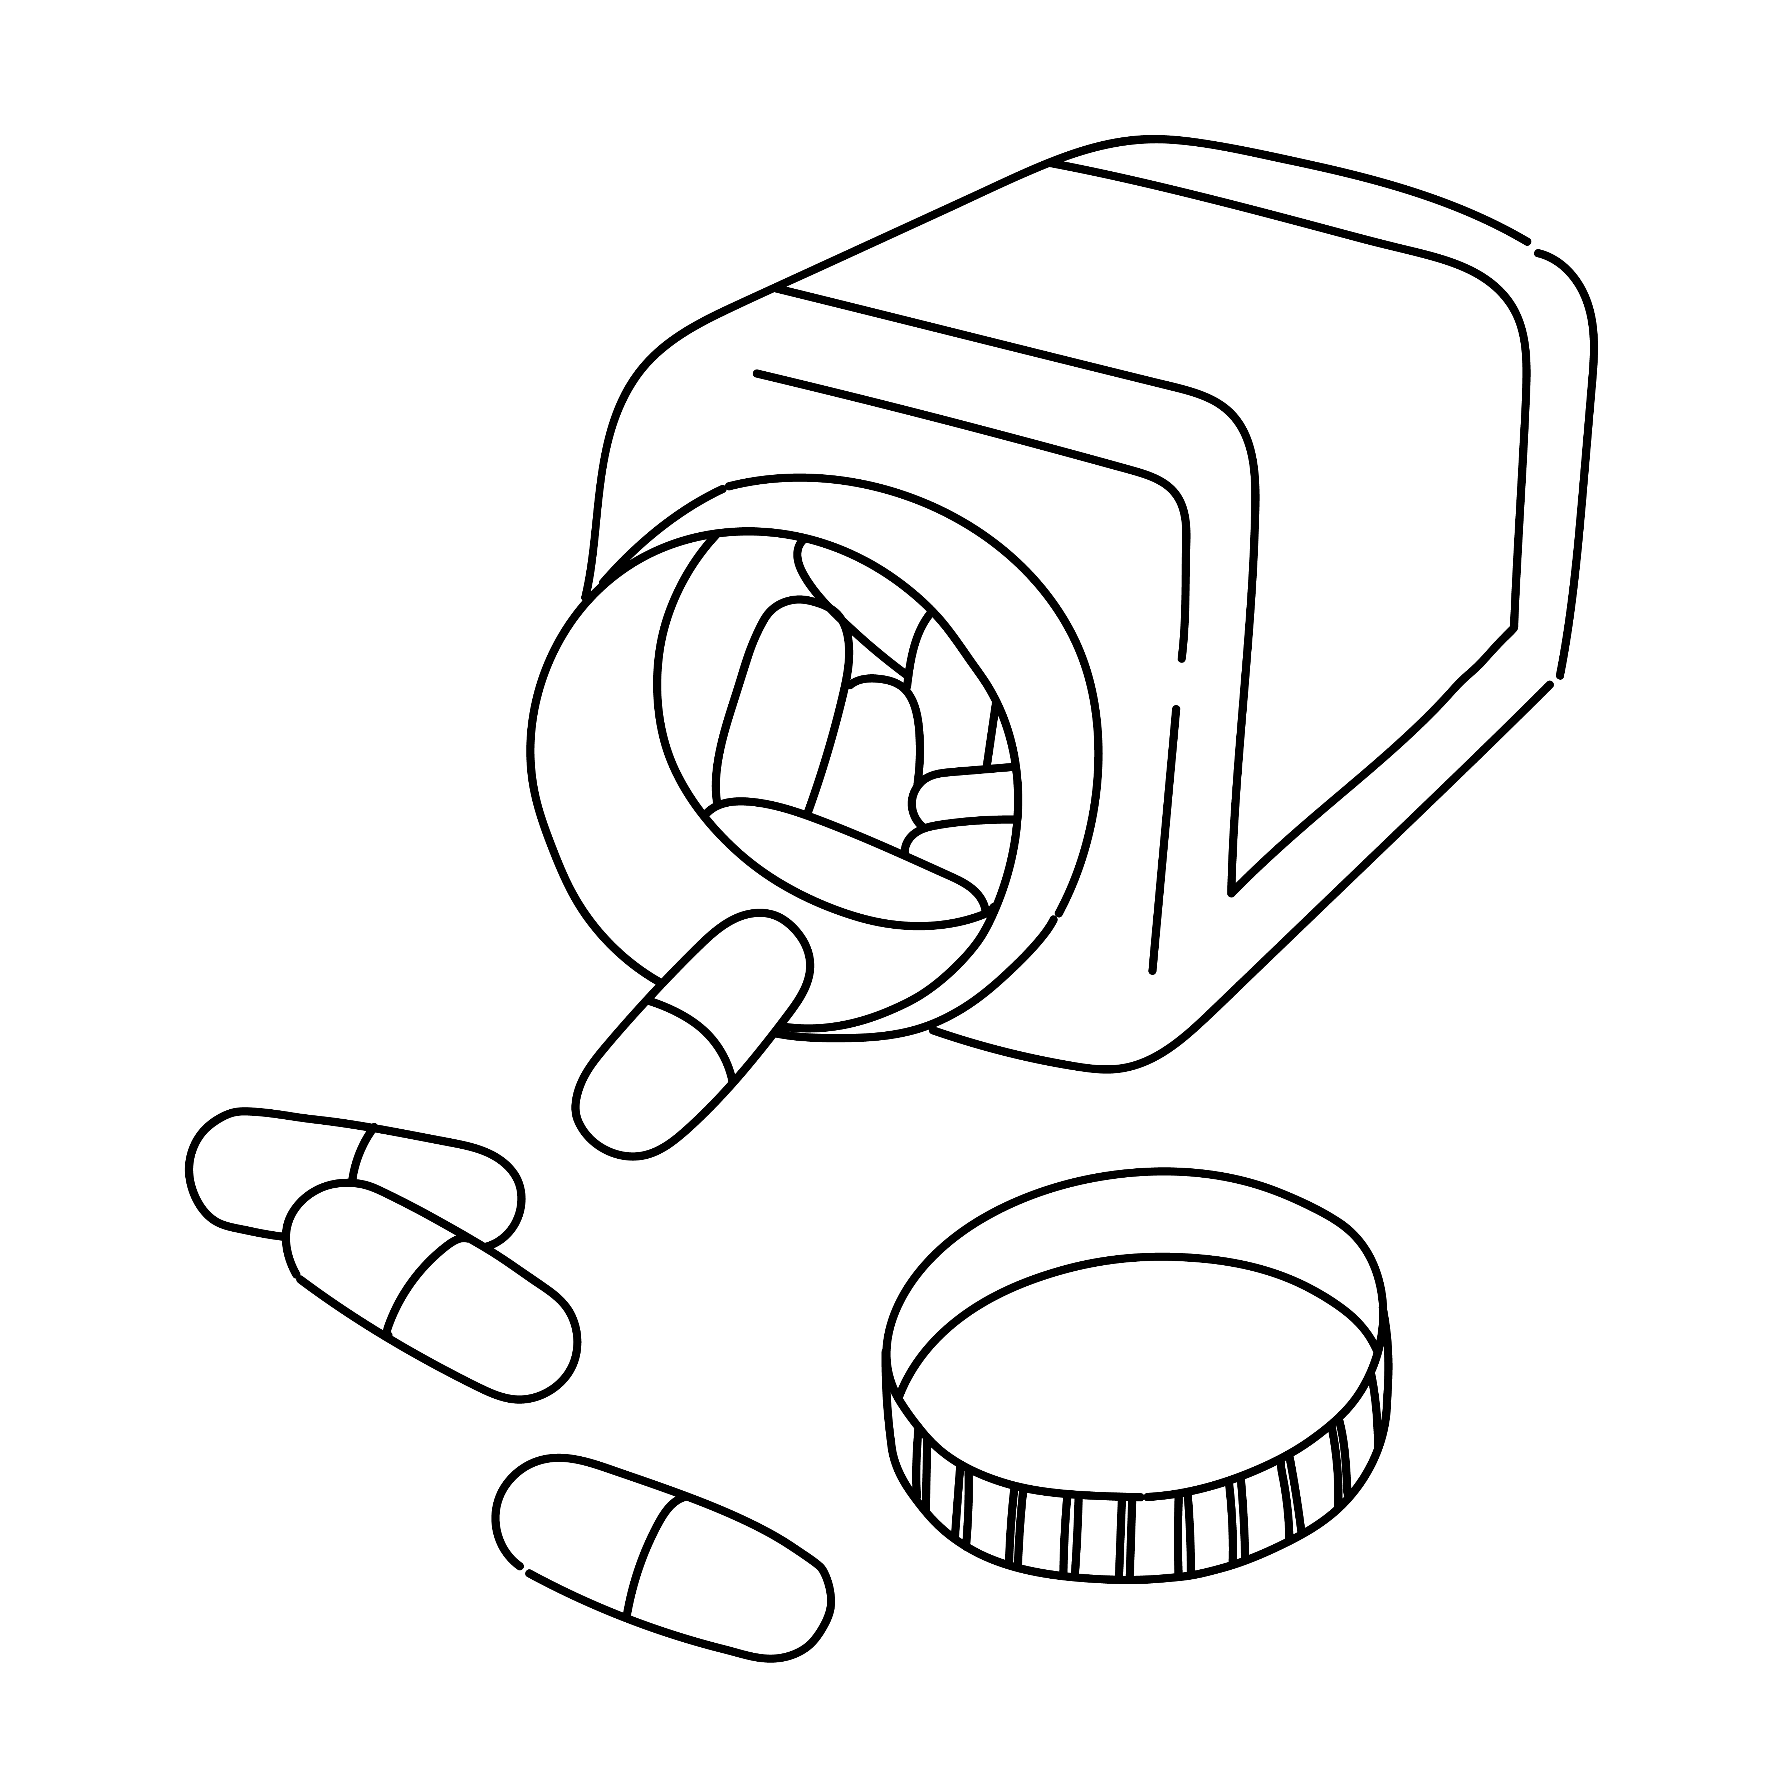
Most young people don’t use drugs
Fact:
Recognise that majority of young people choose not to use drugs and its not as common as it might seem.
Your opinion matters:
Focus on how you see yourself, not on what others think.
Your choices define you:
Be proud of making decisions that are right for you.

Slide 14

How to say no with confidence
Be prepared:
Think ahead about how you’ll respond if someone offers you drugs.
Keep it simple:
A firm, clear “No, I'm not into that” is enough, you don’t owe anyone an explanation.
Don’t overthink it:
You don't need to apologise or feel awkward for saying no.
No, thank you!

Slide 15

Spotting real friends
True friends respect you:
Real friends won’t pressure you into doing something you don’t want to .
Question their motives:
If someone’s pushing drugs on you, ask yourself why, it’s usually about them, not you.
Being assertive = confidence:
Standing your ground shows self-respect and earns respect from others.

Slide 16
Spotting real friends
Notice the pressure:
If you see a friend being pushed into taking drugs, check in with them.
Speak up:
Encourage them to say no and let them know they don’t have to go along with it.
Get help if needed:
If things feel serious, talk to a trusted adult, it’s not snitching, it’s keeping people safe.
16

Slide 17

Finding the right crowd
Check your group vibe:
If you feel like you can’t be yourself, it might be time to step back.
Real friends accept you:
You shouldn’t feel pressured to change or do thing that make you uncomfortable.
New friends, new vibe:
There are loads of people who share your interests without needing to drugs to have fun.

Slide 18
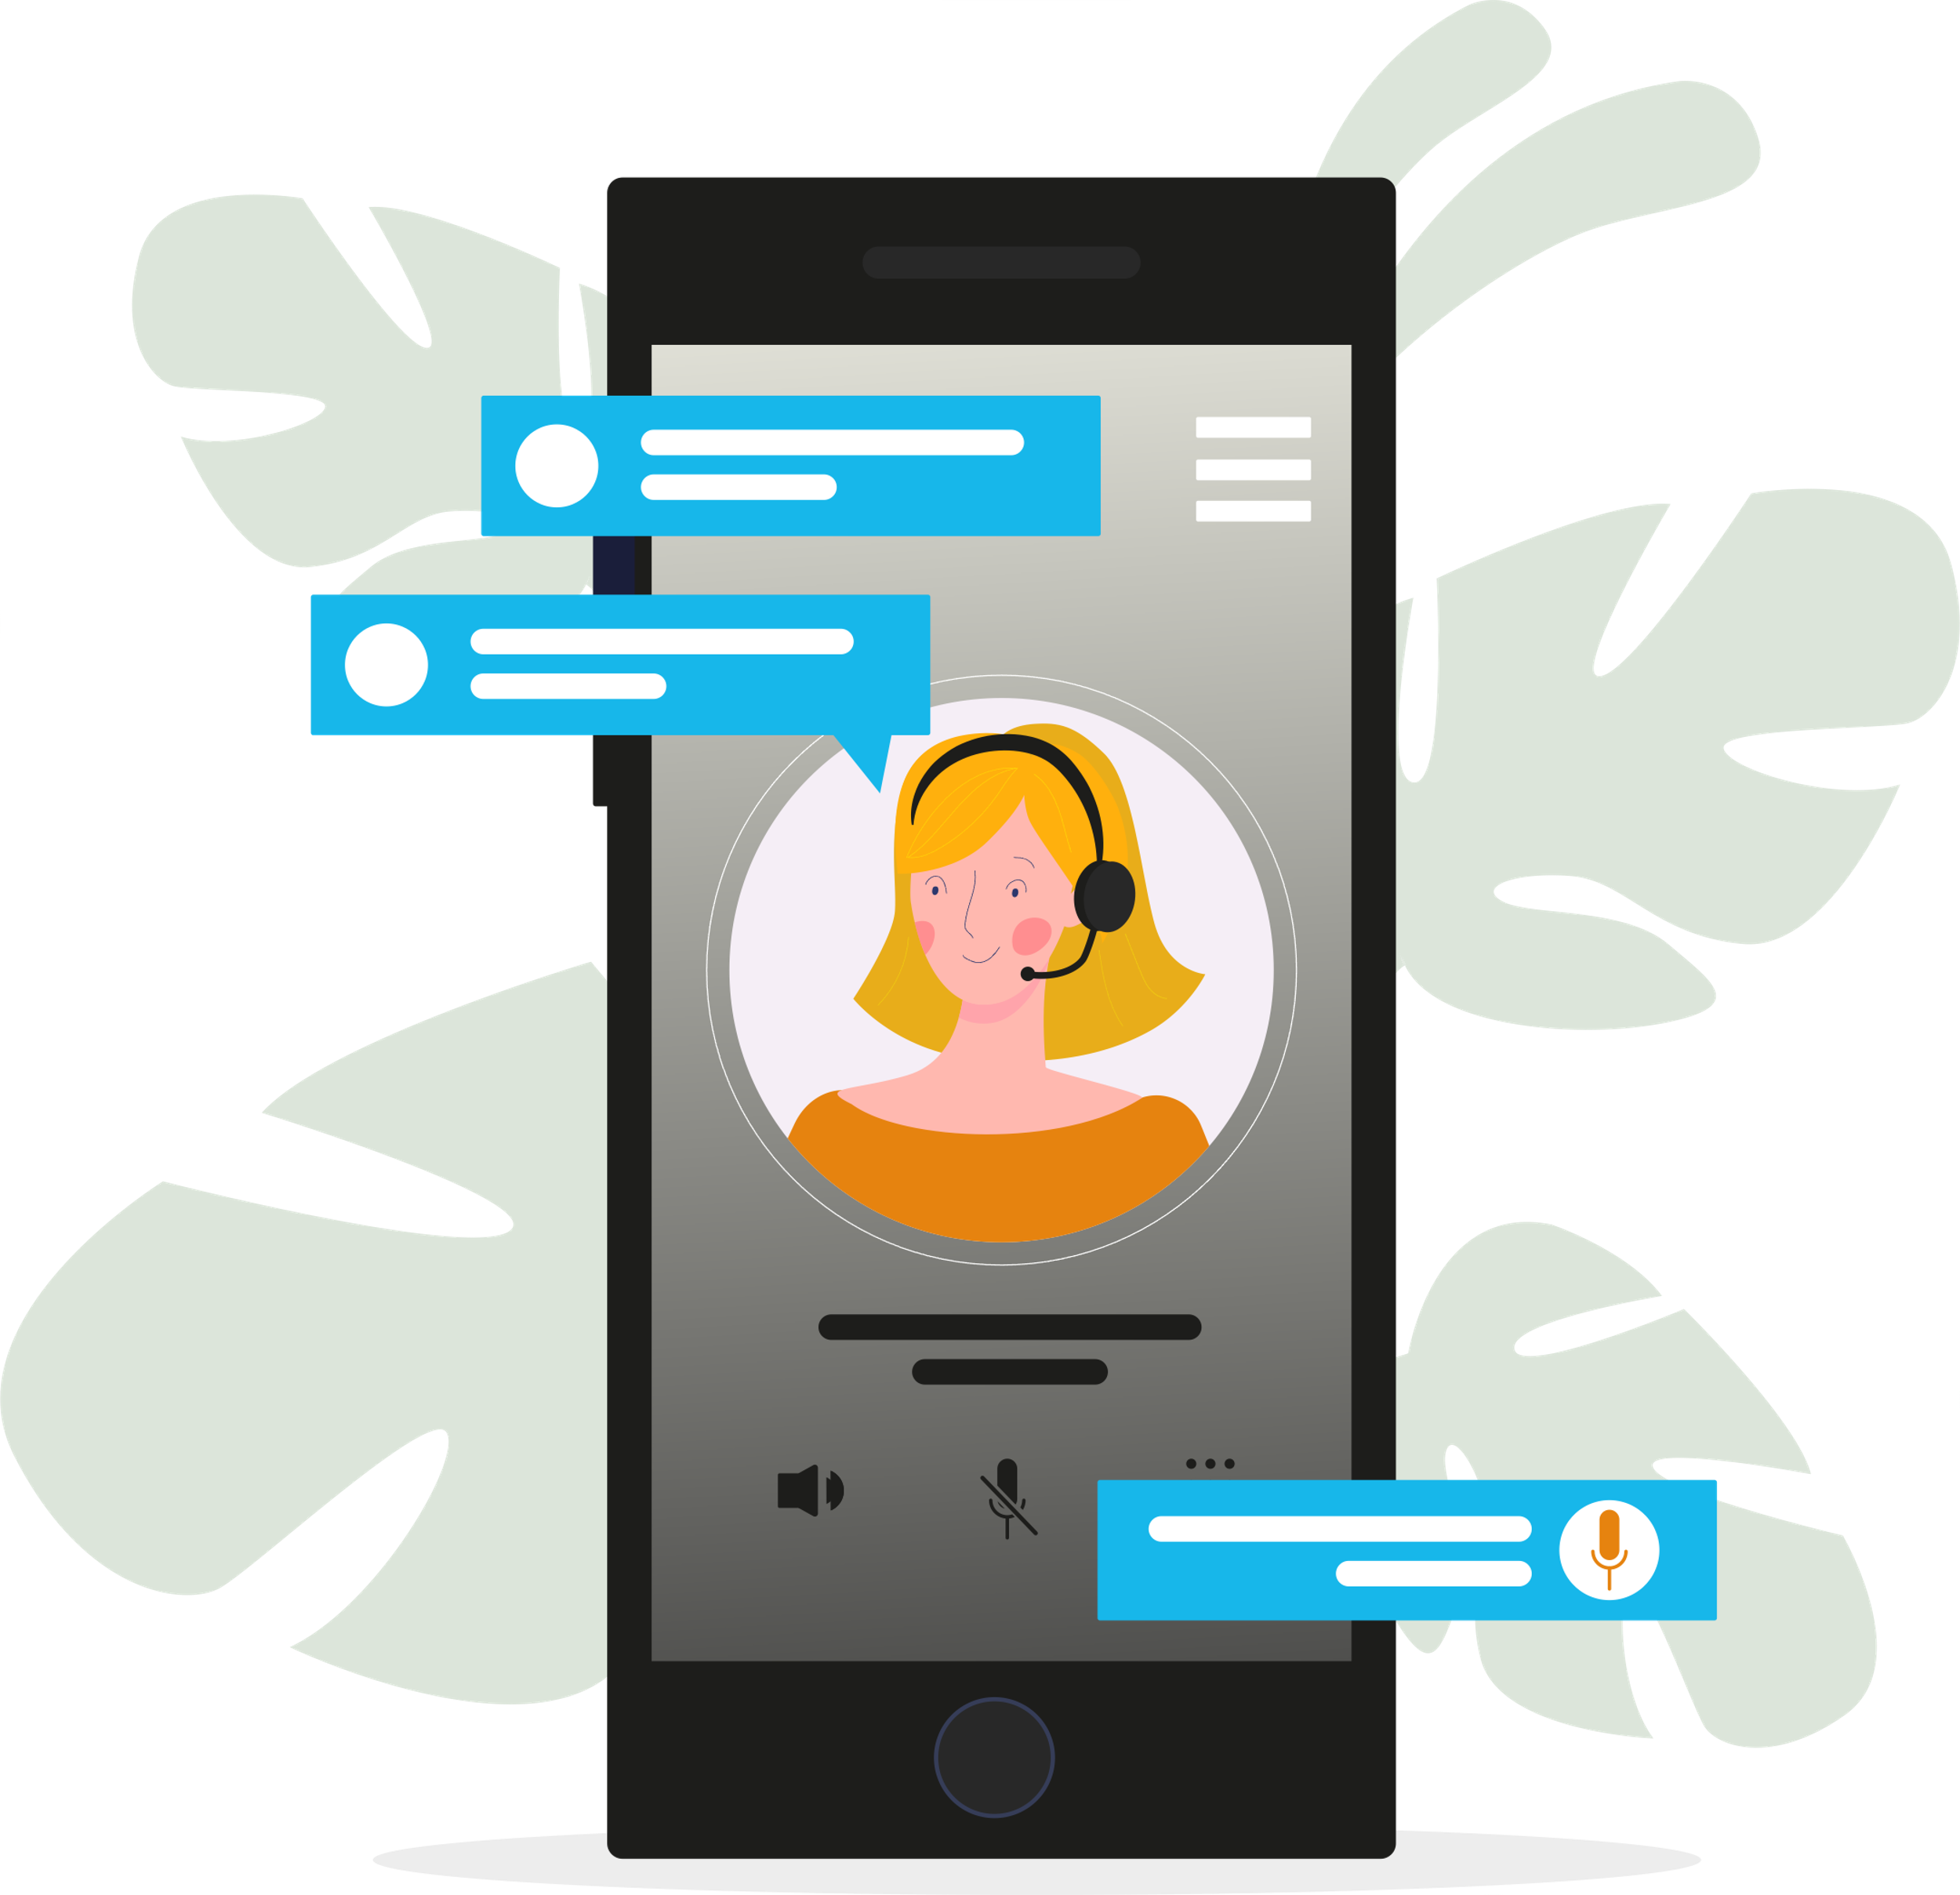

Getting help
Before trying anything new, it makes sense to know what’s what.
When it comes to drugs, getting your info from the right place is so important. There’s loads of bad advice online, but websites like Talk to Frank give you the real facts.
Let’s take Ketamine as an example which we mentioned in part 1 — we’ll show you how to use the site to find out what it does, why it’s dangerous, and how to stay safe.
You can find out more about different drugs on the Drugs A to Z on talktofrank.com/drugs-a-z or call FRANK on 0300 123 6600 at any time, day or night or text 82111.

Slide 19
Options on help and advice
Talk to teachers / school nurses
Contact your GP or speak with a trusted adult like a family member
Report crime or anything suspicious anonymously on https://crimestoppers-uk.org/fearless
Childline – 08001111
Local services for young people:
ReFresh (Hull) – 01482 331059
WithYou (North East Lincolnshire) 01472 86890
WithYou (North Lincolnshire) 01724 857633
DELTA (North Lincolnshire) 01724-298528
Youth and Family Support (East Riding) – 01482 391700

