Slide 1




Helping young people protect themselves from Radicalisation
Recommended for:
Key stage 3, 4 and above

Slide 2

Learning Outcomes
1. How to identify information you can and cannot trust.
2. How disinformation and radicalisation can increase hate.
3. How to protect yourself and others.

Slide 3

Trigger warning!
Content includes racism
and radicalisation
If any content causes
distress, a safe place to
go is…
Session Expectations
No personal questions or comments.
Listen to each other.
Treat each other with respect, even if you disagree.
Engage with and try to enjoy the learning.
RULES

Slide 4

Part one How to identify information you can and cannot trust
This short film will explain how to understand Misinformation and Disinformation.
Source:
Shout Out UK
If you're having trouble accessing the video, here's a direct link:
Dis and misinformation on Vimeo

Slide 5
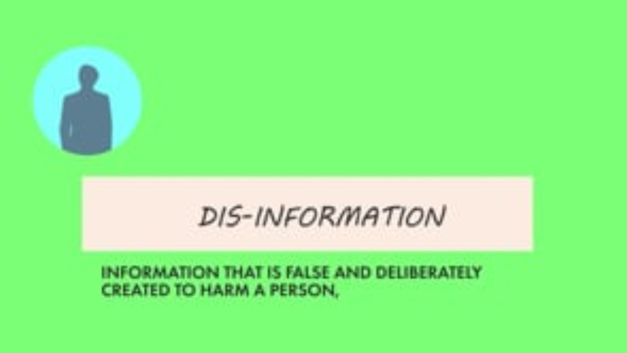

Slide 6


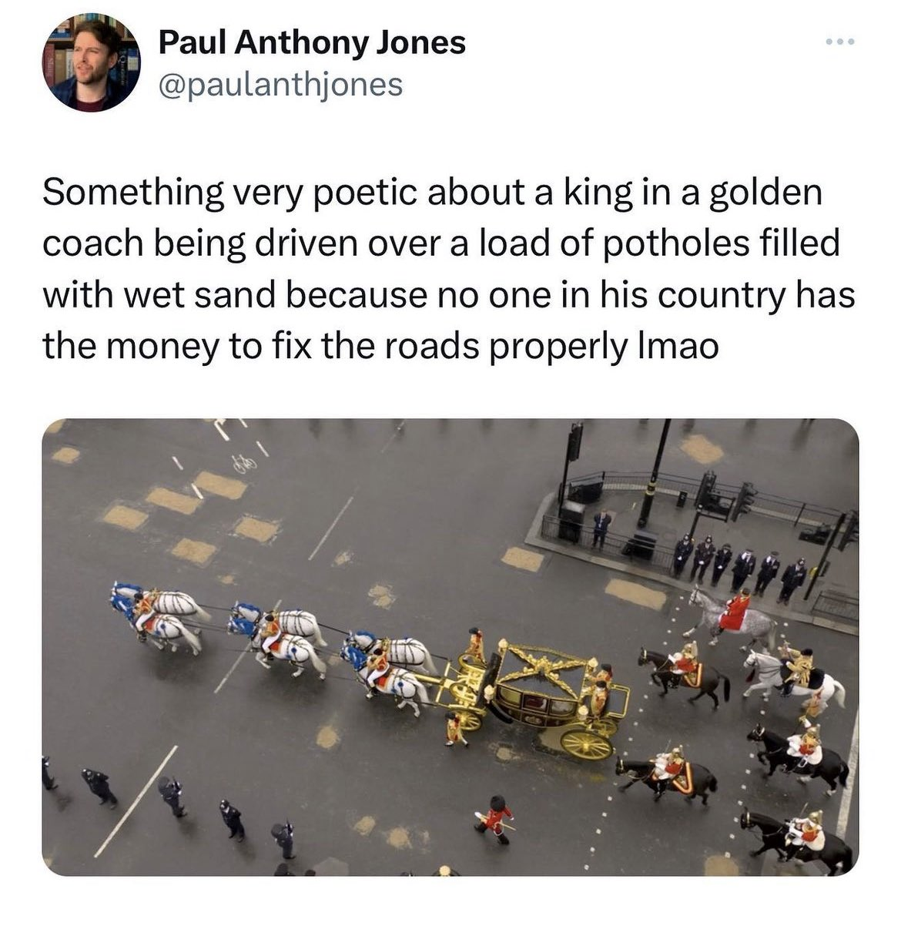
Quiz Time
Is this…
Misinformation
Disinformation
or
?
It is either a mistake or a joke, so it is:
Misinformation

Slide 7

A way to remember
it…
Misinformation -
is fake news that is created and spread by mistake by someone who doesn’t realise that it’s false.
Best thing to do:
Try to find two or three trusted sources which are balanced (giving both sides of the story) and check the facts from the account or posts there.

Slide 8
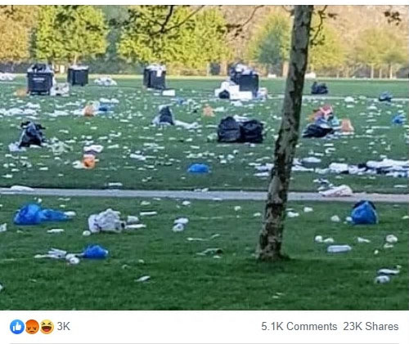
Quiz Time
Is this…
“Look at the mess today’s climate protestors left behind in beautiful Hyde Park. So much plastic. So much landfill. So sad ☹”
Misinformation
Disinformation
?
or
It is a lie intended to discredit someone, so it is: Disinformation
*this photo was from after another unrelated event.

Slide 9
A way to remember
it…
“Look at the mess today’s climate protestors left behind in beautiful Hyde Park. So much plastic. So much landfill. So sad ☹”
Disinformation -
Disinformation is when people deliberately spread or create fake news to cause trouble, which could involve ’dissing’ someone or something.
Best thing to do:
Question what you see online, double-check sources (fact checking) and use reliable and trustworthy outlets before sharing.

Slide 10
Misinformation or Disinformation
?
?
Reading about an unproven cure to a disease and telling your friends about it.
Making up an embarrassing rumour about a friend because you're mad at them.
Misinformation
Disinformation
You think it’s true,
but it’s not.
You know it’s not true,
but you say it anyway.

Slide 11


Part two How disinformation
and radicalisation
can increase hate
We are now going to watch a short
film from the Circle North series.
Based on a true and local story.
Radicalised
If you're having trouble accessing the video, here's a direct link:
Trigger warning!
This film features racist views.

Slide 12
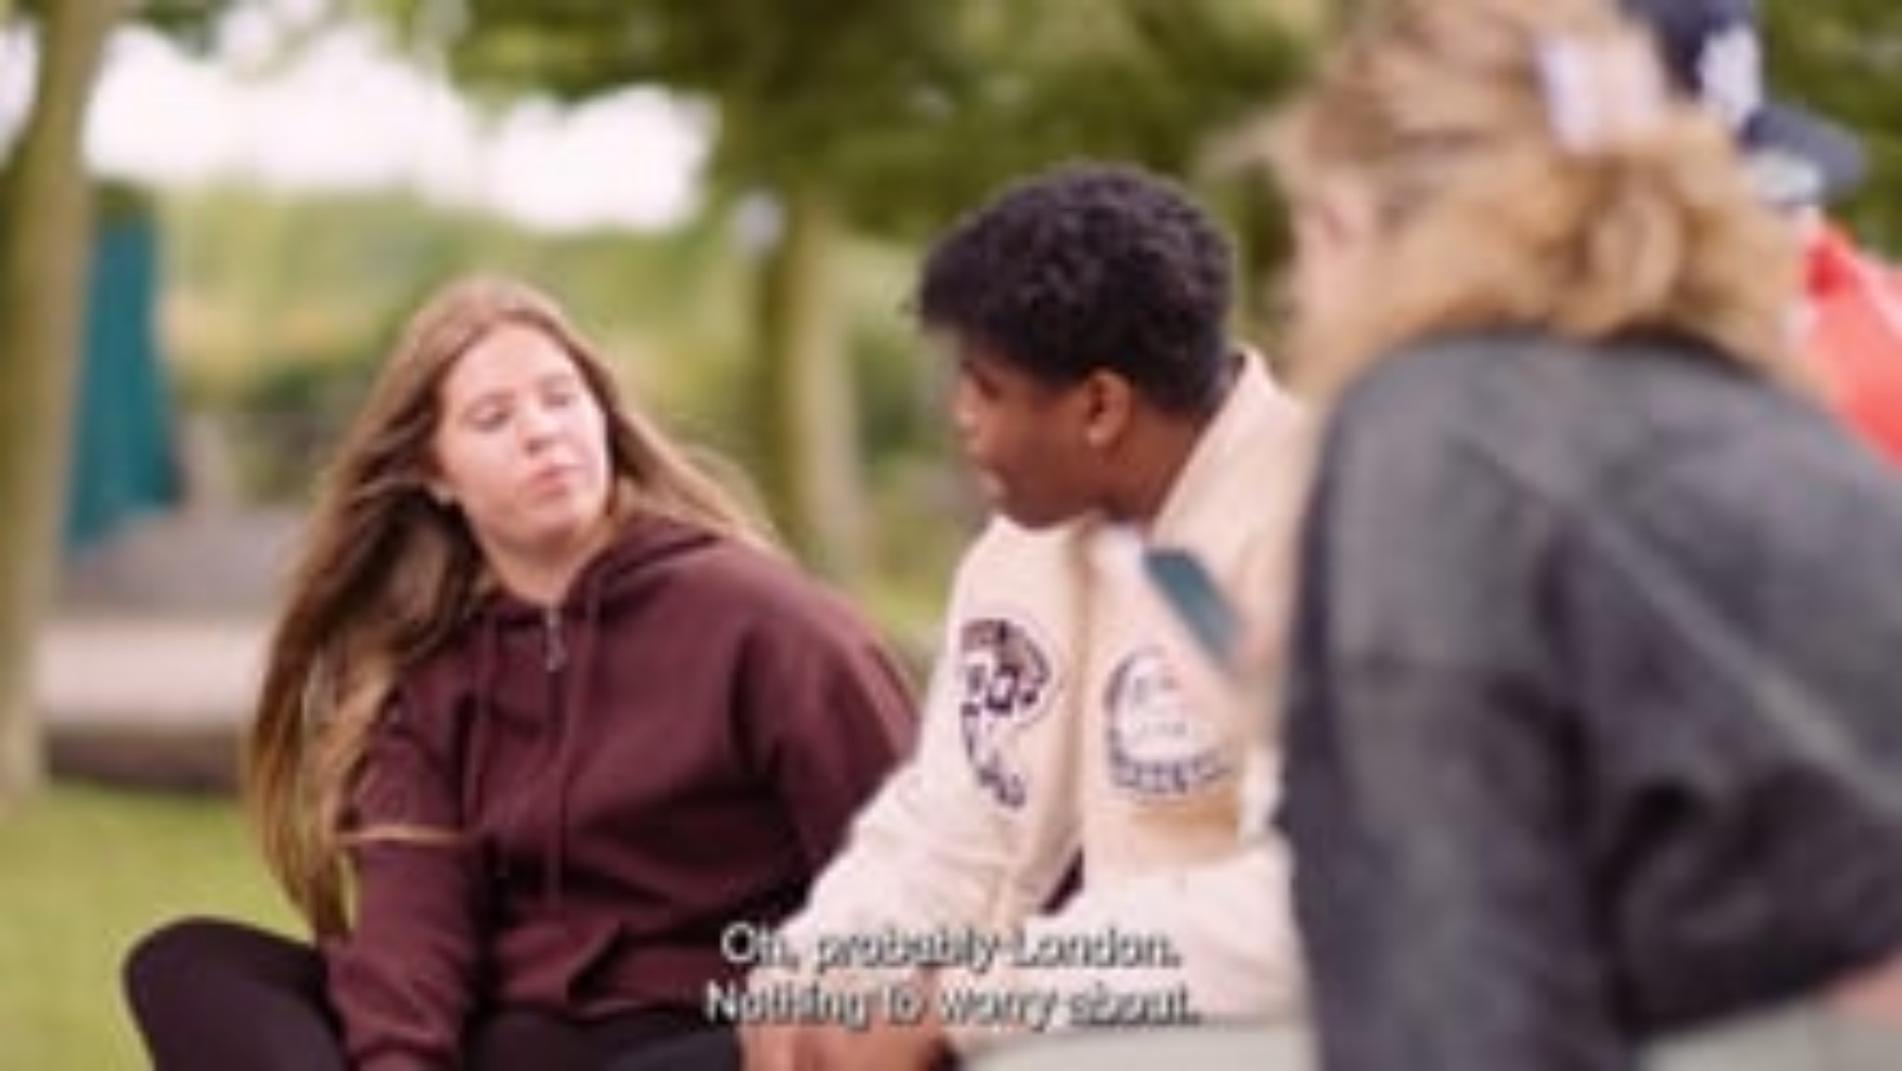

Slide 13
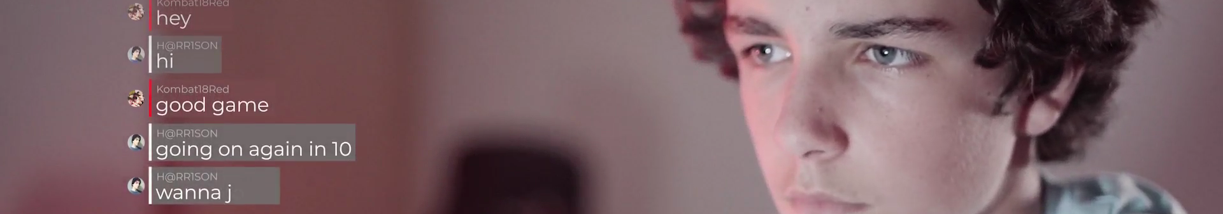


Radicalisation is… the process through which a person comes to support or be involved in extremist beliefs.
Which red flag warnings did we see earlier in the film that Harrison was being groomed to be radicalised?

Slide 14
Hints:
INVITING HIM TO PLACES THEY
CAN TALK PRIVATELY.
TREATING HIM LIKE HE IS ‘ONE OF THEM’.
CREATING FEAR OF THE ‘OTHER’ AND HOW THEY ARE A RISK.
MAKING OUT THAT THIS IS ABOUT PROTECTING GIRLS, SUCH AS HIS SISTER
MAKING HIM FEEL PART OF SOMETHING E.G., “YOU’VE PROVED YOURSELF”.

Slide 15
Racism is…
Extremism is…
when someone is treated differently because of their race, ethnicity, nationality or colour.
defined by the Home Office as a vocal or active opposition to fundamental British values.
Can you name any of the 4 British values?

Slide 16

The British values
Democracy
A culture based on freedom and equality, where everyone has a say in how the country is run.
Rule of law
The need for rules to create a safe and secure environment for living and working.
Individual liberty
The protection of your rights, and the rights of people around you.
Respect and tolerance
Understanding that people have different beliefs and values, as well as respecting the values of others.
Speaking or acting against any of these values is called extremism.
Which red flag warnings did we see earlier in the film that Harrison was being groomed to be radicalised?
16

Slide 17

How is extremism spread online?
VIOLENT IMAGES
MESSAGES
SPEECHES AND VIDEOS ON SOCIAL MEDIA
HANDS
UP
PRIVATE MESSAGING PLATFORMS
GAMING PLATFORMS
Click for hints
FORUMS
MEMES

Slide 18

How fake news
fueled disorder
This short film will give an example of how disinformation led to racism and extremism in the UK.
Source:
Sky News
If you're having trouble accessing the video, here's a direct link:
Fake news

Slide 19


Slide 20
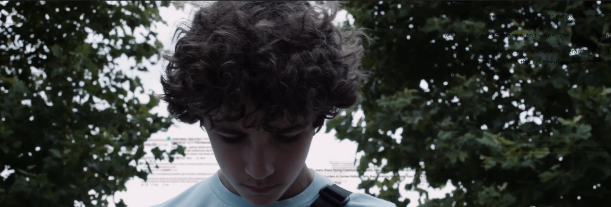
Racism and the law
Under the Race Relations Act 1965 racial discrimination in public places and the promotion of hatred on the grounds of ‘colour, race, or ethnic or national origins’ is illegal.
Many of the people involved in the disorder, racist protests, and sharing information online have been sent to prison.
Which red flag warnings did we see earlier in the film that Harrison was being groomed to be radicalised?

Slide 21
Quiz Time
What percentage of young people said that they have come across content that is either hateful, violent, extremist or terrorist?
33%
53%
73%

Slide 22
Quiz Time
What percentage of young people said that they are worried about the extent of extremist content on the internet and social media?
28%
48%
68%

Slide 23
Part three How to protect yourself and others
This short film will explain how to how to REVIEW information before you share it.
Source:
Shout Out UK
If you're having trouble accessing the video, here's a direct link:
Watch REVIEW

Slide 24


Slide 25
R
REPUTATION
E
EVIDENCE
Can you remember
what each letter
stands for?
V
VERIFICATION
I
INTENT
E
EMOTIONS
W
WEIGHT IT UP

Slide 26
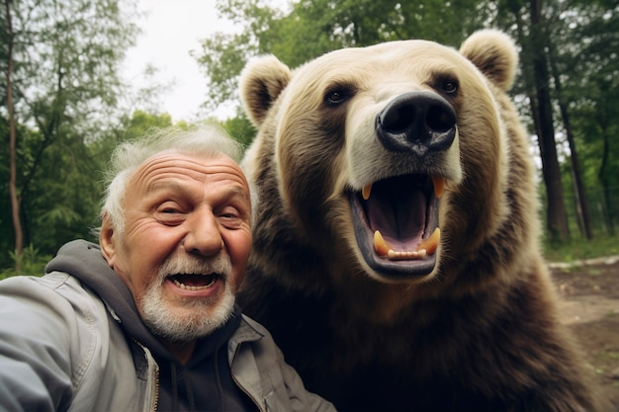


Clues of online disinformation
Blurred or altered logos of well-known news organisations,
(e.g. the BBC).
Highly emotional or exaggerated language,
(e.g. clickbait headlines).
Edited / AI photos or images: spreaders of false information often use digital tools to manipulate images to support their ‘story’.
You won’t believe what happens when man and bear get into wrestling match...”
Watch here: www.breaknews.biz.org/ bearfight/click-through/
A less well-known, or unknown, publication name and logo.
A suspicious URL with an unusual ending.
REAL LIFE 3

Slide 27
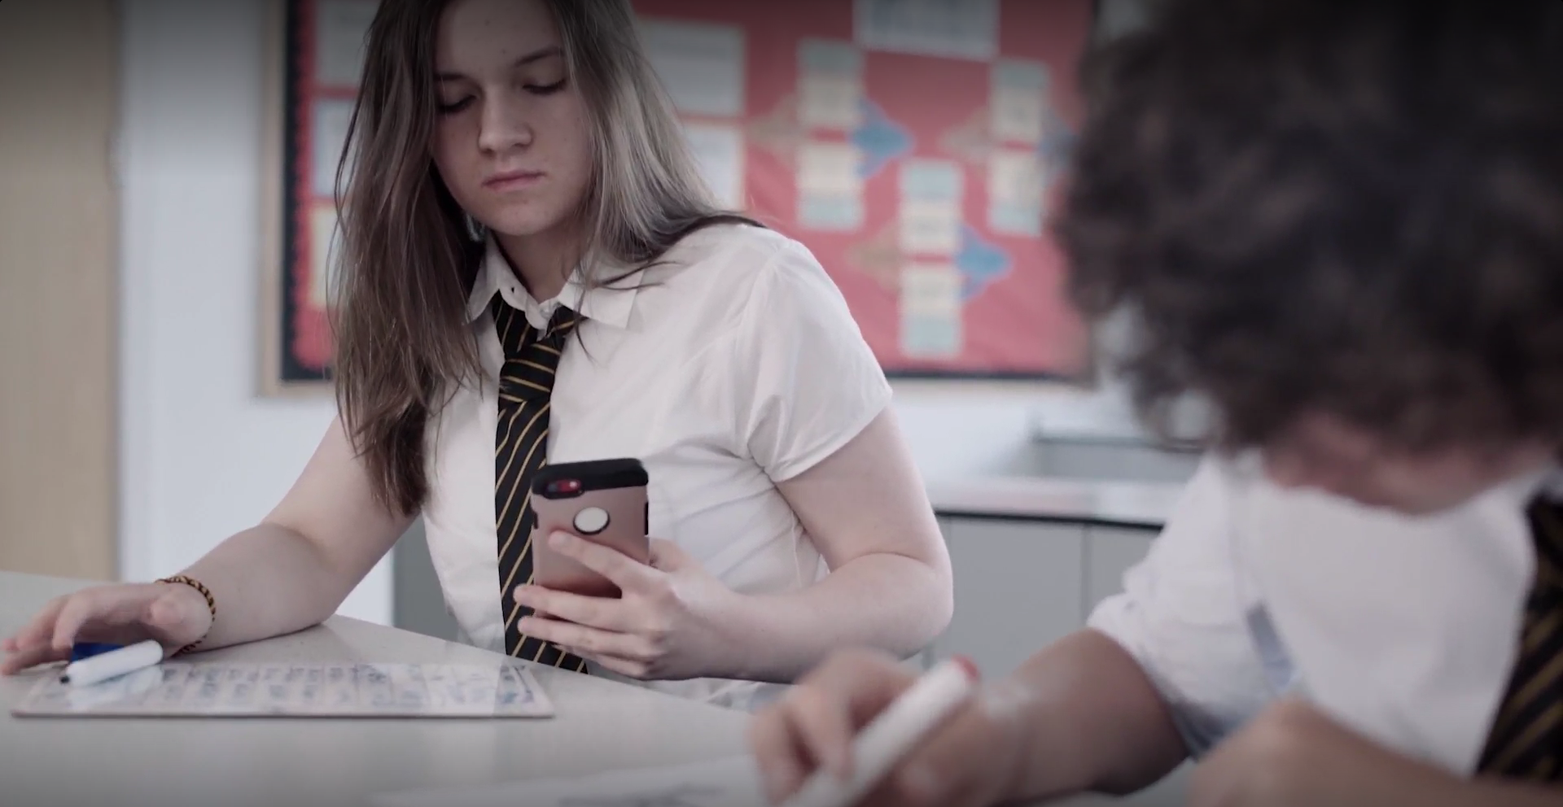
What can you do if you are worried someone around you is being radicalised?
All the teachers at your school have had ‘Prevent’ training.
You could talk to a trusted adult at school or home.
Even if you are not sure, but you are worried something ‘isn’t right’, speak to someone you trust.

Slide 28
This short film has some tips on how to help yourself and others in a risky situation.
Click for video
If you're having trouble accessing the video, here's a direct link:
Staying safe
Notes:
both

Slide 29


Slide 30

Reporting Content
Crimes committed against someone because of their race, religion or belief are hate crimes and should be reported to the police.
www.report-it.org.uk/your_police_force
Or, if you see the above content on a social media app, you can report it via the app itself.
If you believe someone is going to act in a way to cause immediate harm to others, such as carry out an attack call 999.

Slide 31
Can you name
5 things we have
learned today?

Slide 32
For more information on this and other topics
www.notinourcommunity.org

