Slide 1




This is a NEW
Not In Our Community resource being tested
Feedback on what we can change or improve is very welcome. Please email mail@notinourcommunity.org with comments or to a request a call. Thank you for your support.

Slide 2
Introduction to Online Harm
Recommended for:
Key stage 3, 4 and above.
Content discusses online bullying/harassment and the sharing of explicit images.

Slide 3
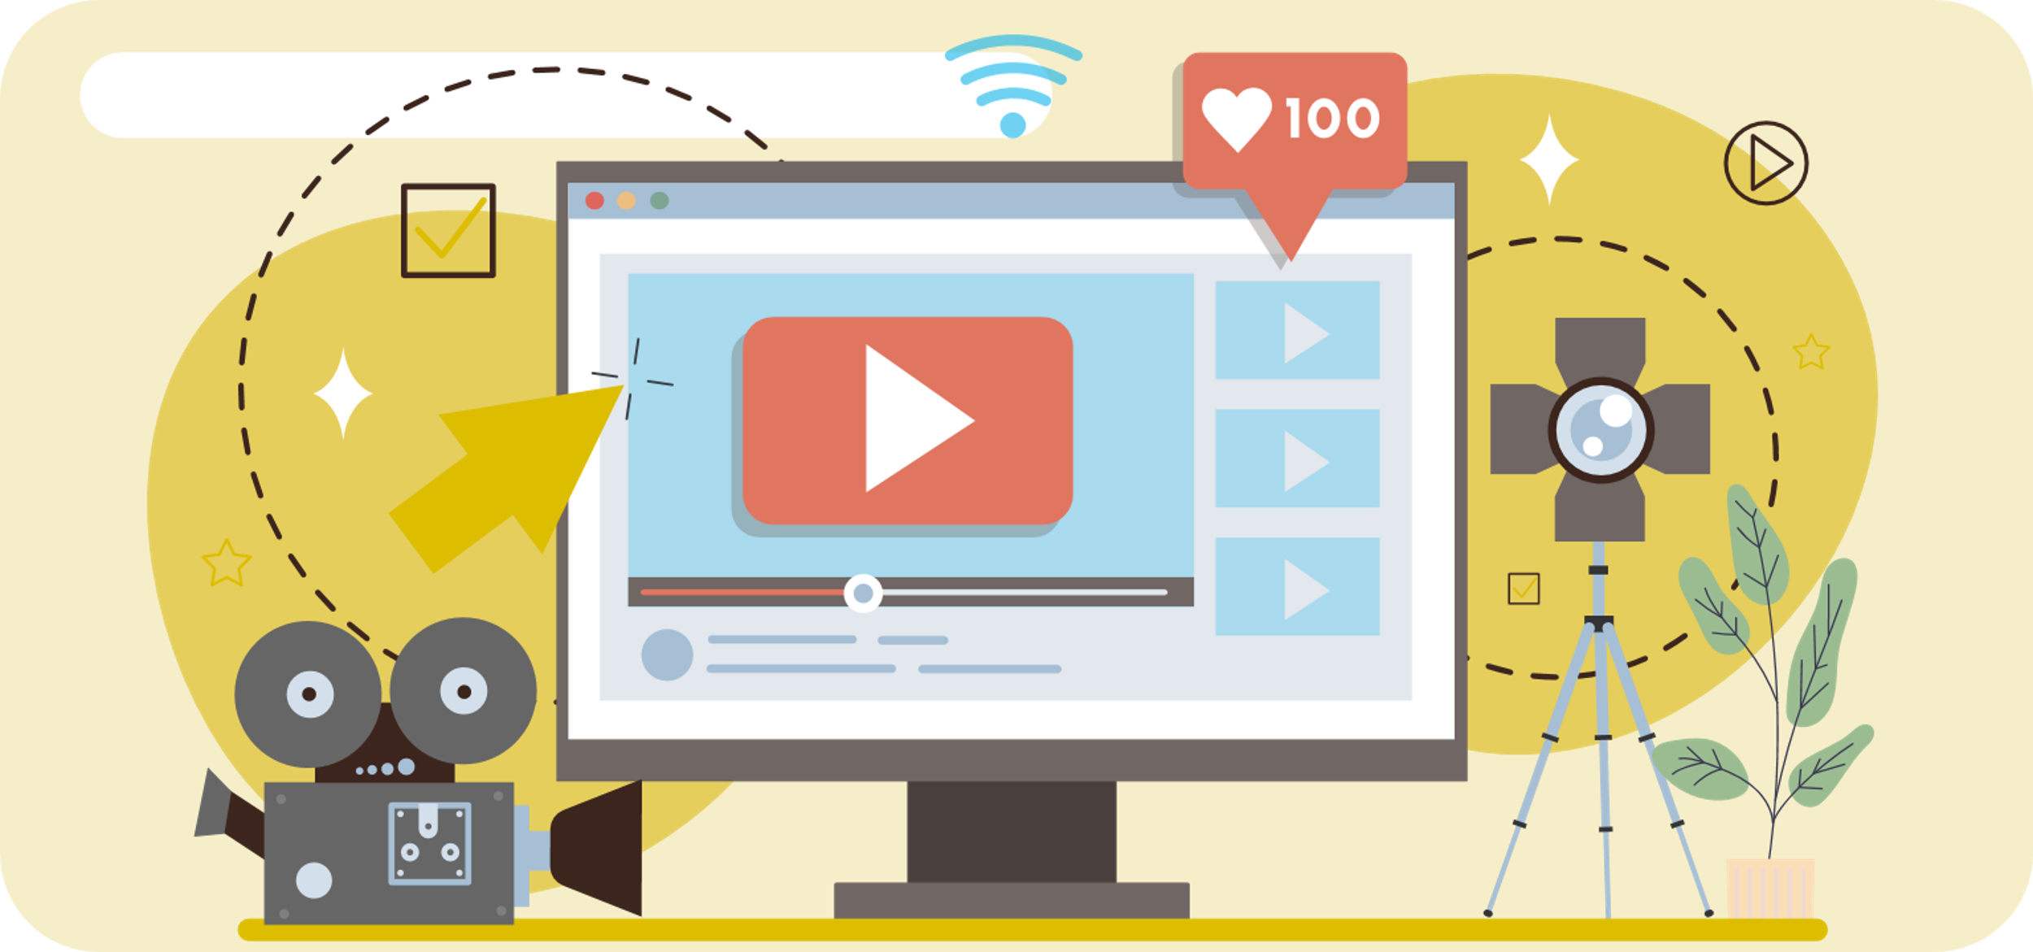
Learning Outcomes
About the different types of online harm.
Attacks to get your personal information.
Attacks and harassment against your body.
How to avoid committing or being a victim of online harm.

Slide 4
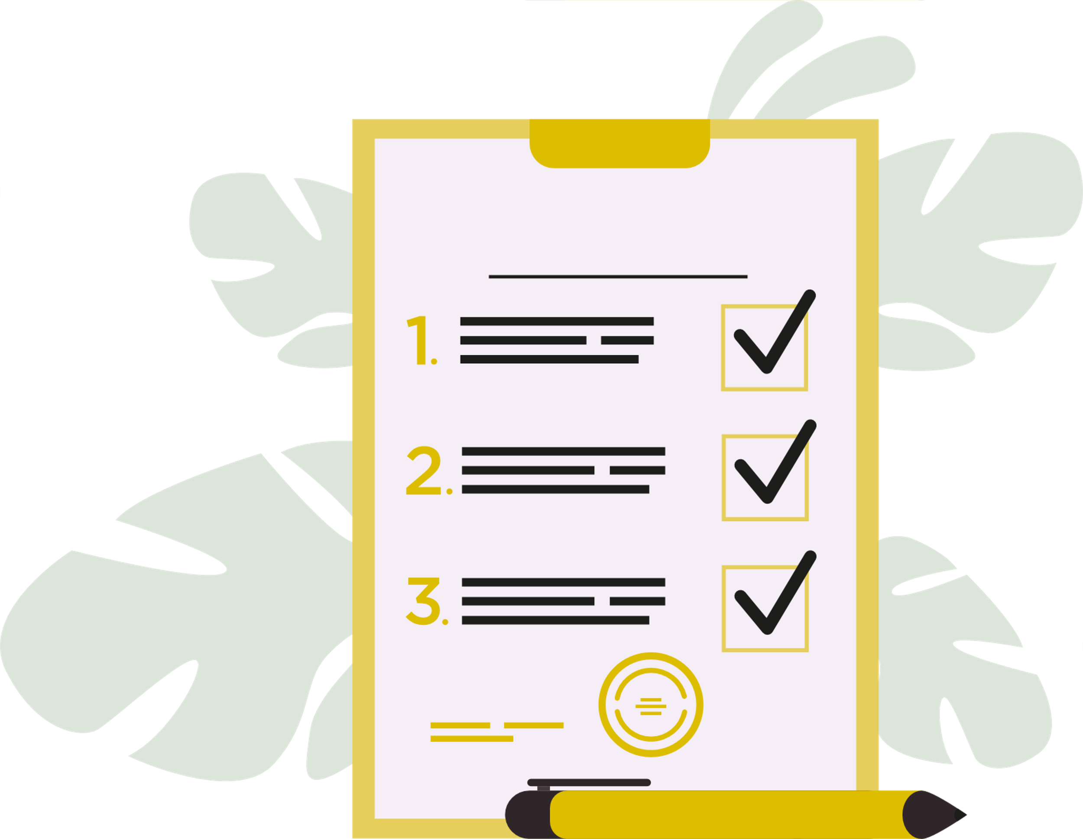
Trigger warning!
Content discusses online bullying/harassment and the sharing of explicit images
If any content causes
distress, a safe place to
go is…
Session Expectations
No personal questions or comments.
Listen to each other.
Treat each other with respect, even if you disagree.
Engage with and try to enjoy the learning.
RULES

Slide 5


What do you think online harm means?
What examples have you seen or heard?
HANDS UP!

Slide 6
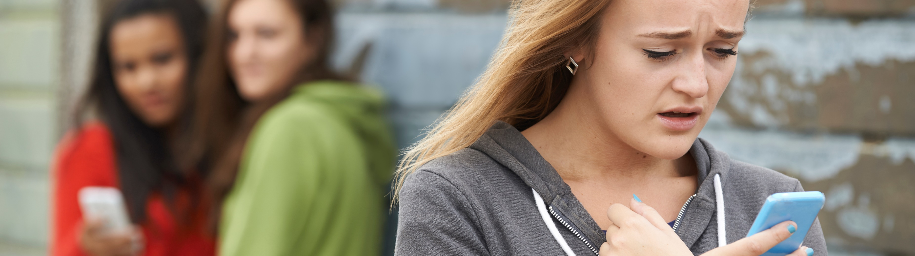
Online harm is…
Any negative or harmful behaviour, content, or interaction that occurs in digital spaces.
Can you think of how and where this harm can appear online?
Click next slide to reveal examples →

Slide 7

Types of online harm
Click for answers
Cyberbullying
Scams and fraud
Online exploitation
Harmful content
Slander and libel
- Harassment, threats, public shaming.
- Phishing (fake calls & messages), fake websites, identity theft.
- Sharing private images, blackmail.
- Self harm encouragement, violent materials.
- Ruining your reputation on social media platforms.
Let’s look at these, starting with scams and fraud →

Slide 8
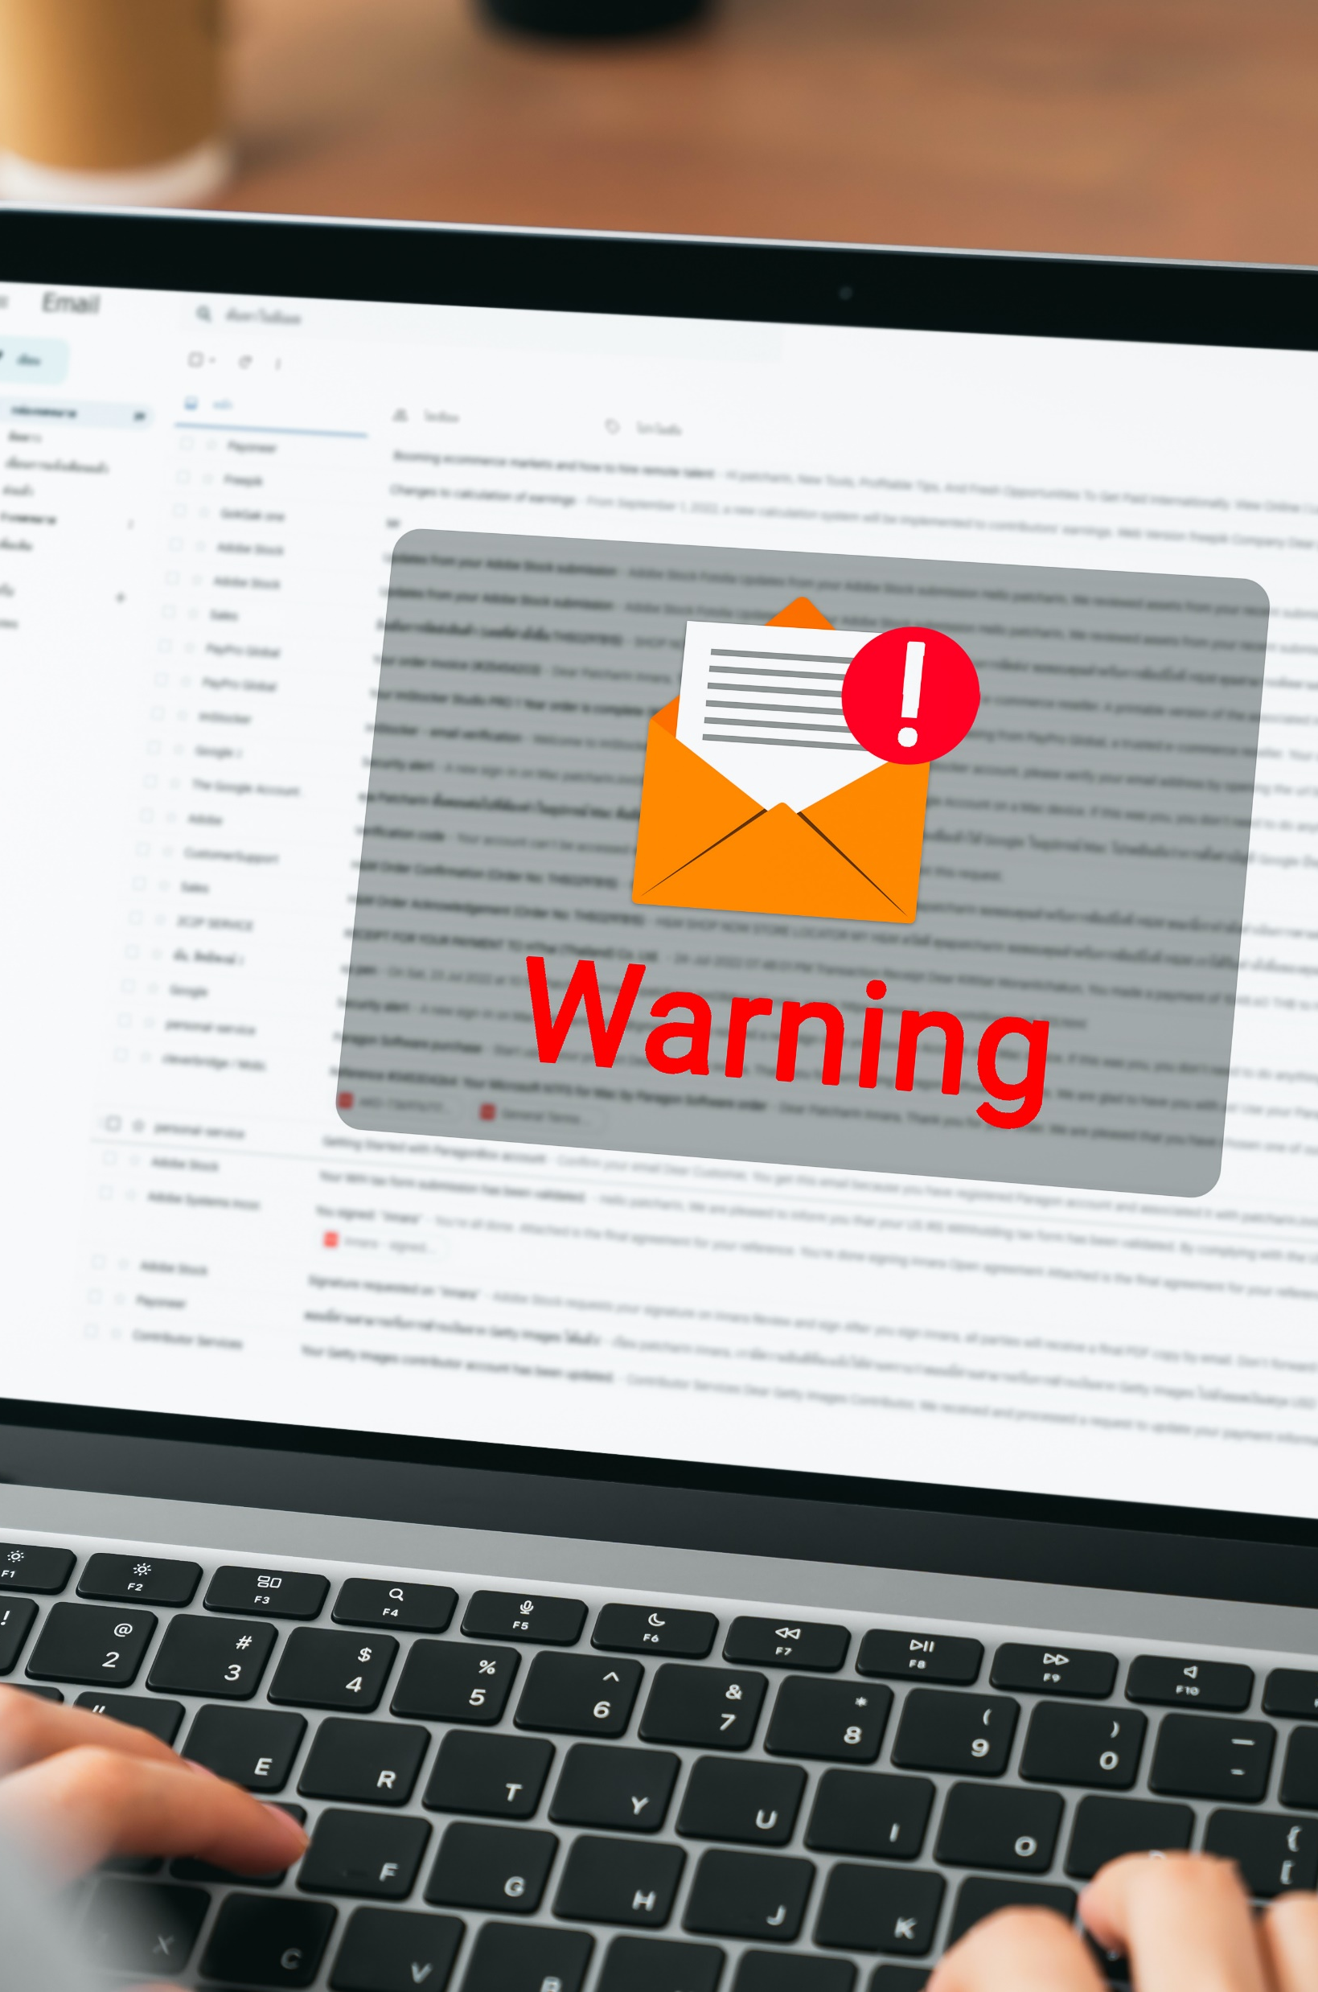
Spot the scam
Which one of these below do you think is a scam?
A text about winning a free iPhone asking for bank details.
An email claiming your account was hacked with a suspicious link.
A pop-up offering cash prizes for clicking the link.
All of the above.
Answer: D all the above

Slide 9
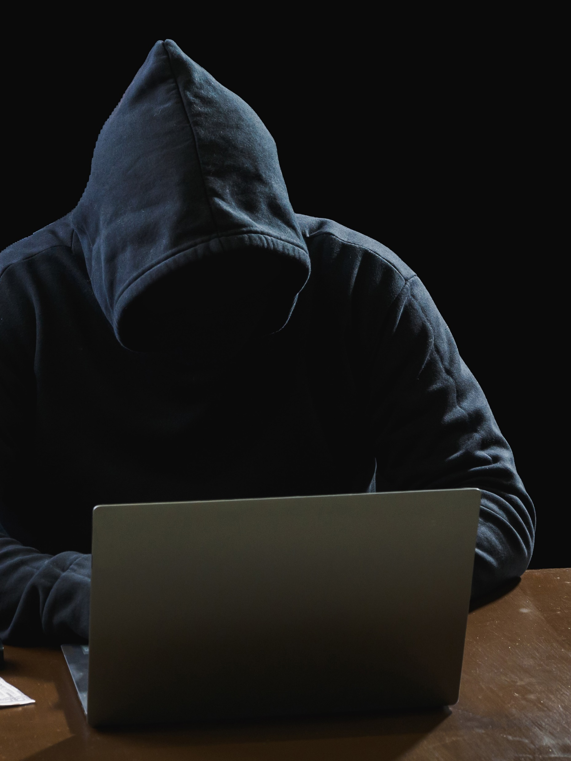
What you should know! Be careful who you give your information to…
Some hackers don’t just hack computers – they hack people by tricking them into giving away personal information like passwords or bank details. Instead of using tech, they use lies and manipulation to gain trust.
Think of it like this: if a stranger asks for your house keys, you’d say no. But what if they pretended to be a delivery driver or someone from your school? That’s social engineering!
Let’s have a look at common scams on the next slide →

Slide 10
Common Scams
Phishing
Pretexting
Baiting
cc
Fake emails or messages that look real (from your bank or online shopping) asking you to click a link and enter your details.
A scammer pretends to be someone you trust (like a teacher or a website you use) to get your personal information.
An offer of something free (like a prize or free game download) which asks for personal details or card information to be given first.
If scammers trick people into giving personal details, what happens if someone misuses that information?
They can take your money and identity away.

Slide 11

Recognising risks online
Match the risks to the prevention strategy:
Phishing email
Weak password
Online harassment
Block and report the user to the platform
Don’t click unknown links
Use a combination of letters, numbers and symbols

Slide 12
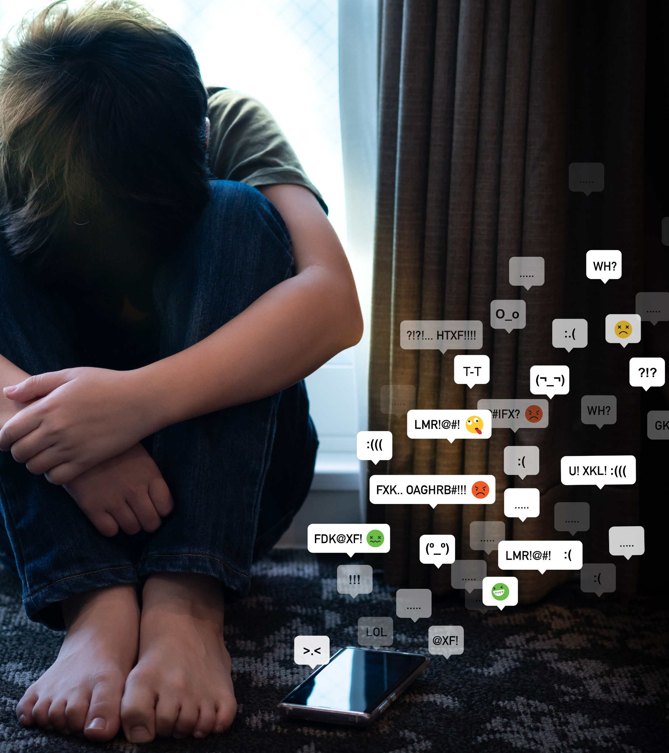
Cyberbullying, Harassment and Trolling
Cyberbullying: rumours, exclusion, nasty messages.
Harassment: threats, exposing private details, constant targeting.
Trolling: posting nasty comments just to upset people and provoke reactions .
Slander: spreading false, harmful statements about someone to damage their reputation online.
Bullying and harassment don’t just happen in person; they can also take place online. Trolling often goes hand in hand with harassment, especially when it becomes targeted or abusive. And these are a lot more common than you’d think.
Have you ever experienced any of these whilst being online?

Slide 13

Choose the correct answer
How many times do you think someone needs to send an unwanted message for it to legally class as harassment?
1
2
5
10
Answer: b) 2
Harassment is defined as a "course of conduct" involving two or more related incidents. This could be sending unwanted texts or emails.

Slide 14
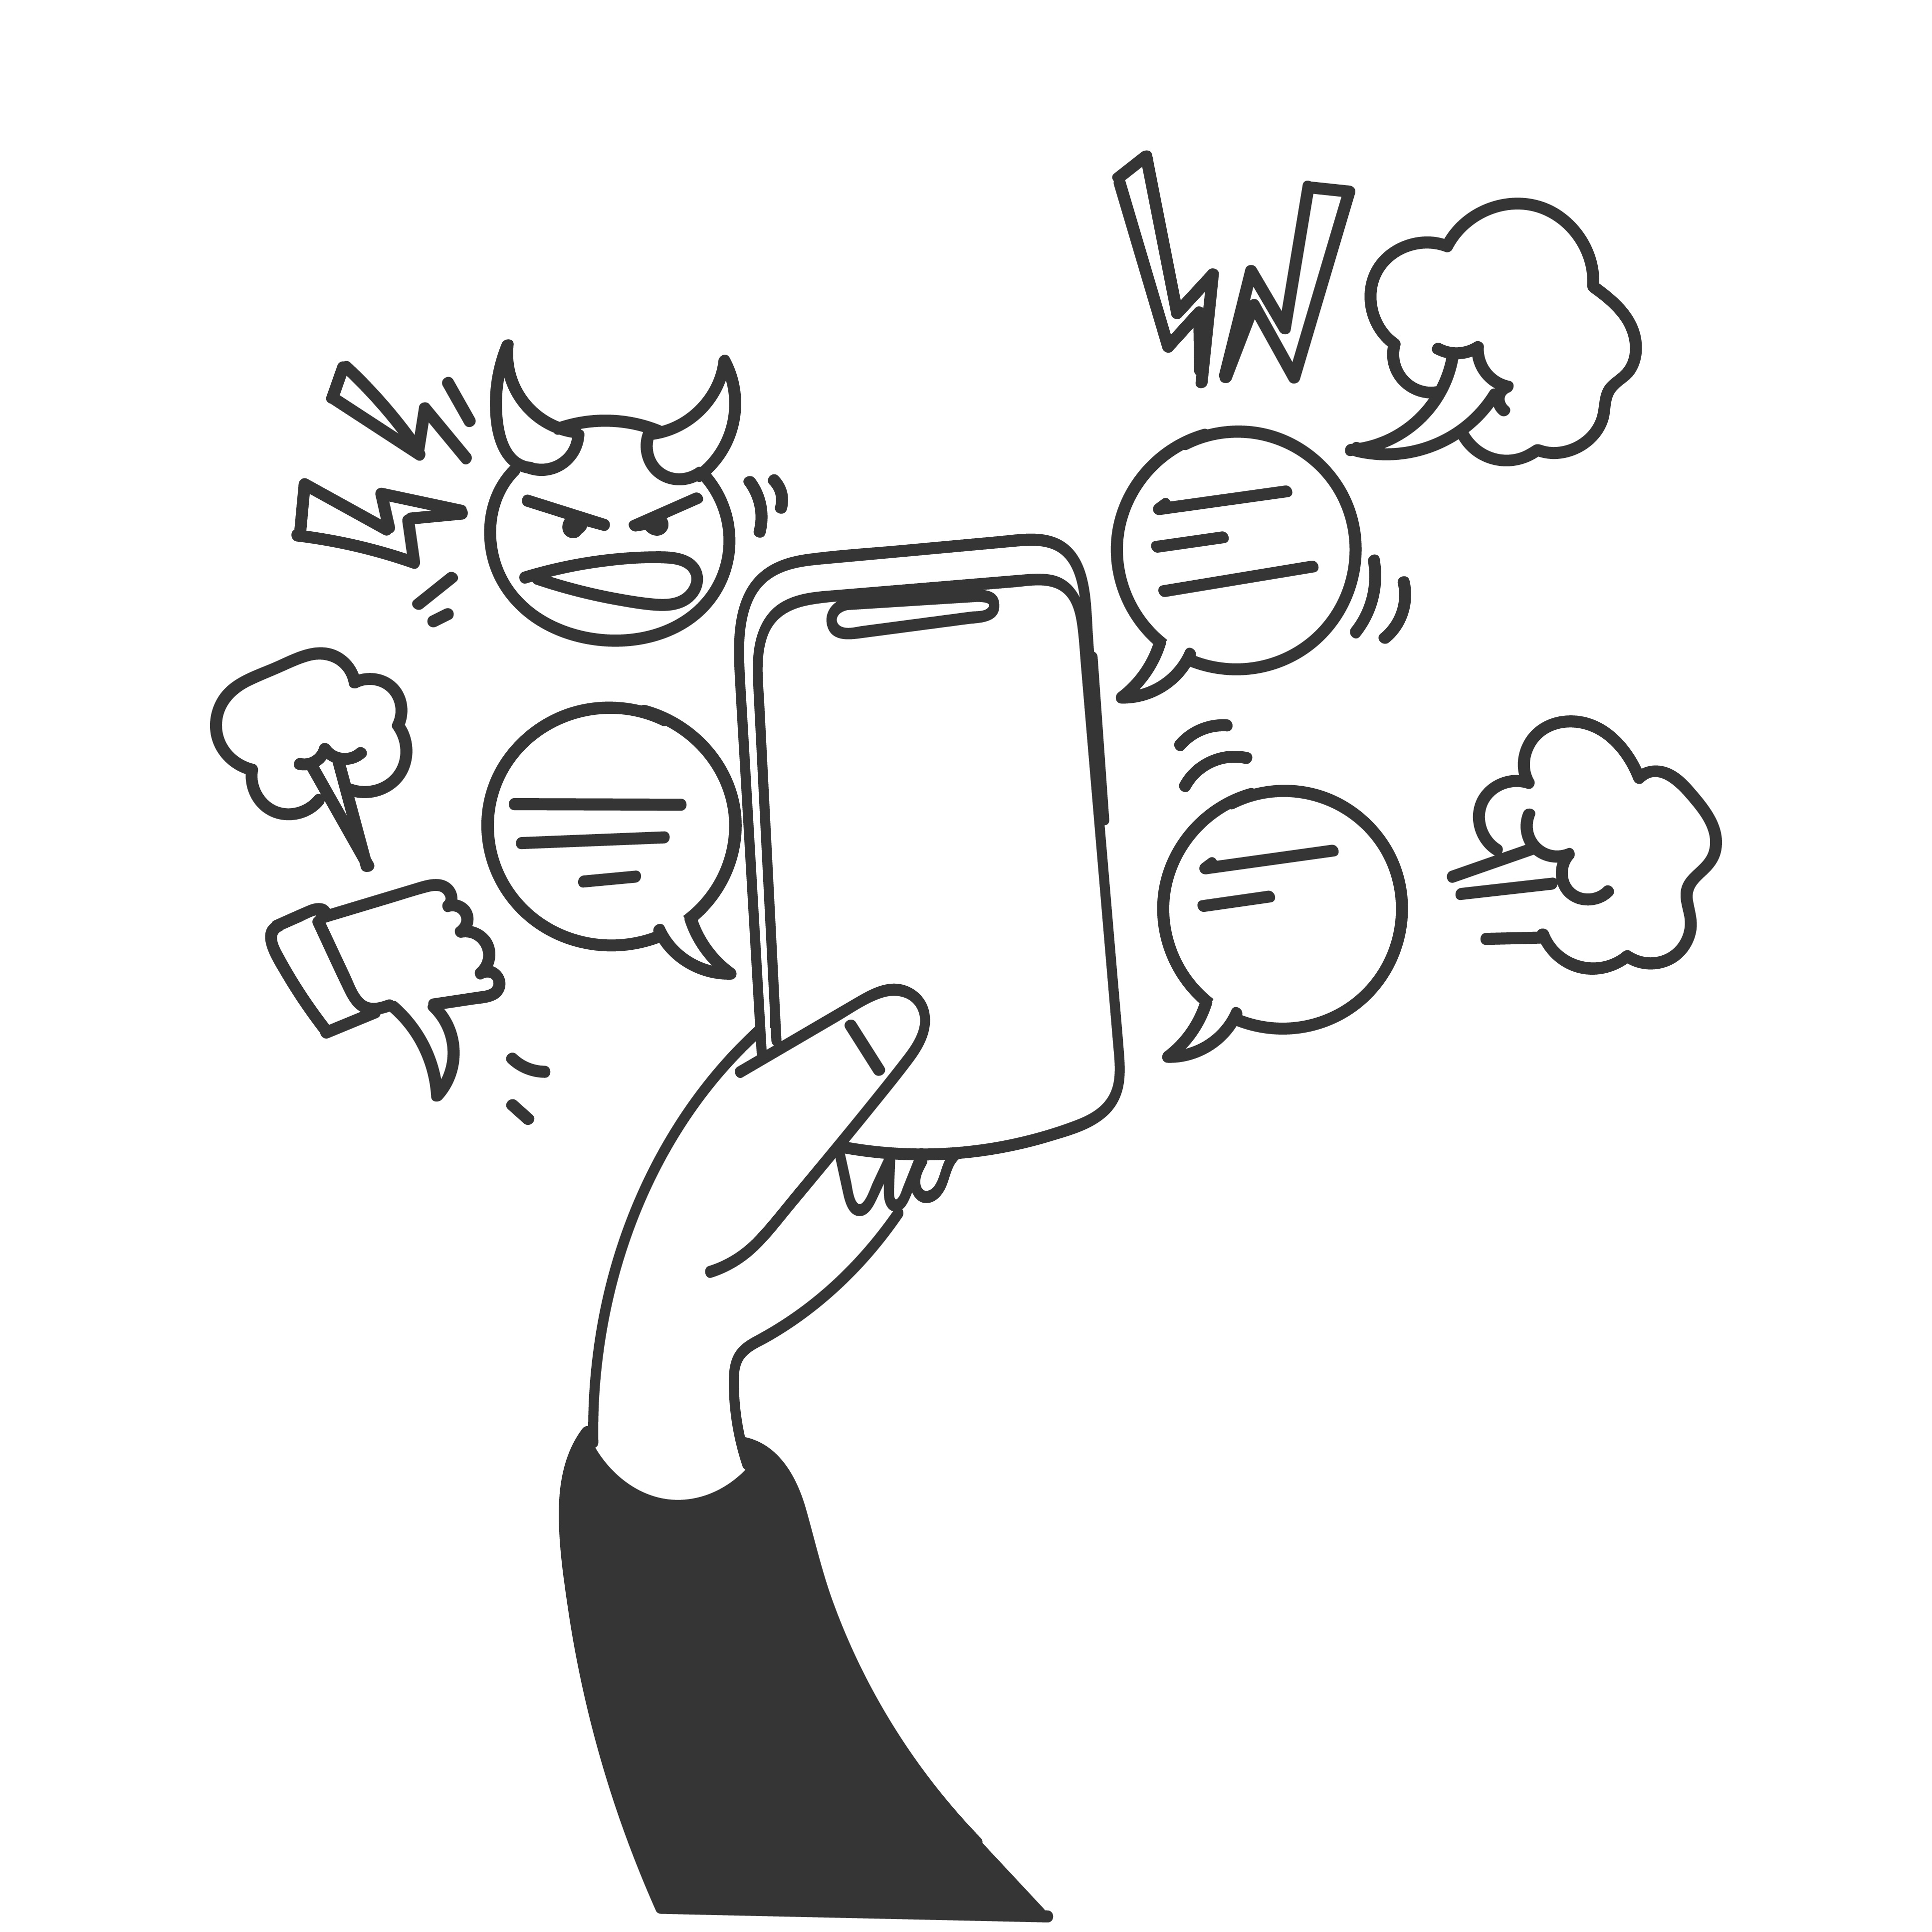
What do you think?
At what point do you think trolling becomes harassment?
Click for hints
Trolling crosses the line when it stops being a one-time joke and turns into constant hate.
If someone keeps targeting you with mean comments, trying to embarrass you, or making you feel upset or unsafe - that’s harassment.
It’s not just ‘banter’ if it keeps happening and makes you feel trapped.

Slide 15

Quiz time True or False
Using someone else’s Netflix account without permission is a form of online harm?
TRUE
Yes, using someone else's Netflix account without their permission can be a type of online harm. It’s called unauthorised access, which means logging into someone’s account without them knowing or saying it’s okay.

Slide 16
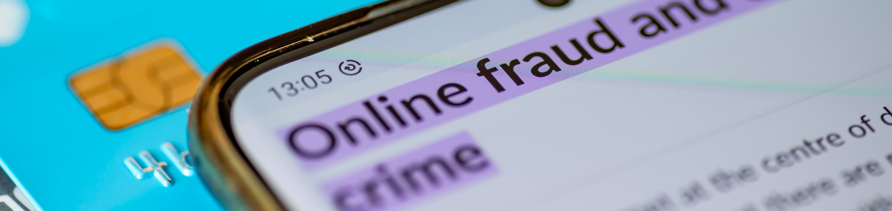
Which online actions become crimes?
HACKING: GUESSING PASSWORD OR ACCESSING PRIVATE ACCOUNTS
SHARING HACKED OR LEAKED INFORMATION
ONLINE HARASSMENT AND BLACKMAIL
PARTICIPATING IN SCAMS OR FRAUD
Some online actions aren’t just harmful – they’re illegal.
Have you or someone you know ever seen one of these happen online?
What would you do if you did?
Click for answers

Slide 17

Consequences of engaging in online harm
The Computer Misuse Act 1990 is the main law dealing with cybercrime.
Unauthorised access to computer material can result in up to two years in prison.
More serious offenses can lead to up to ten years in prison.

Slide 18
What the law says…
Click for answers
What do you think?
If someone spreads a computer virus on purpose, how long do you think they could go to prison for?
10 years.
What about guessing passwords to an account? Do you think it’s prison time or just a fine?
Can be both, depending on the severity; 2-year sentence or a fine .

Slide 19

Sharing nudes or pictures without consent
Message Received – part 1
Sharing pictures without consent is illegal. Once shared, you lose control over them. Deepfakes can use harmless photos to create fake, harmful content.
If you're having trouble accessing the video, here's a direct link:
Message Received

Slide 20
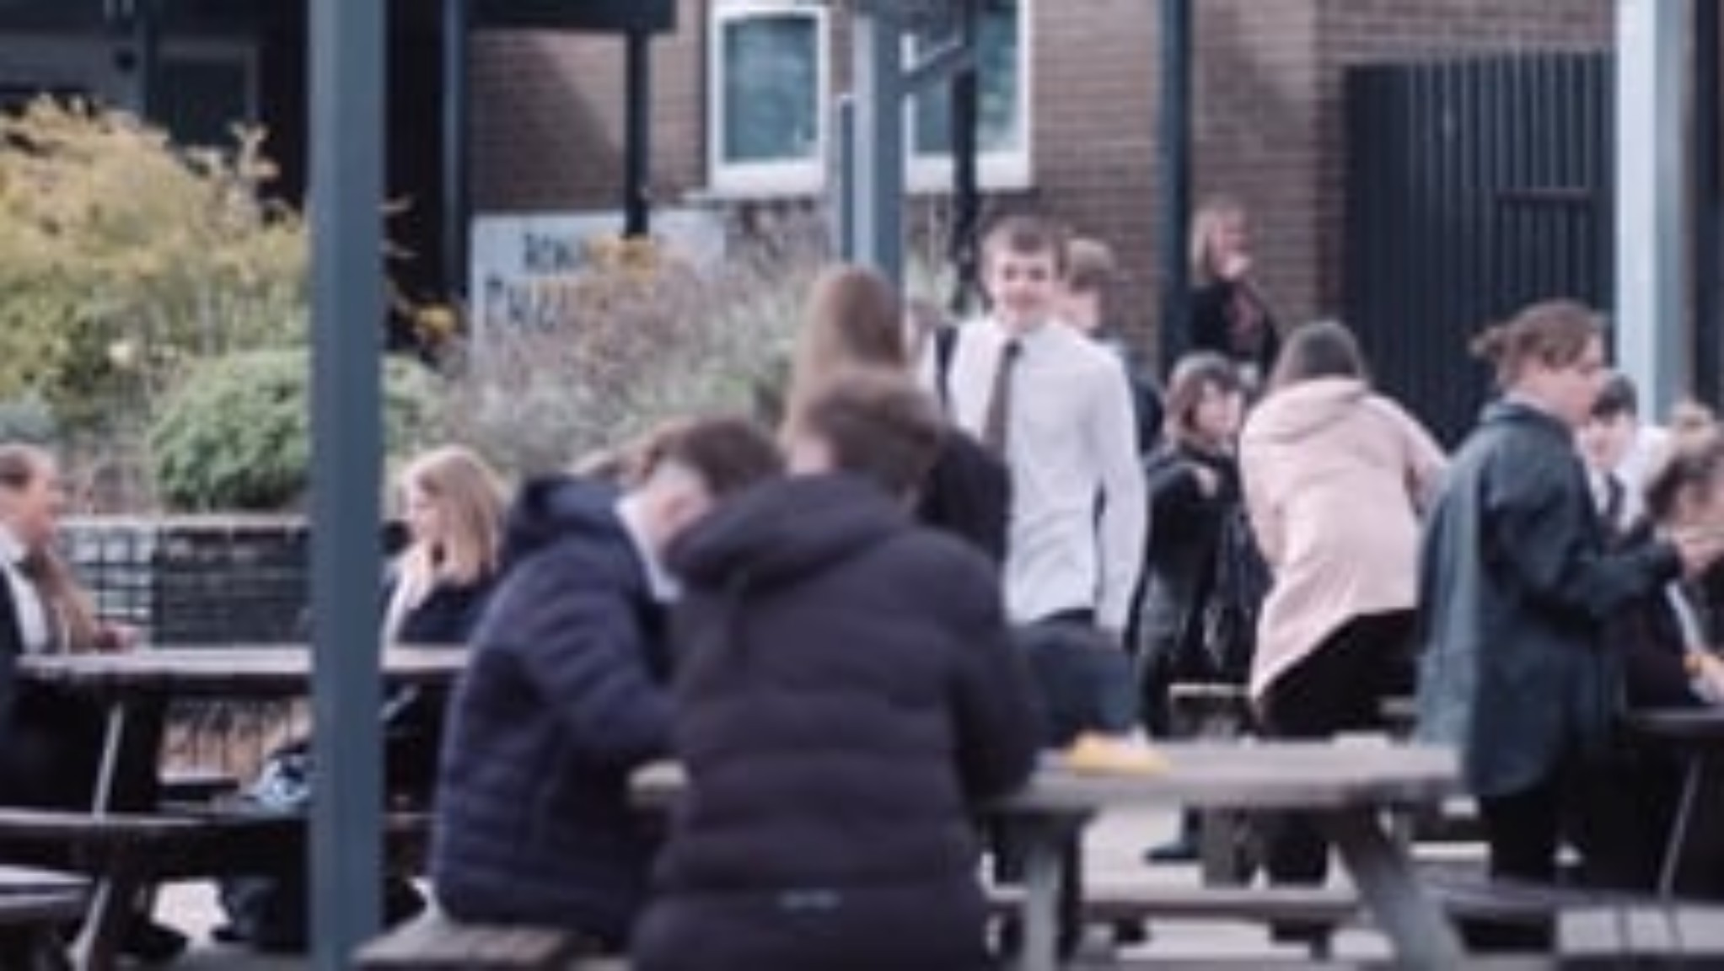

Slide 21
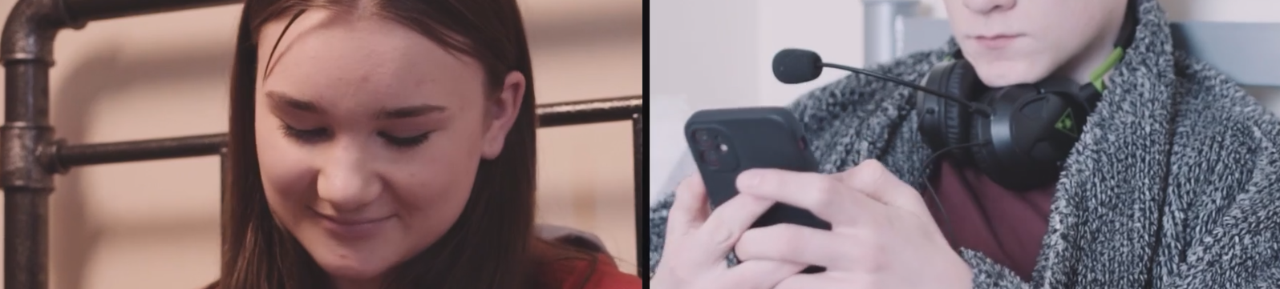

What do you think?
What do you think?
Why do you think some people are pressured to share private photos (nudes)?
Think from Anna’s and Taylor’s perspective.
HINTS ON
THE NEXT SLIDE

Slide 22
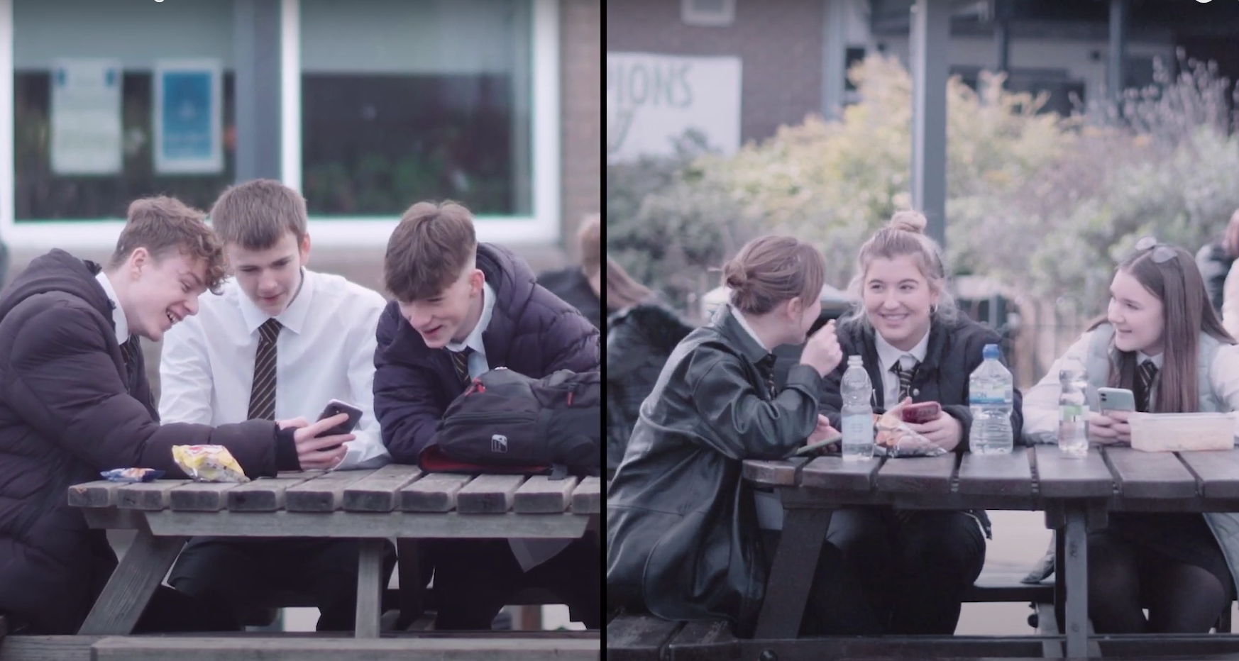

Let’s look at the impact this can have for everyone involved →
“Everyone else is doing it.”
“If I don’t send one, they might break up with me.”
“I thought I could trust them not to share it.”
“If I don’t receive them, they might think I’m frigid.”
If you're having trouble accessing the video, here's a direct link:
Message Received

Slide 23
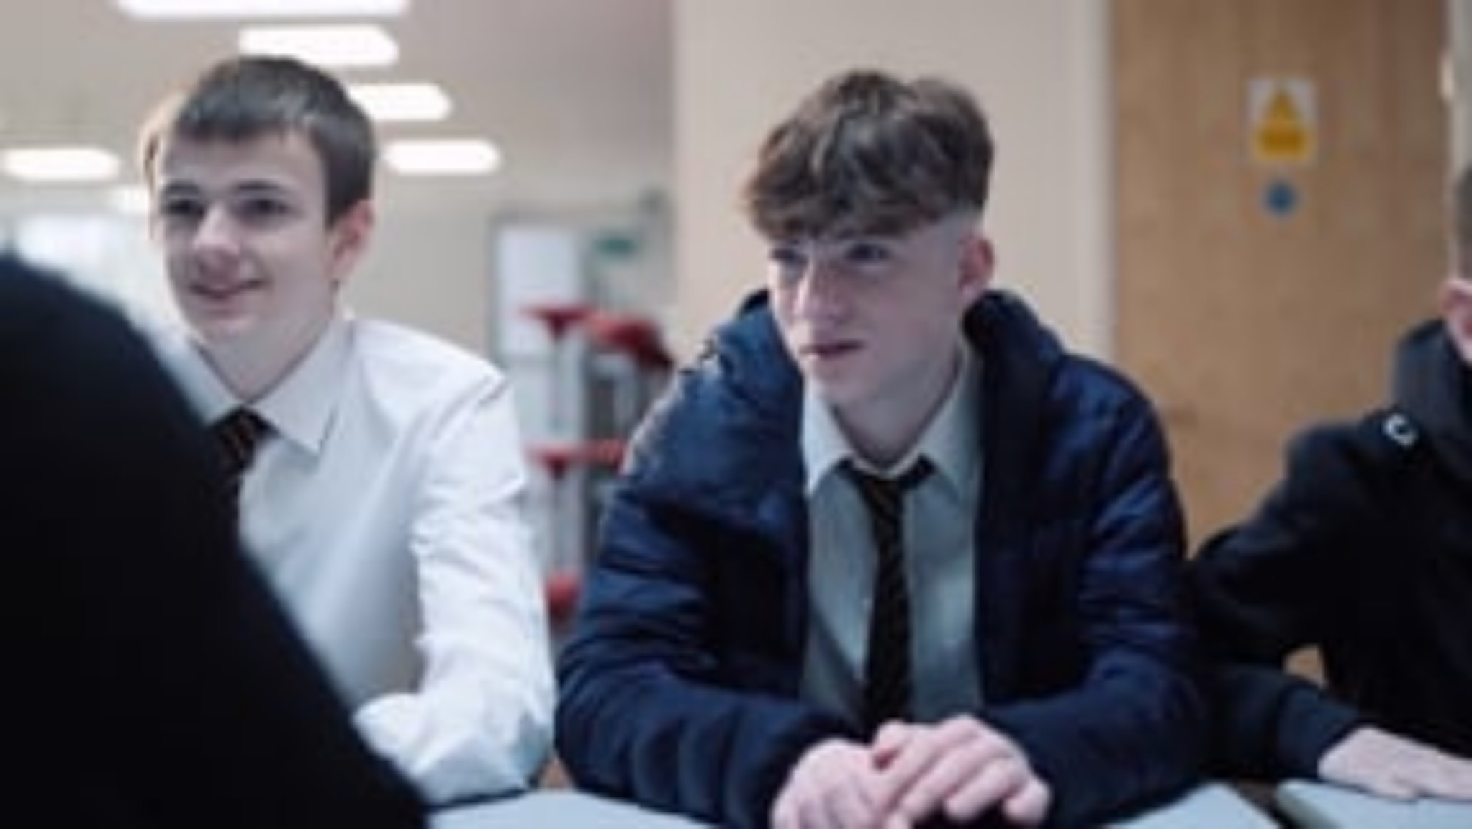

Slide 24
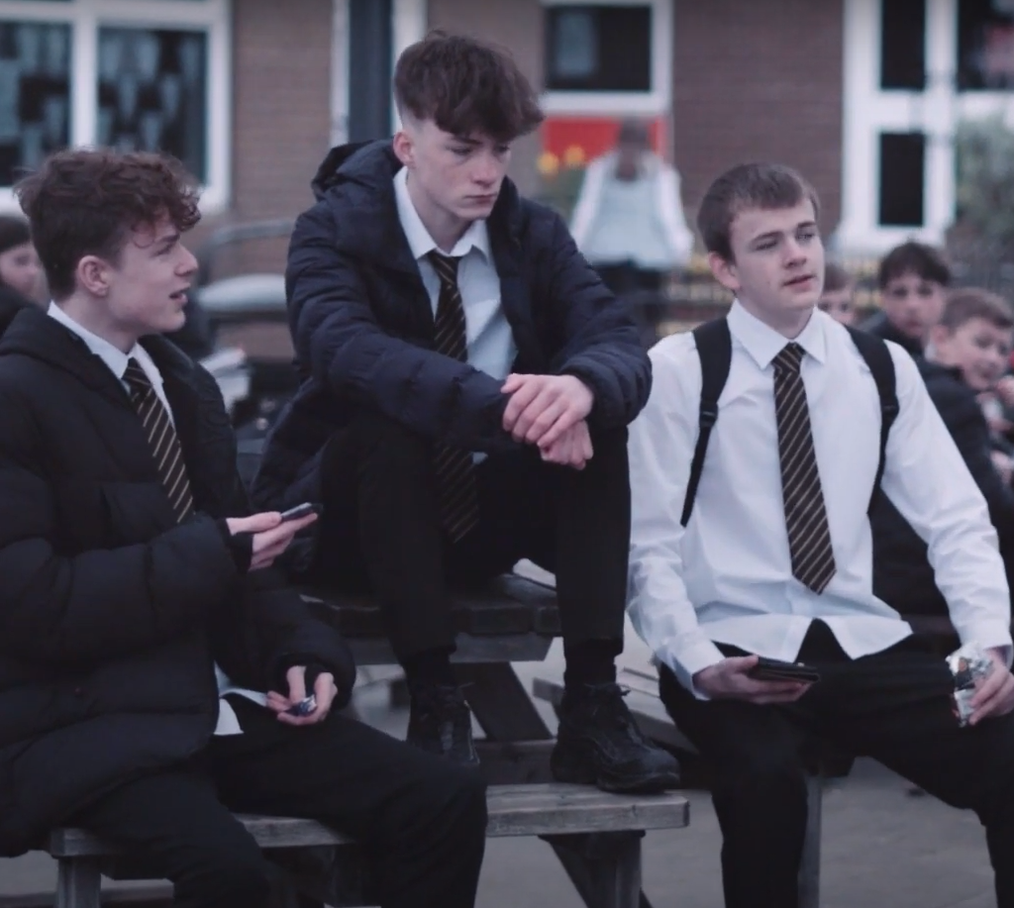
Discussion
1. Do you think Taylor thought about the consequences of forwarding the image?
2. How has this impacted Anna’s mental health?
3. Who else, besides Anna, has been affected by this, and how?

Slide 25
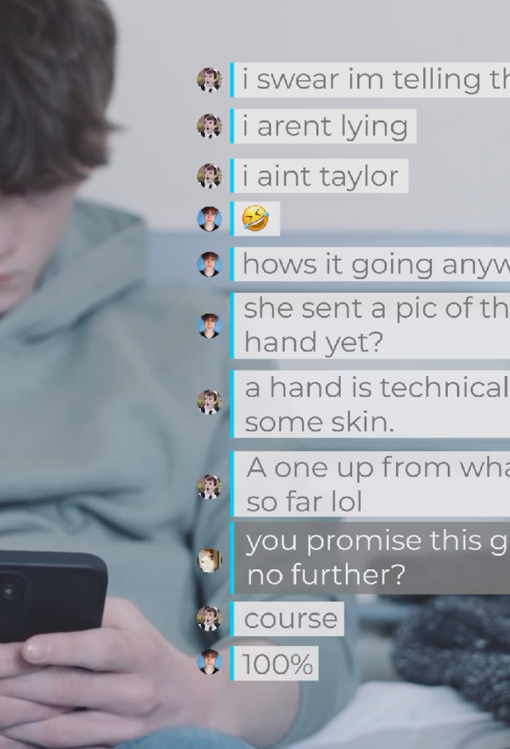
Here are 5 facts about sexualised images and nudes
1. Images can be saved – Even on apps like Snapchat, pictures can be screenshotted or saved by others.
2. No pressure to send nudes – It’s never okay for someone to pressure you into sending a nude picture.
3. It’s illegal under 18 – Sending or receiving nudes if you're under 18 is against the law.
4. Not everyone shares nudes – It’s normal if you or your partner don’t want to share nudes in a relationship.
5. Support is available – If things go wrong, there are services to help and offer support.

Slide 26
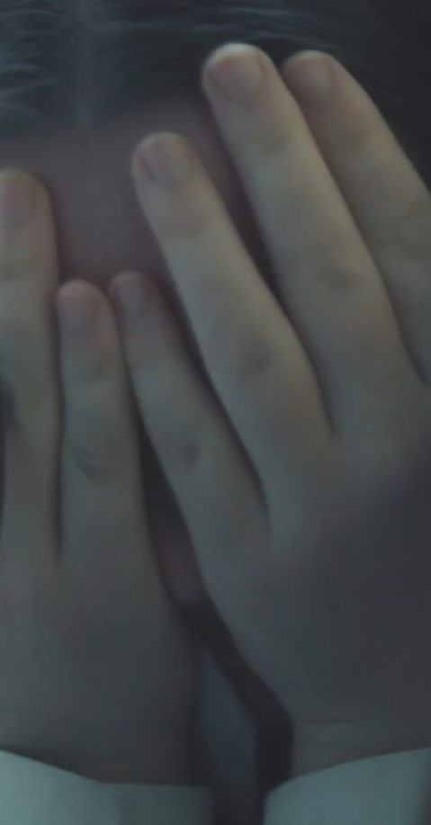
Think before you share!
It’s important to understand how consent works, if someone says ‘no’ or even if they are unsure, you must respect it.
Sharing someone’s photo or video without their permission isn’t just wrong – it’s illegal. But what if you never even shared a photo, and one still appeared online? Technology like deepfakes can take your pictures and turn them into fake but realistic-looking content.
Imagine this: a video of you pops up online saying or doing something you never did. How would you feel?

Slide 27
Deepfakes
Which of these is an example of a deepfake?
A video where a celebrity’s face is edited into a movie they were never in.
A video of a politician giving a fake speech they never said.
Both a and b.
None of the above.
Answer: c) both a and b.
Deepfakes are videos, images, or audio that look or sound real but are completely fake. They're made using advanced computer technology (Artificial Intelligence) to make it seem like someone is doing or saying something they never did.

Slide 28

Slander
Slander can also harm someone’s reputation.
What is slander?
Spreading false statements to damage someone’s reputation.
Examples include:
- False rumours on social media.
- Twisted voice notes or videos.
- Fake profiles spreading lies.
Have you ever heard a rumour about someone online that wasn't true?

Slide 29
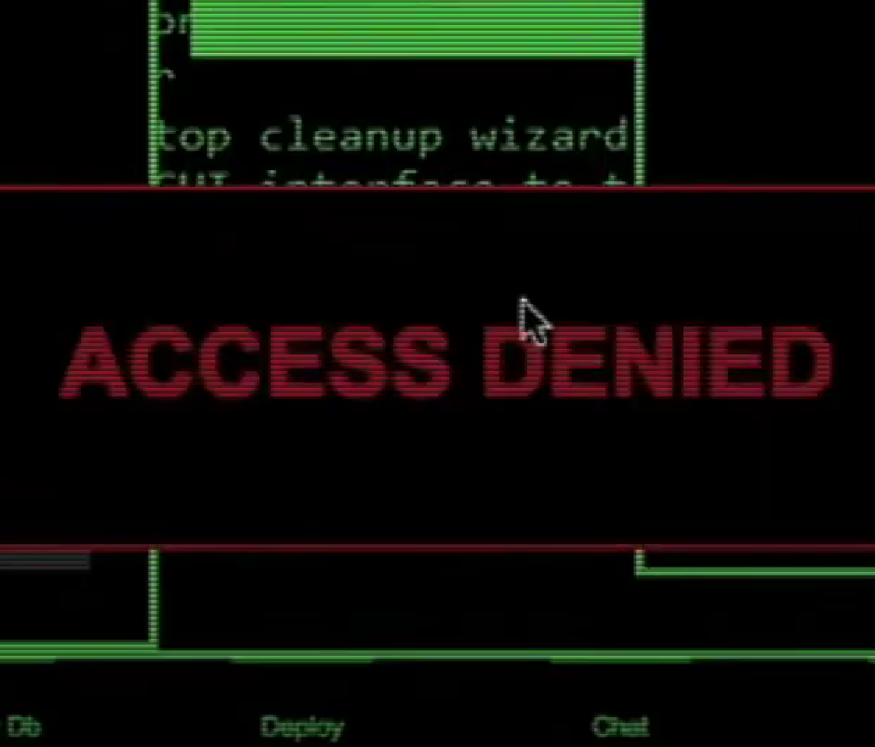
What do you think?
Which of these actions do you think are crimes under the Computer Misuse Act?
Guessing a password to snoop.
Installing a virus to delete files.
Buying hacking software online.
Answer: all of the above.

Slide 30
Click to watch
We’re now going to watch a short clip about cyber crime
Source
Tarian RCCU
If you're having trouble accessing the video, here's a direct link:
Cyber crime

Slide 31
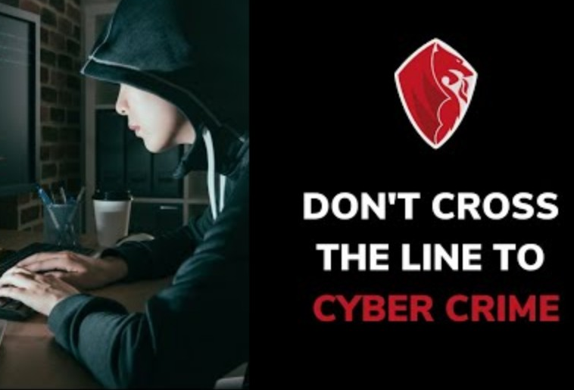

Slide 32
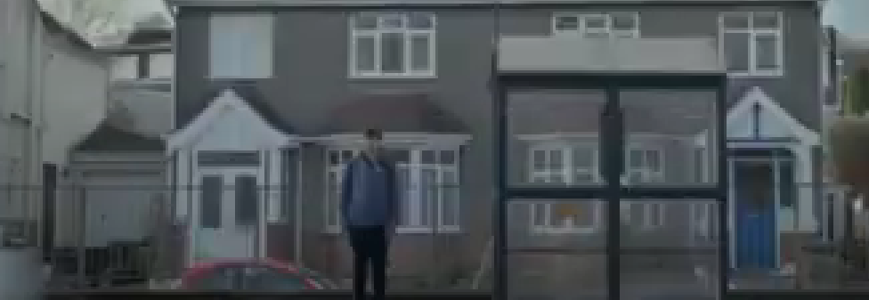
What do you think?
At what point in the film do you think the main character could have stopped before it became serious?
Why do you think people start committing cybercrimes?
Hints on the next slide →

Slide 33
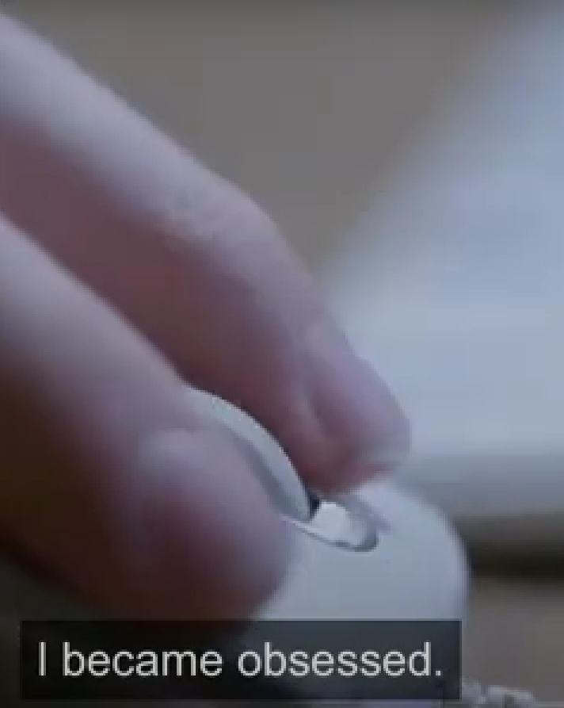
Possible reasons…
Power and Control: Some want to intimidate or embarrass others.
Peer Pressure: Trying to fit in or join harmful trends.
Feeling Anonymous: Thinking they won’t get caught.
Temptation: Can get carried away, thinking it’s fun.
Not understanding the harm: Some might not realise how their actions affect others.

Slide 34
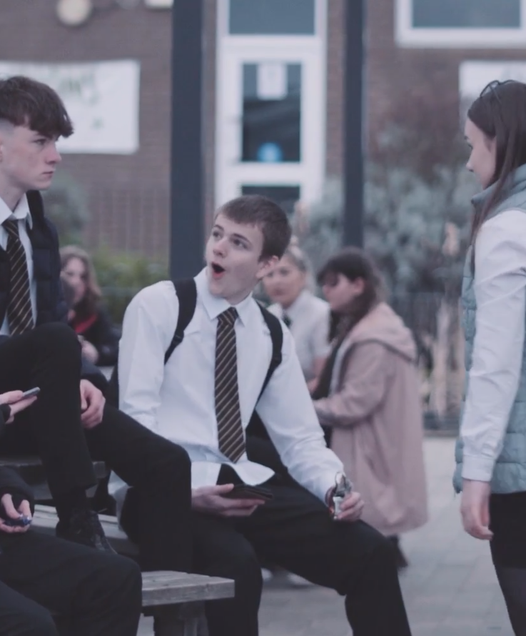
The impact online harm has on people
Online harm has an impact on victims, perpetrators and bystanders too.
It can make people lose trust in online spaces, if there’s too much trolling or harassment, people might stop using certain websites or apps.
This can also lead to stricter rules on the internet, which can limit everyone’s freedom on the internet.
Can you think of some real-life examples of a stricter environment online?
Have you experienced it yourself?

Slide 35

The impact it has on people committing online harm
If employers or universities see trolling, offensive posts, or illegal activity linked to you online, it can harm your chances of getting a job or a place.
Friends and family can get affected by your actions which could lead to mistrust.
It could leave you feeling stressed or anxious, worsening your well-being.
Once something is online, it’s hard to erase, a bad digital footprint could pop up years later and affect your reputation.

Slide 36
Quick Cash? Think again!
How it works
Consequences
cc
cc
Sometimes people might offer you money to accept or move cash through your bank account.
It might seem like an easy way to make money, but it could be part of something illegal like money laundering.
Money laundering is illegal and can lead to prison, fines, and a criminal record. Banks may close your account, making it harder to get loans or a job. Criminals might also pressure or threaten you to stay involved.
In pairs, discuss:
What would you do if someone offered you money for moving cash?
Why could it be dangerous?

Slide 37
Call it out!
Can you think of any positive alternatives to engaging in online crime?
HANDS UP!
Click for suggestions

Slide 38


Positive alternatives
Learn ethical hacking which teaches you how to protect systems from cyber threat and hackers!
Game design.
Graphic design.
Stay social and active!

Slide 39
8 Tips to stay safe online
Never give out your name, address, phone number, email, password or school name.
Be careful who you send your pictures to, never send them to a stranger.
Never open emails, files or links from people you don’t know or trust.
Before downloading anything, check with a trusted adult
Never respond to new people online.
If anyone asks to meet you online, make sure to tell a trusted adult.
Never tell a stranger where you are going or what time.
Try not to use rude language online ☺.

Slide 40
This short film has some tips on how to help yourself and others in a risky situation.
Click for video
If you're having trouble accessing the video, here's a direct link:
Staying Safe

Slide 41


Slide 42
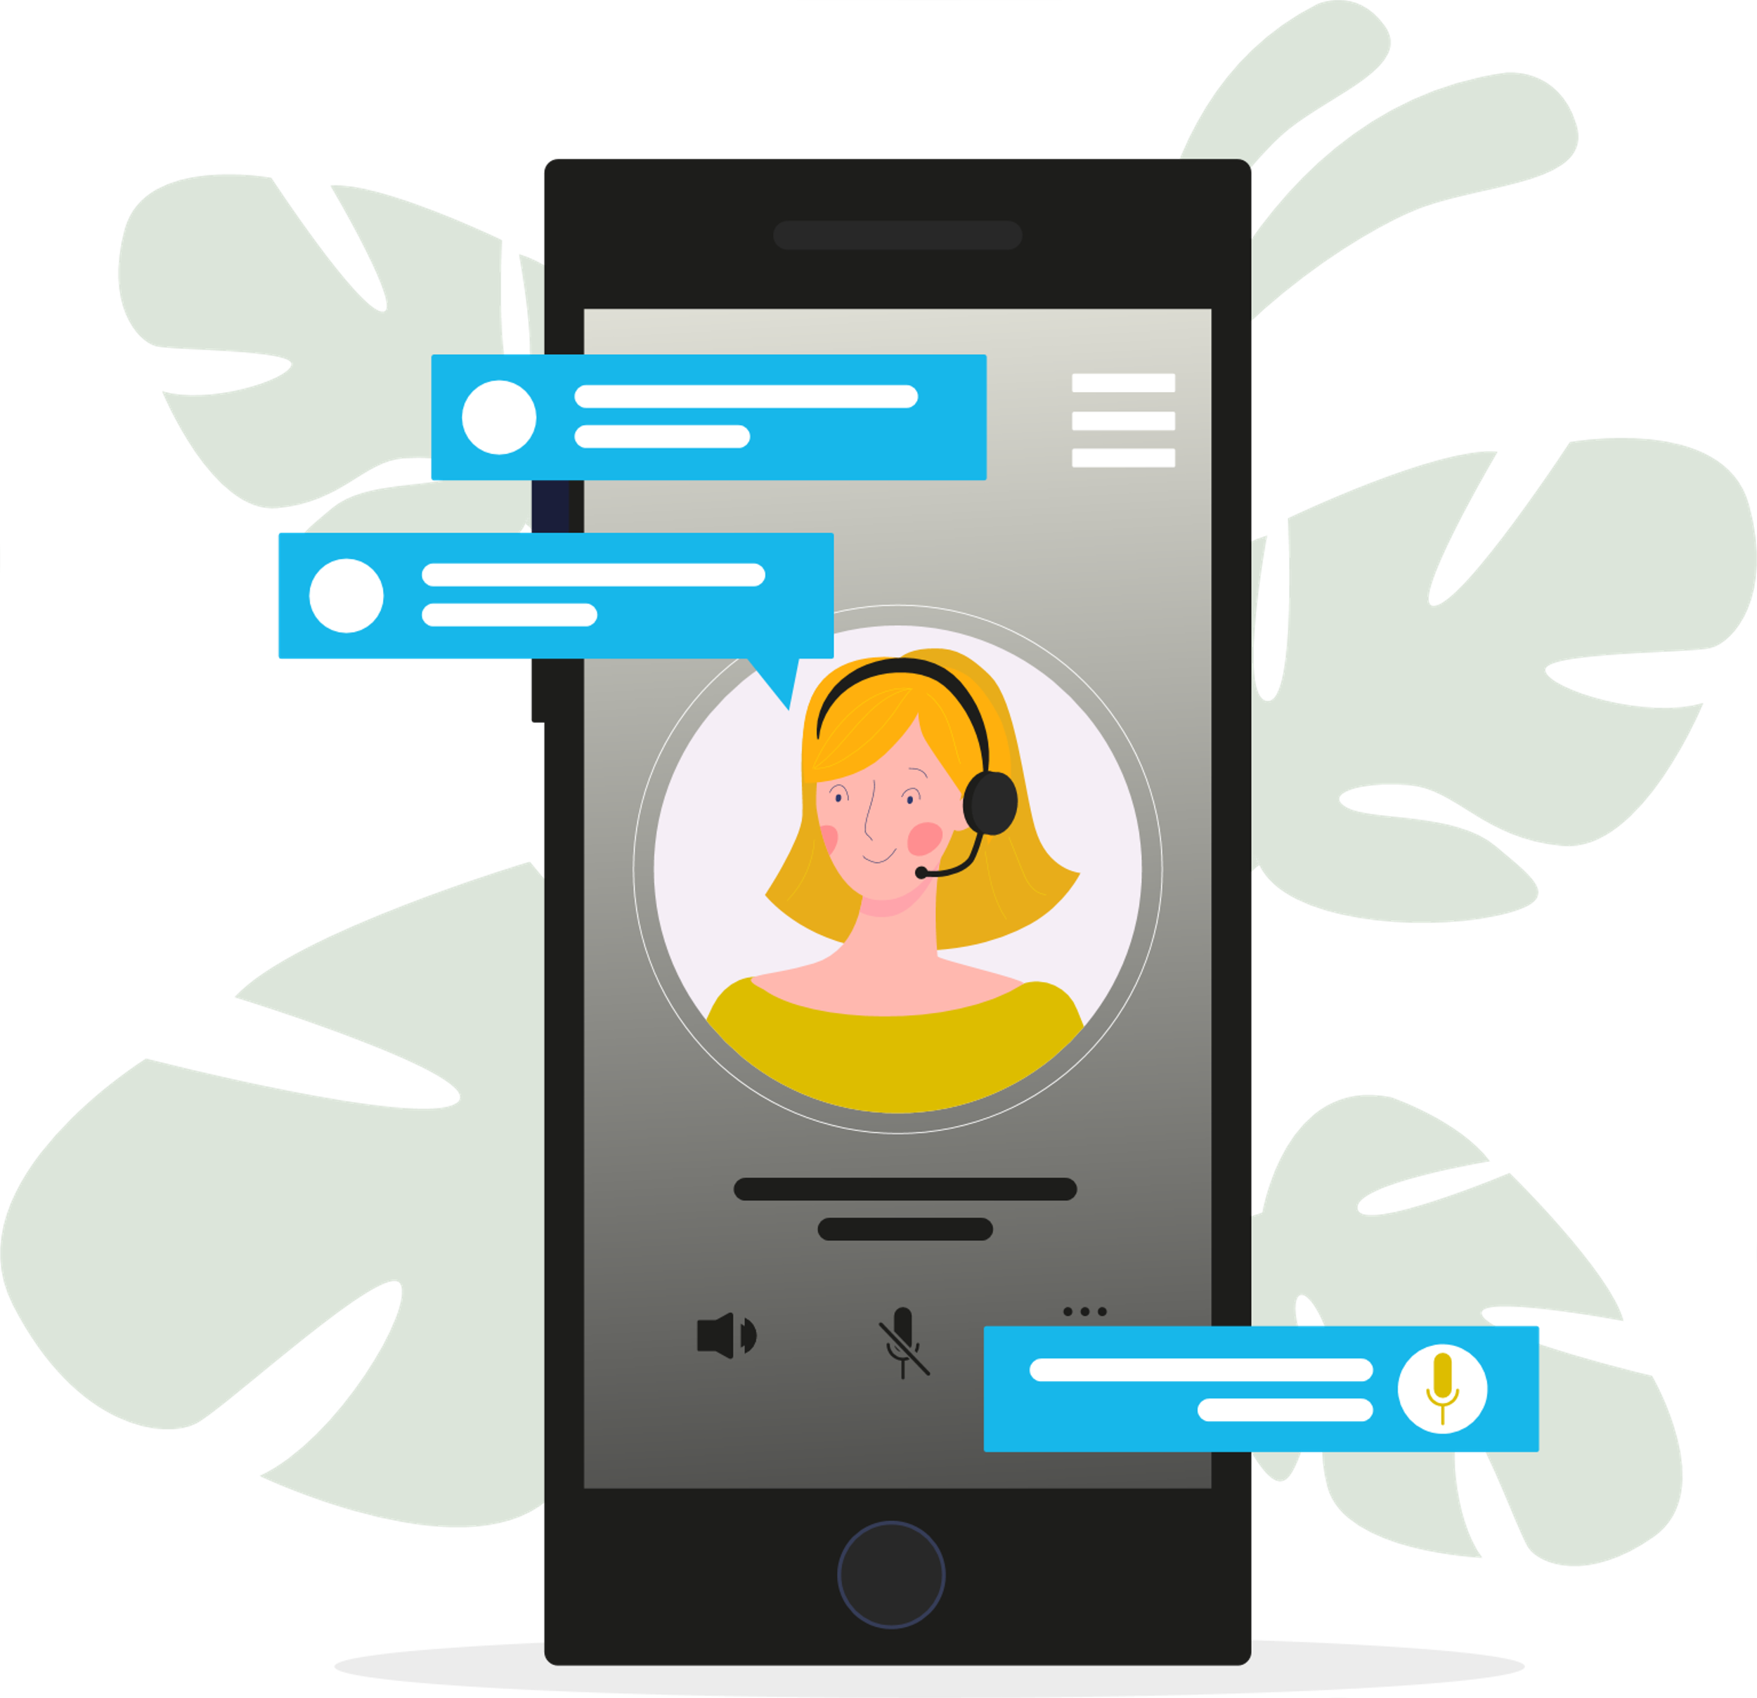
Support and help
NSPCC www.nspcc.org.uk
Childline www.childline.org.uk The Internet Watch Foundation’s Report Remove tool, available through Childline, lets young people report sexual images or videos of themselves and have them removed from the internet confidentially.
The Cyber Choices programme to help people make informed choices and to use their cyber skills in a legal way. - https://www.nationalcrimeagency.gov.uk/cyber-choices
Anonymous reporting via www.fearless.org or Crimestoppers.

