Slide 1




This is a NEW
Not In Our Community resource being tested
Feedback on what we can change or improve is very welcome.
Please email mail@notinourcommunity.org with comments or to request a call.
Thank you for your support.

Slide 2
Introduction to Hate Awareness
Recommended for: Key stage 3, 4 and above.
Content discusses hate against race, disability, sexuality & other forms of discrimination.

Slide 3

Learning
Outcomes
1. Different types of hate.
2. Why people commit hate crimes.
3. How disinformation can increase hate.
4. How to protect yourself and others.

Slide 4

Trigger warning!
Content discusses hate against race, disability, sexuality & other forms of discrimination.
If any content causes
distress, a safe place to
go is…
Session Expectations
No personal questions or comments.
Listen to each other.
Treat each other with respect, even if you disagree.
Engage with and try to enjoy the learning.

Slide 5


What do you know about hate?
What are types of hate crime?

Slide 6






Types of Hate
A hate crime is a criminal act that is motivated by prejudice or hatred against someone because of their identity or protected characteristics.
Click for examples
Protected characteristics:
Race, ethnicity and culture
Religion or belief
Examples of hateful acts include:
Sexual orientation
Vandalism
Attacks
Gender identity
Harassment
Online abuse
Disability (Visible and Hidden)
Slurs
Mocking someone

Slide 7
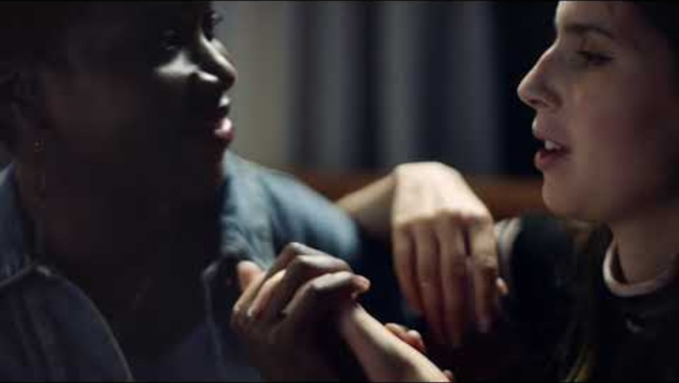
Now we're going to watch a quick video about hate crime and the different forms it can take:
If you're having trouble accessing the video, here's a direct link:
Hate crime - Nationwide campaign
Notes:
Video length – 1 minute

Slide 8


What do you think?
Have you ever seen or heard about a
hate crime in the news or on social media?
How did people react?
We are now going to discuss some incidents on the next slide to determine if they are a hate crime and if so, why? →

Slide 9
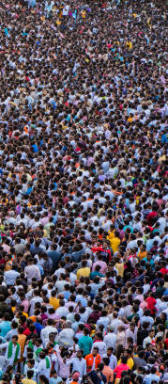
Spot the hate crime
Which of these are hate crimes?
A shop worker refuses to serve a female customer for wearing a hijab, telling them that they don’t serve ‘her kind’ here.
A student is called offensive slurs for being autistic.
Someone is trolled online because of their football team.
A group shouts homophobic abuse towards a straight male leaving a public house used by the LGBTQ+ community.
Answer: a, b and d are hate crimes.
c can be offensive but isn’t a hate crime.

Slide 10
Hate against:
Sexual Orientation and Transgender Identity
Acts of hate – (click for common behaviours)
cc
Verbal Abuse
Online
Calling people slurs, deadnaming*, making offensive jokes, or using negative stereotypes about LGBTQ+ people.
Trolling, sending hateful messages, or spreading false information about LGBTQ+ individuals.
Physical Abuse
*Deadnaming is the act of calling a transgender or non-binary person by their birth name after they have chosen a new name.
Assaults
Can you name any other things people might do?

Slide 11

Hate against:
Sexual Orientation and Transgender Identity
In pairs, discuss:
Verbal Abuse & Bullying
Online Hate
Q1. Have you ever witnessed or heard about any of the behaviours on the last slide?
Q2. How might this impact the person these behaviours were directed at?

Slide 12
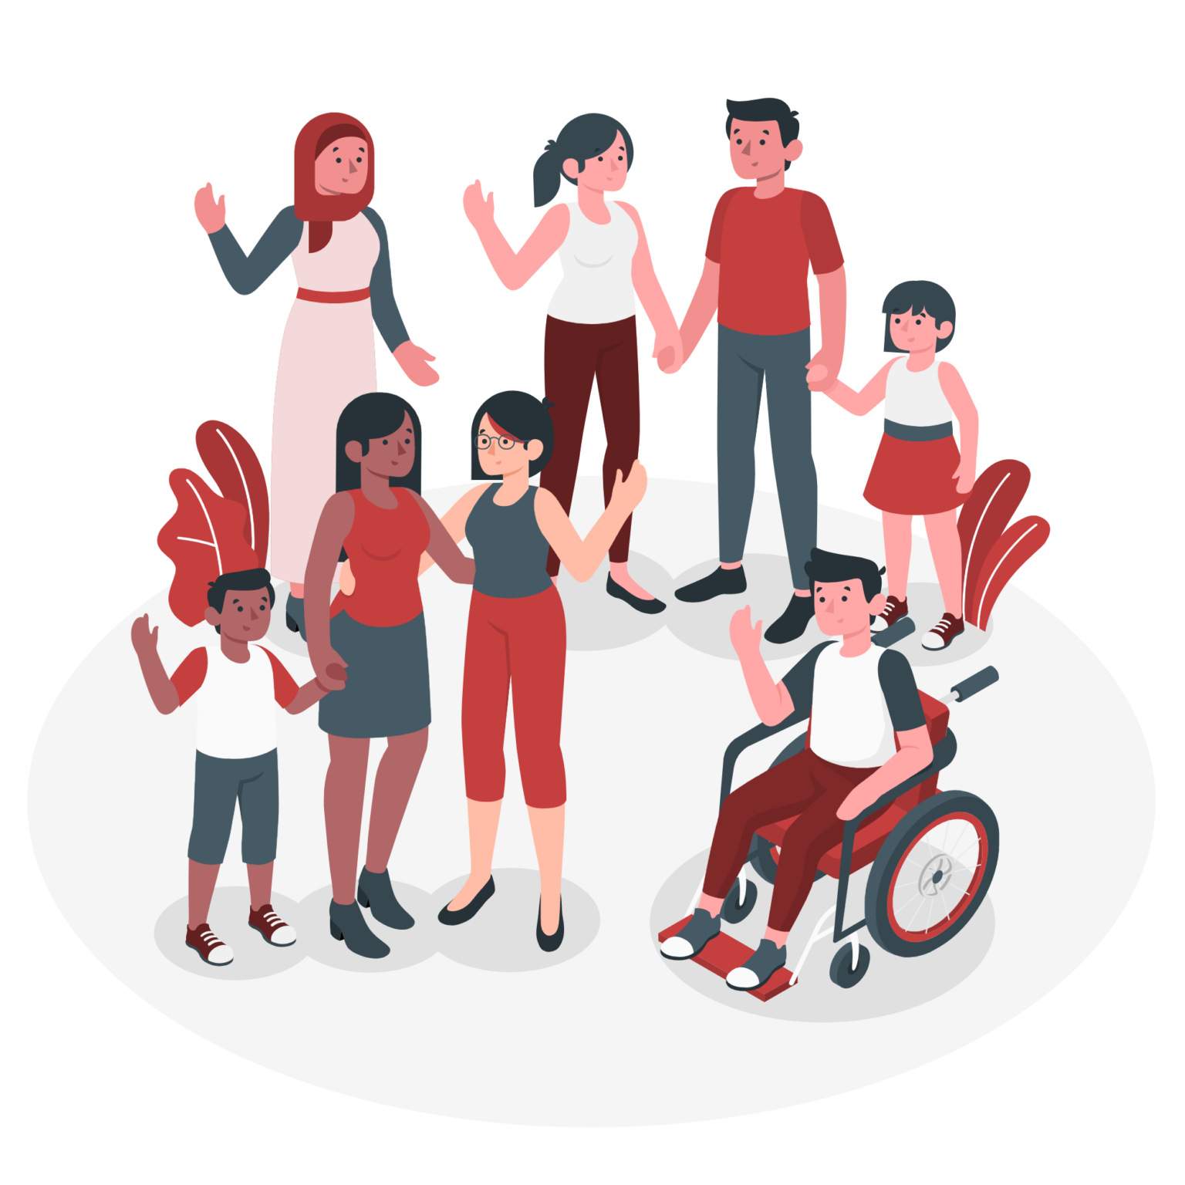
Hate against:
Disability
Most hate incidents and crimes involve but are not limited to; verbal abuse, physical abuse as well as threatening behaviours which may result in offensive name-calling and assaults.
Did you know that:
“Mate Crime” is a behaviour which means taking advantage and abusing someone with learning disabilities, learning difficulty, and/or mental health conditions.
Source: Stop Hate UK

Slide 13
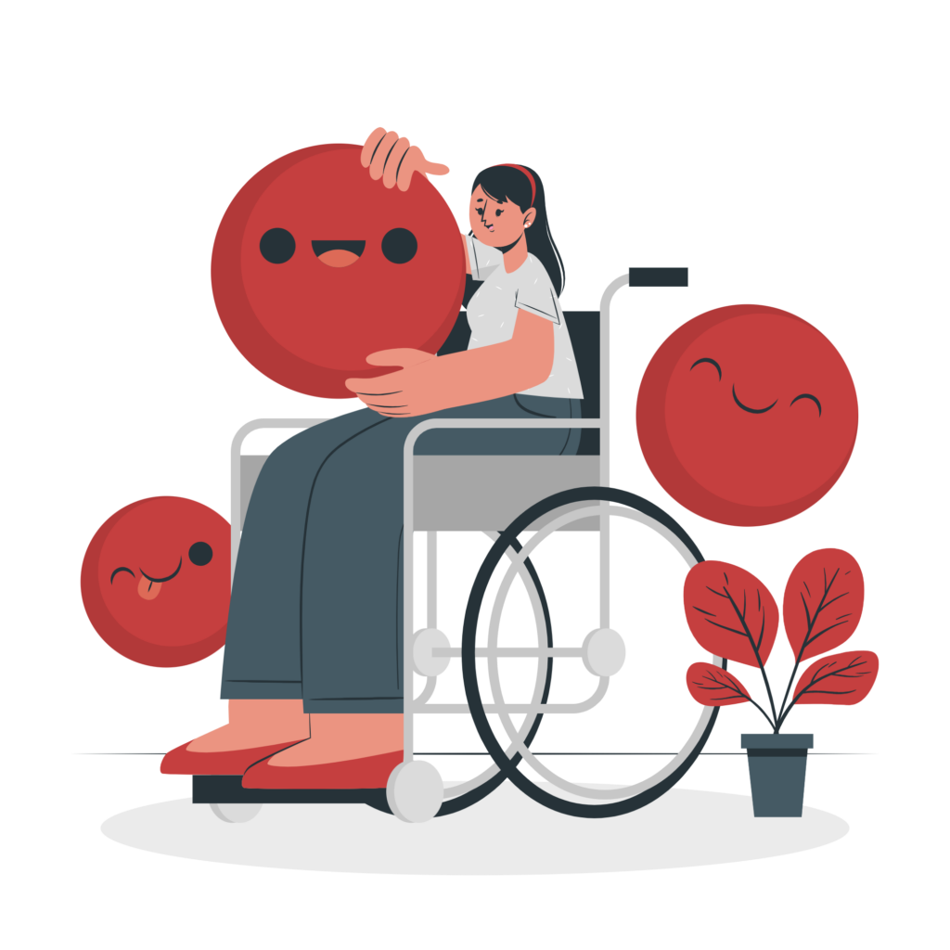
Hate against:
Disability
Q1. How do you think a person being targeted in this manner would feel?
Q2. How would you feel if this happened to someone you care about like a family member or a close friend?
Source: Stop Hate UK

Slide 14

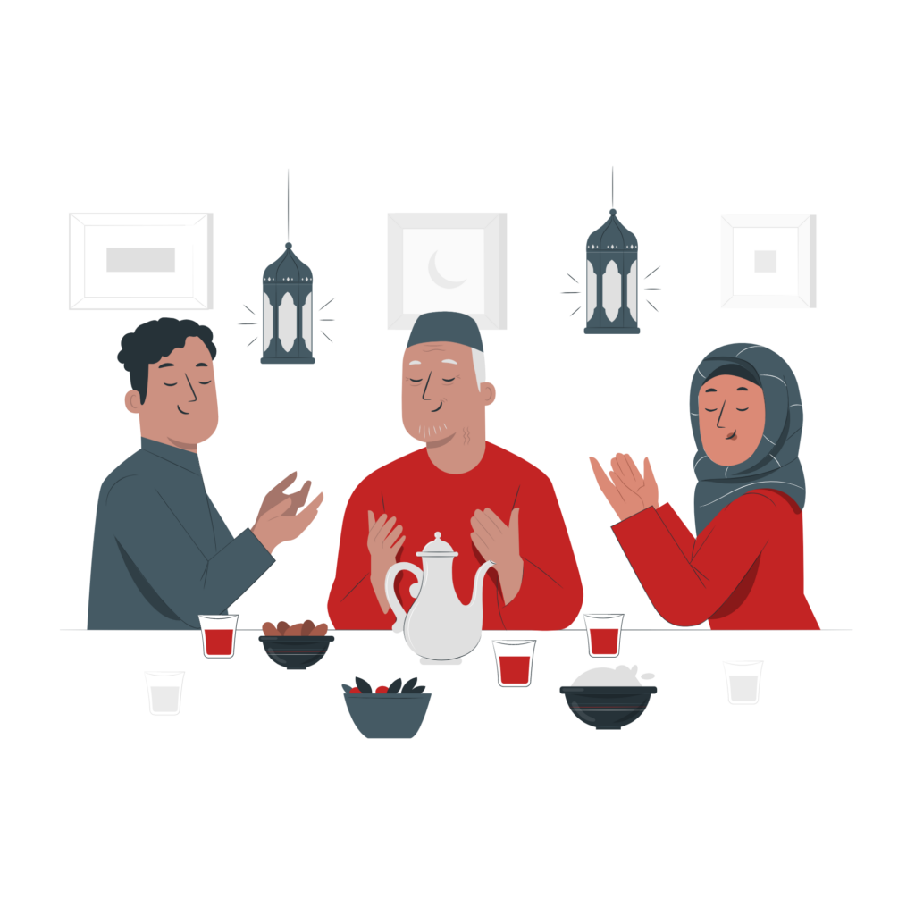

Hate against:
Religion and Faith
Hate incidents and crimes often include but are not limited to; verbal abuse, threatening behaviour, harassment and offensive language.
Did you know that:
People with no religion or agnostic people can also face hate and discrimination from religious groups for not adhering to a religion.
In pairs, discuss:
Verbal Abuse & Bullying
Online Hate
Source: Stop Hate UK

Slide 15

Hate against:
Race
Racism is the most commonly reported type of hate crime in the UK.
Forms of hate crime include but are not limited to; racial abuse both verbally and online, physical assaults and having property defaced with threatening/offensive graffiti.
Source: Stop Hate UK

Slide 16
“But - it’s just a joke!”
A joke about for example: your taste in music, can be fun if it does not offend or upset them. 😄
When people aren’t in on the joke, it becomes repetitive, or if it's about an issue that could be sensitive it can become bullying or discrimination. 😔
To remove the risk of getting in trouble or upsetting someone, you should not joke about a protective characteristic such as race, religion, gender identity, sexual orientation or disability. 🤐
However

Slide 17
Discrimination & hate harms society
It creates barriers that prevent people from participating equally in society.
It violates legal protections, such as the Equality Act 2010.
It reinforces exclusion and negative stereotypes about disability, transgender-identity, race, religion or belief, or sexual orientation.
It goes against the British values of Respect and Tolerance.
Discrimination is when someone is treated unfairly or unkindly just because of who they are, such as the colour of their skin, whether they are a boy or girl, the language they speak, their sexuality or if they have a disability.

Slide 18

Discrimination in Action
“My partner and I visited a hotel.
I booked a room online, and I was questioned on reception whether I knew I booked a double room.
I said ‘Yes’. The receptionist looked behind me and said: ‘Yeah, but you’re two men’.
She walked off to speak to her manager and came back and told us that they didn’t allow gay people to stay in their hotel and that we had to leave immediately.”
Q) What kind of discrimination is shown here?
Homophobia.
(Discrimination against sexual orientation.)

Slide 19
Hate in Action
“My teenage daughter was walking through town with the aid of her sticks. A group of older children were laughing at how slow she moved and took her sticks to play with.
They threw the sticks in a bush and walked off laughing.”
Q) What kind of hate is shown here?
Hate against someone because of their disability.
This could be classed as a hate crime.

Slide 20

What the law says on hate crime in the UK
The Crime and Disorder Act 1998 and Public Order Act 1986 make it illegal to target someone based on race, religion, disability, sexual orientation or gender identity.
Extra penalties
If a crime is motivated by hate, the punishment can be more severe.
Yes, even online abuse counts
Sending hate messages or sharing offensive memes can be reported as hate crime.

Slide 21
Why would someone commit a hate crime?
What do you think?
4 common reasons are on the following slides
Notes:
Common Reasons may be
They find it exciting.
They think it will give them excitement and maybe mistakenly think that people would support what they are doing or find it amusing.
They want revenge.
They are acting out against an act of terrorism, something they think is unfair, or something that affected them personally.
They think they are defending against something.
They think that they need to stand up against a group that poses them a risk and therefore use hateful words and actions.
They believe they have a “cause”.
Possibly they are part of a group online or meeting up to act against what they consider to be a rival religion or race.
This can be influenced by misinformation from people they know and/or online.

Slide 22
Why would someone commit a hate crime?
There are 4 common reasons:
1. They find it exciting.
They think it will give them excitement and maybe mistakenly think that people will support what they are doing or find it amusing.
2. They want revenge.
They are acting out against an act of terrorism, something they think is unfair, or something that has affected them personally.

Slide 23
Why would someone commit a hate crime?
There are 4 common reasons:
3. They think that they are defending against something.
They think that they need to stand up against a group that poses them a risk and therefore use hateful words and actions.
4. They believe they have a “cause”.
Possibly they are part of a group online or meeting up to act against others that they consider to be a rival religion or race.
This can be influenced by misinformation from people they know and/or online.

Slide 24
What do you think?
1. Are any of these reasons to commit a hate crime justified?
2. What would you say to challenge someone who was going to commit a hate crime because of one of these reasons?

Slide 25

The law and harmful content
The law protects us from harmful actions like hate crime, but what about harmful information online? To stay safe, we need to know what this looks like and how to spot it.
Misinformation and disinformation can spread just like hate speech, causing harm to people and communities.
We also need to know how to spot harmful or false information – as the next short film shows
If you're having trouble accessing the video, here's a direct link:
FYI fake news

Slide 26

Notes:
Video length 5minutes 45 seconds.

Slide 27
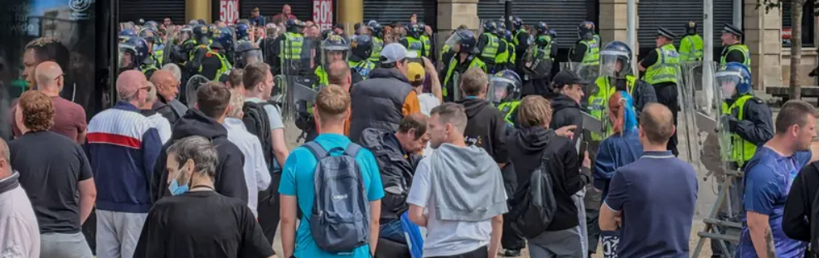
How do you feel about what happened
with the UK disorder of 2024?
Notes:
Video length – 4minutes

Slide 28
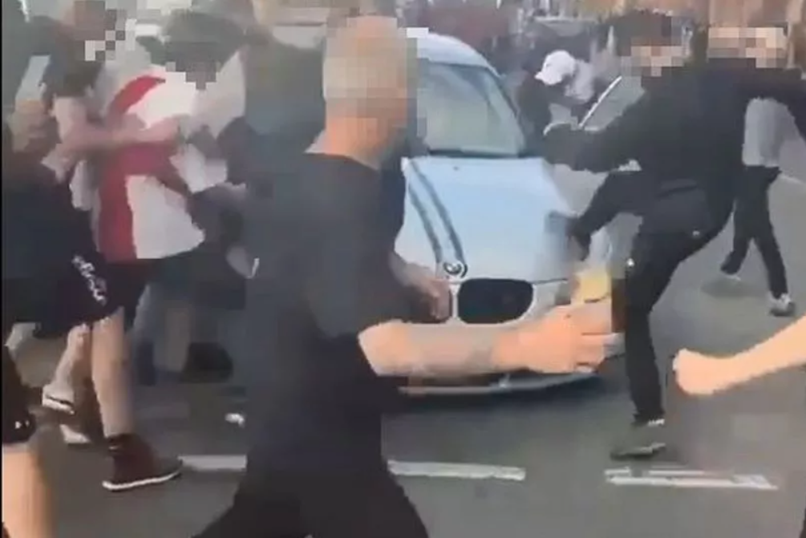
Here is how the disorder affected some young people in the Humber area:
“The events that have occurred made me feel sad and disappointed but more than anything, I feel very unsafe in the city I have called home for 10 years.”

Slide 29
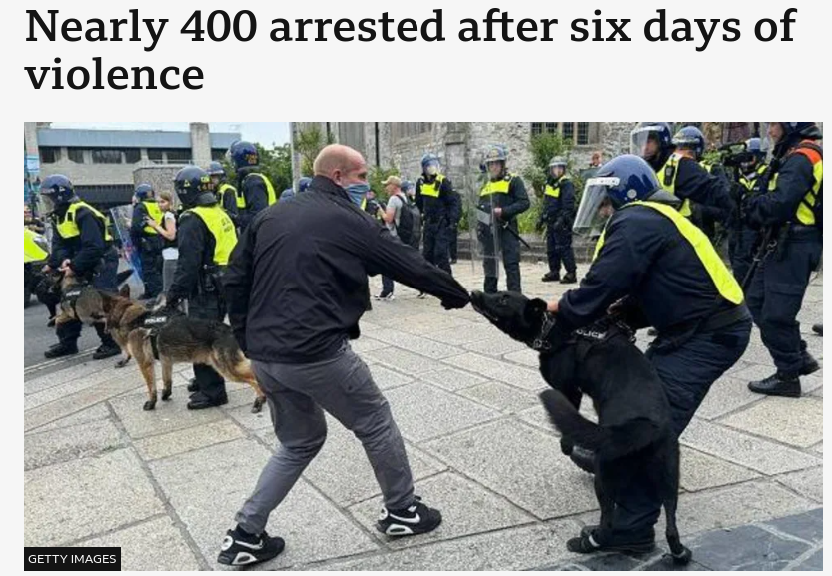
Here is how the disorder affected some young people in the Humber area:
“This has made me feel uncomfortable and scared of my skin colour because it isn't safe anymore and it is really sad to know that all this is still happening even after everything that has happened in history.”

Slide 30
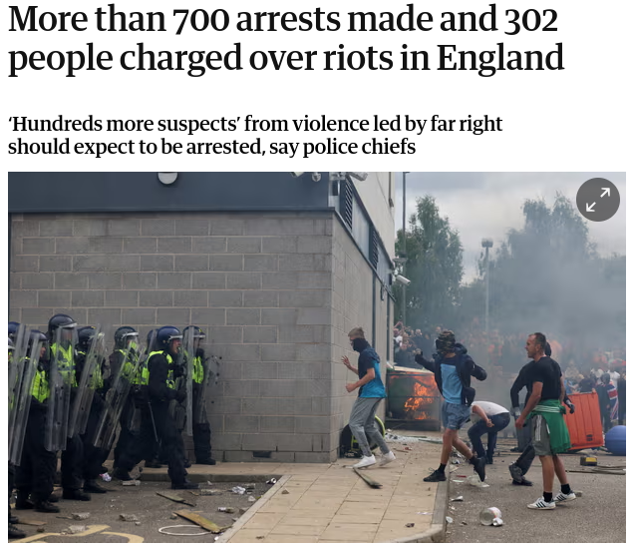
Here is how the disorder affected some young people in the Humber area:
“I’m scared to go outside again.
It was such an unpredictable event that I don’t even know when it will be safe again, when I or my family will be safe again.”

Slide 31

How to stop the spread of hateful messages
This short film will explain how to REVIEW information before you share it.
If you're having trouble accessing the video, here's a direct link:
REVIEW
Source:
Shout Out UK

Slide 32


Slide 33
R
REPUTATION
E
EVIDENCE
Can you remember
what each letter
stands for?
V
VERIFICATION
I
INTENT
E
EMOTIONS
W
WEIGHT IT UP

Slide 34

This short film has some tips on how to help yourself and others in a risky situation, such as when a hate crime is being planned or committed.
Click for video
If you're having trouble accessing the video, here's a direct link →
Staying Safe
Notes:
Video length – 2minutes and 42 seconds

Slide 35


Slide 36


Reporting Hate
Crimes committed against someone because of their race, religion or belief, sexual orientation, gender identity or disability are all hate crimes and should be reported to the police.
Did you know:
That if you see hateful content on a social media app, you can report it via the app itself?
Finally,
If you believe someone is going to act in a way to cause immediate harm to others, such as carry out an attack call 999.
Notes:
both

Slide 37

Can you name
5 things we have
learned today?

Slide 38
For more information on this and other topics
www.notinourcommunity.org

